Slide 1
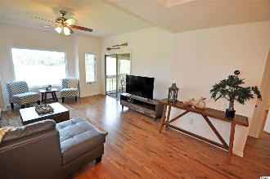
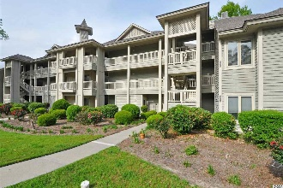
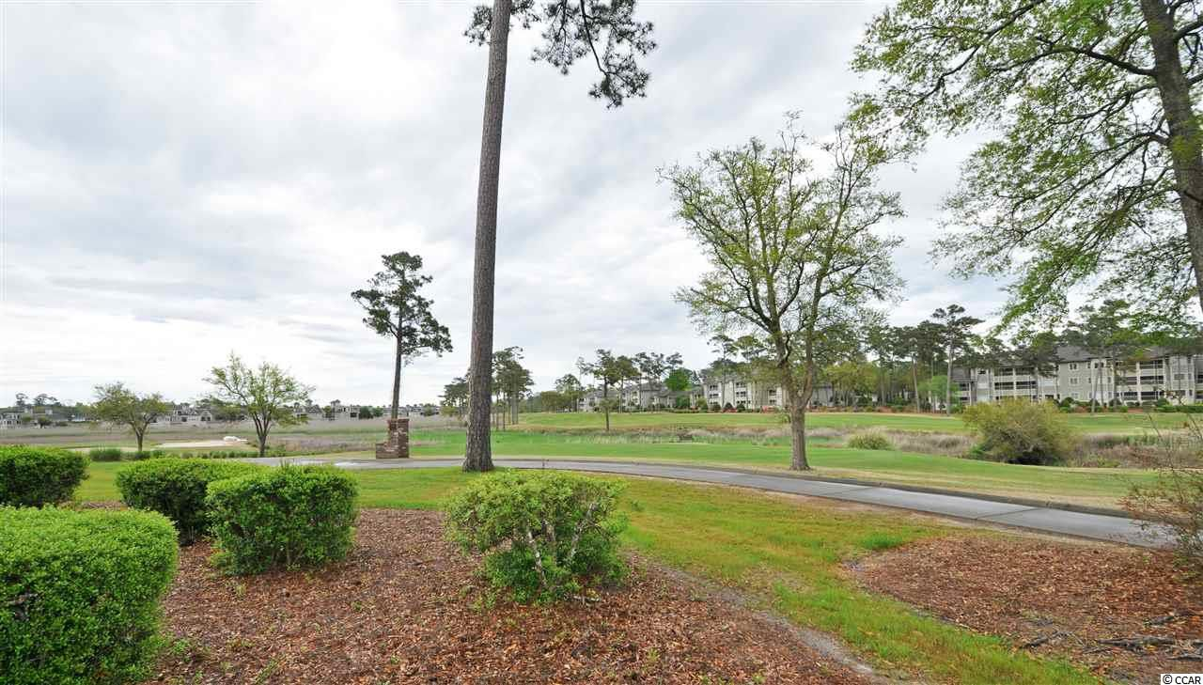
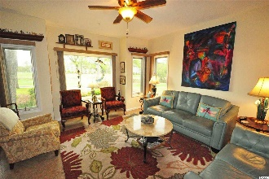
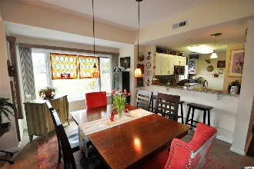
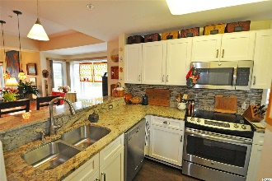
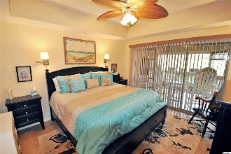
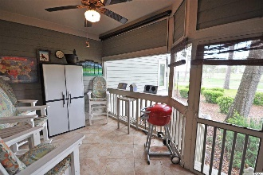
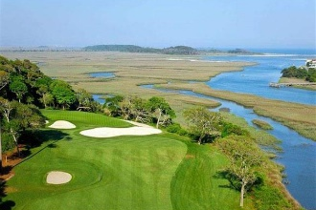
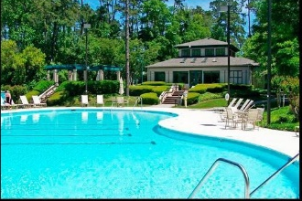
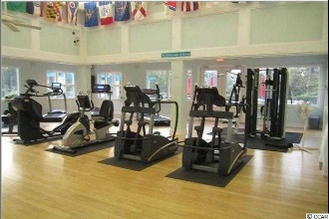
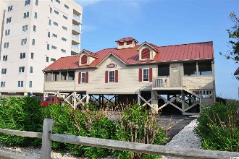


Classic, Highly Desirable, Upscale Model
1401 Lighthouse Drive #4311
Lighthouse Point Villas ~ North Myrtle Beach
Tidewater Plantation ~ MLS# 1908400 ~ $228,900
When something is judged over time to be of the highest quality and the most outstanding of its kind, it is called a CLASSIC! Welcome, therefore, to this highly desirable, upscale Lighthouse Point Villas preferred-model 3-bedroom/3-bath spacious classic beach-golf condominium. It is the epitome of Southern Living, and the close-up views of the ICW, marsh and the signature 9th and 18th holes with full tee-to-green vistas of the world-famous Tidewater Golf Course are right out of Golf Digest. Moreover, it is located in the prestigious Tidewater Plantation Resort in popular North Myrtle Beach. Such rare, impeccably decorated and upgraded properties are highly valued as homes, second homes, and investment properties. This is the unit everybody wants -- remarkable features outlined in the associated documents, parking adjacent to the building, handicap access & wide halls, tranquil open location, and a FIRST-FLOOR END UNIT with those incomparable GOLF COURSE VIEWS from several big windows, offering much natural light also! This building is set apart in a natural enclave -- in a secluded and peaceful setting, featuring additional opportunity to view the areas' abundant wildlife and lovely surprises SUCH AS BOATS GOING ALONG THE INTRACOASTAL WATERWAY and birds feeding off the back porch. Plus, it has the most requested Tidewater Plantation 3-bedroom-condo floor plan -- split bedrooms with master off of the great-room area and with an over-sized, inviting screened porch from the stately, comfortable living room and large but cozy master bedroom with grand king bed and that incredible view, yet perfect privacy. The master enjoys a walk-in closet, en suite with double-sink vanity topped by wonderful Corian-inspired countertops, new cabinetry as in all three baths, a fabulous six-foot walk-in shower matching the countertops in the finish, and free-standing linen-closet bureau. The second bedroom has an en suite, lots of light & a big closet; the third bedroom, currently used as a study, has a spacious en suite full-bath which also opens to the living space for ease of use for guests. There is lots of storage, too, including a convenient pantry in the kitchen and hall owners closets for laundry, entry items, linens, and household supplies. This impressive unit is sold mostly furnished and is in classic condition, used only as an incomparable, well-loved home. The kitchen has nice, new stainless steel appliances, granite countertops, and all new cabinets that are soft-close. All major appliances including HVAC & hot water heater are new. Even so, a top-of-the-line Old Republic Home Warranty is included. There are both a breakfast bar and gathering-sized dining/great room, perfect for a family or foursome, and wonderful for entertaining. The furniture is a memorable leather and lives luxuriously. At this established-value price, do not let this singular Tidewater beauty slip away! Amenity-rich Tidewater is on a tree-lined road to oceanfront Anne Tilghman Boyce Coastal Reserve, a nature conservancy, including Waties Island, with access for managed recreational use. Tidewater itself is on an elevated peninsula of live oaks and southern pines between the ICW and the Cherry Grove Inlet to the Atlantic Ocean. The plantation also preserves the singular look of its own historic origins. It is minutes from the beach, shopping, medical services, entertainment and access to major highways. Amenities include that oceanfront beach cabana for owners' use with open/screened porches, bathrooms, showers, and kitchen. Residents enjoy the use of several pools/hot tubs. Other amenities include a driving range, golf shop, clubhouse with bar/dining and event facilities, clay and hard surface tennis courts, pickle ball court, fitness center overlooking a pool, bocce courts and amenity center for public/private events. Tidewater has a gated storage yard for boats, jet skis, motorcycles, and kayaks. Tidewater Resort reflects the CLASSIC lifestyle at the beach!
Deborah Collins
843-424-9013
dctidewater@yahoo.com
Connie Ross-Karl
702-306-2643
conniesross@aol.com
NEW WAY PROPERTIES MYRTLE BEACH

