Slide 1
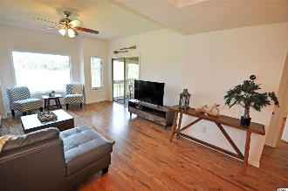
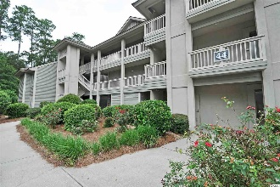
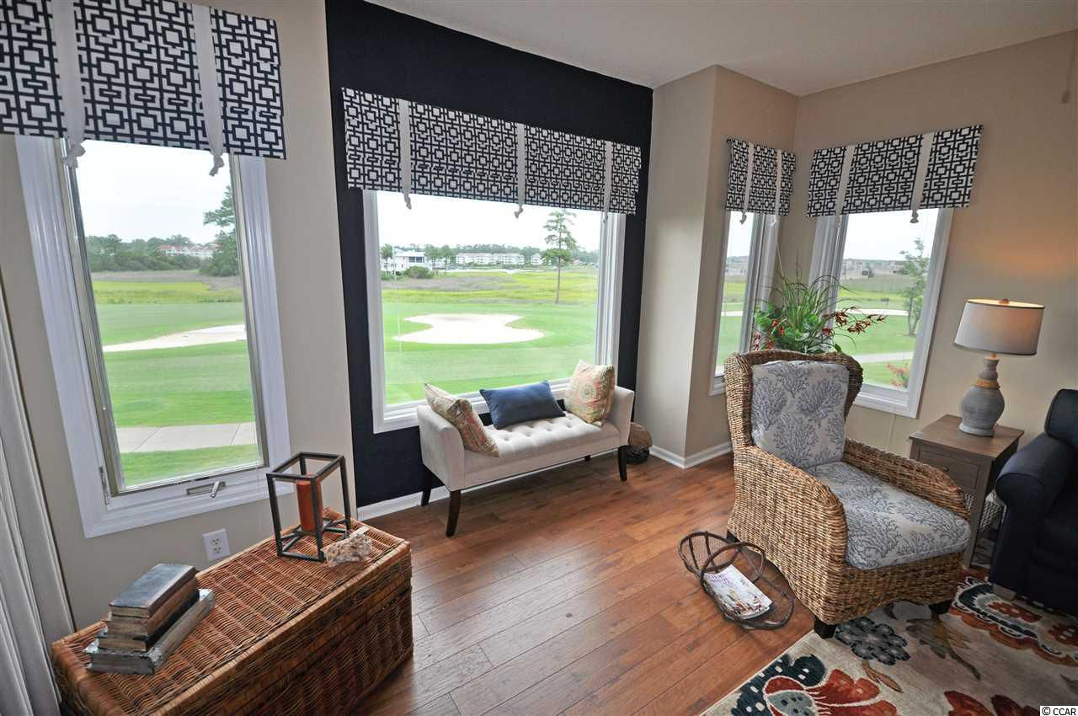
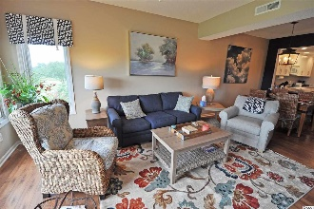
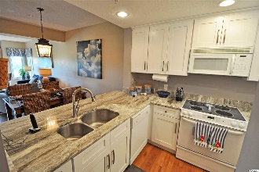
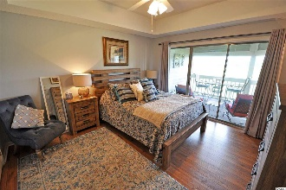
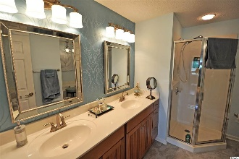
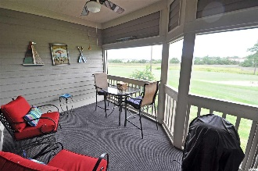
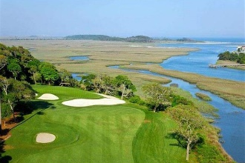
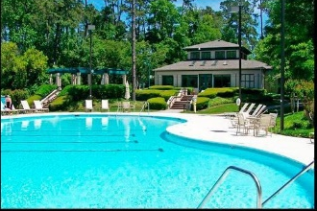
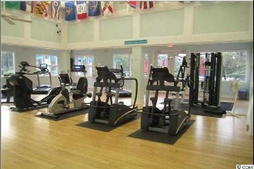
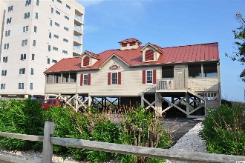


Turnkey Condo With World-class Golf, Intracoastal Waterway, and Marsh Views
1401 Lighthouse Drive #4422
Lighthouse Point Villas ~ North Myrtle Beach
Tidewater Plantation ~ MLS# 1815864 ~ $172,900
This is the unit everybody wants -- Direct ICW, marsh and golf-course views! Maybe THE BEST VIEWS OF ANY CONDO IN TIDEWATER. Words and photos notwithstanding, you really have to see this lovely 2 bedroom/2 bath easy-living primary-home. Take the virtual tour as well, but see this one in person today...New! New! NEW: granite in kitchen and guest bath, kitchen and other cabinetry, high-tech manufactured flooring throughout, light and plumbing fixtures, paint, window treatments, decor and MORE! HVAC even replaced in 2017. Furnishings are in a stylish, popular gray, white, navy, brick, beige and teal motif, airy, stunning and upscale. The unit itself is light and inviting. Decorative accessories are likewise extraordinary. The large picture window in the living room, as well as the side windows and the screened-in porch off the living/dining area and master bedroom, all have THE VIEW! Other amenities include convenient parking adjacent to building, handicap access and wide halls, SECOND FLOOR NEAR ELEVATOR and lots of open space surrounding the building. The 44 Building of Lighthouse Point Villas is set apart, secluded and peaceful! It also has the most requested Tidewater Plantation spacious 2-bedroom condo floor plan -- split bedrooms with master off the great-room area and featuring a large screened porch from the living room and master bedroom with that amazing ICW view and privacy. Even wake up to it! The master also enjoys a walk-in closet, en suite with double-sink vanity, separate walk-in shower and jetted garden tub. The split guest bedroom has a large jack and jill bath that also opens to living space for ease of use for guests. The laundry is off the hallway as well. The dining room is big and seats six comfortably. There are numerous storage closets, and the primary closets have been reconfigured for better usage and more space. The condo has it all and is just what everyone wants. Plus, it is an incredible opportunity to purchase a singular Tidewater Plantation Resort beauty overlooking the world-class Tidewater Golf Course and the Intracoastal Waterway! It walks to clubhouse, two restaurants and golf and is perfect for an investment, home or vacation home. Amenity-rich Tidewater is on a tree-lined road to oceanfront Anne Tilghman Boyce Coastal Reserve, a nature conservancy, including Waties Island, with access for managed recreational use. Tidewater itself is on an elevated peninsula of live oaks and southern pines between the Intracoatal Waterway and the Cherry Grove Inlet to the Atlantic Ocean. The plantation also preserves the singular look of its own historic origins. It is minutes from the beach, shopping, medical services, entertainment and access to major highways. Amenities include an oceanfront beach cabana for owners' use with open/screened porches, bathrooms, showers and kitchen. Residents enjoy the use of several pools/hot tubs. Other amenities include a driving range, golf shop, clubhouse with bar/dining and event facilities overlooking the 18th hole, clay and hard surface tennis courts, pickle ball court, fitness center overlooking a pool, bocce courts and amenity center for public/private events. Tidewater has a gated storage yard for boats, jet skis, motorcycles and kayaks. Tidewater Plantation, with its full range of things to do and to enjoy, really reflects a "way of life" in safe, popular North Myrtle Beach.
Deborah Collins
843-424-9013
dctidewater@yahoo.com
Connie Ross-Karl
702-306-2643
conniesross@aol.com
NEW WAY PROPERTIES MYRTLE BEACH

