Slide 1
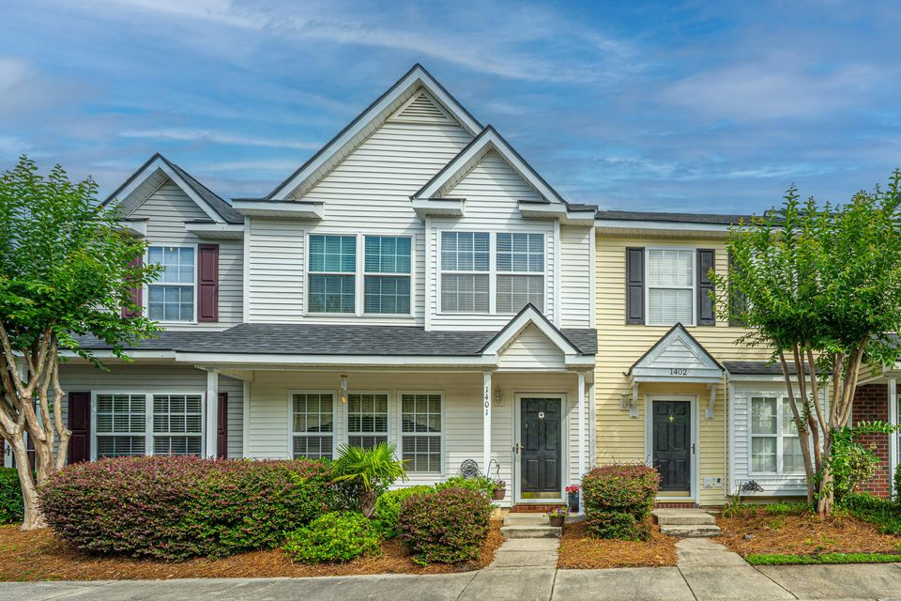
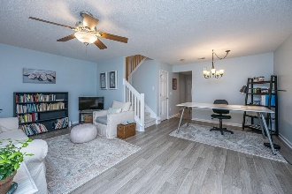
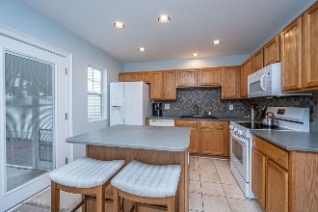
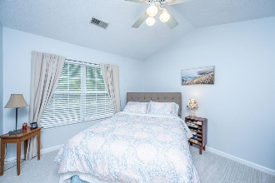
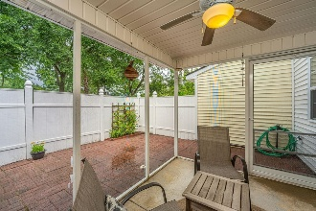
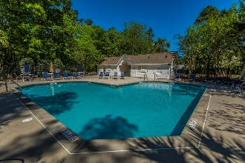

1401 Elm Hall Circle Summer Wood · Summerville, SC 29483 · MLS# 25015046 · $265,000
Beautiful Townhome in Summer Wood
2.5% Buyer Agent Co-op Being Offered
Turnkey | Roof & HVAC Replaced in 2024 | New Carpet Upstairs | Refrigerator, Washer & Dryer Convey
Welcome to 1401 Elm Hall Circle in the Summer Wood Subdivision. This residence features neutral décor, a new HVAC system (2024), an architectural roof (2024), and carpet replaced in 2024. For maintenance-free living, the HOA covers lawn care, exterior hazardous insurance, two neighborhood pools, termite bond, and pressure washing of the townhome exterior. Summer Wood is conveniently located near I-26, the Town of Summerville Historic District, shopping centers, restaurants, and hospitals. It also offers easy access to the Volvo and Mercedes plants, Boeing, the airport, Bosch, and the Air Force Base. Upon arrival at 1401 Elm Hall Circle, guests are greeted by a fully covered front porch. Inside, an open concept living space with both family and dining rooms receives an abundance of natural light and features LVP flooring. The kitchen includes ceramic tile floors, Corian countertops, a tiled backsplash, a kitchen island, and a spacious pantry. Downstairs, you will find a guest powder bathroom and a laundry room (washer/dryer included). The screened-in porch at the back provides a storage room and a private backyard enclosed by a vinyl fence.
The split staircase leads upstairs to three generously sized bedrooms. The primary suite boasts a vaulted ceiling, a primary bath, and a walk-in closet. The two secondary bedrooms share a full guest bathroom. Additional storage is available in a closet beneath the staircase. The townhome includes two assigned parking spots directly in front. Visit 1401 Elm Hall Circle and discover its charm and convenience.
Nickole Samios
(843) 330-4136
nickole@carolinaone.com
Carolina One Real Estate
900 N Main St
Summerville, SC 29483
www.summervillesouthcarolinahomes.com

