Slide 1
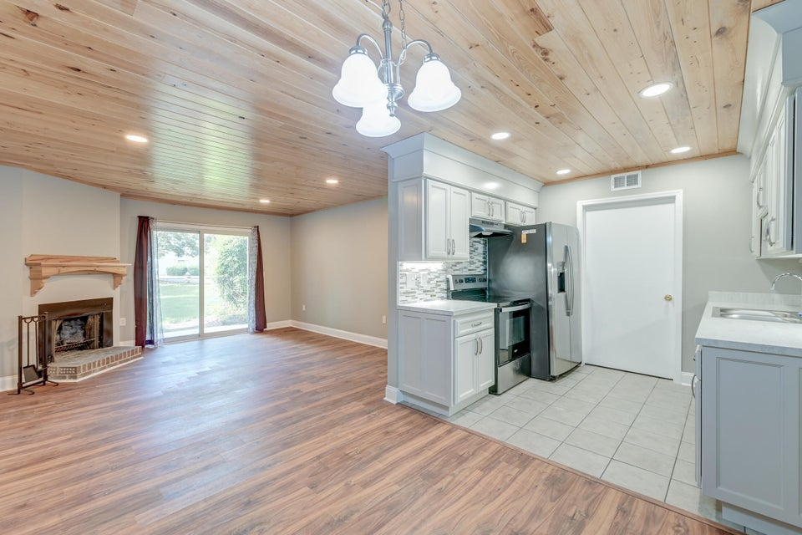




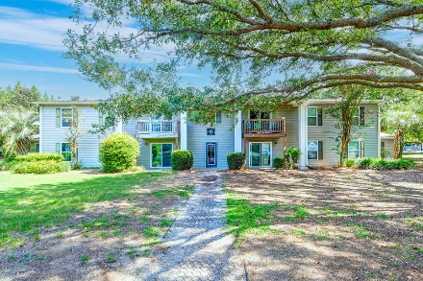



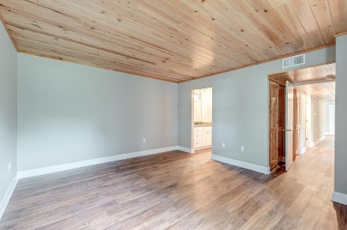

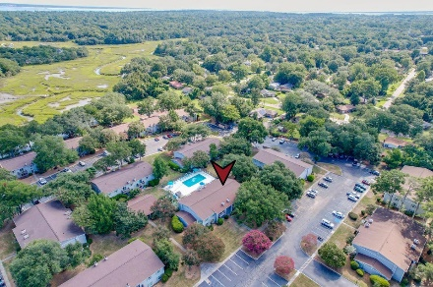
Parkshore Marshfront
Move-in Ready Condo in a Prime Location
1402 Camp Road 6B
Point James | Charleston, SC 29412 | MLS# 24021759 | $293,313
Have you been searching for a move-in ready condo in a prime location? Look no further! Nestled on Camp Road on James Island, this charming first-floor condo has everything you could possibly want and more. As you step inside, you'll be greeted by exquisite details like attractive flooring, a custom tongue and groove cypress ceiling, baseboards, fresh paint, and an inviting open floor plan. The family room, complete with a cozy fireplace, opens up to a serene patio through a sliding door. The dining area flows seamlessly into a functional kitchen, boasting crisp white cabinets, gorgeous countertops, stainless steel appliances including a new dishwasher and oven, new soft close kitchen drawers, and a stylish backsplash.
Down the hallway, the primary bedroom offers a peaceful retreat with an ensuite bath featuring a step-in shower. Two additional bedrooms with custom barn doors, a full bathroom, and a convenient laundry area complete this delightful home. You'll also have peace of mind knowing that the HVAC was replaced in 2019. Beyond the condo's walls, the community offers amenities like an exercise room and a refreshing swimming pool, and boat/kayak storage is available.
This location is tough to beat. Walkable dining options are located just over a half mile away at Paisano's Pizza Grill, Smoky Yolk, and Happy Tail Coffee. This property is also located just 2.3 miles from James Island County Park, 4.9 miles from downtown Charleston, and 6 miles from Folly Beach, this condo is perfectly situated to enjoy all that the area has to offer. Don't let this opportunity slip away!
Caroline Treece | ctreece@mattoneillteam.com | 843-754-0050
Megan Merchant | mmerchant@mattoneillteam.com | 843-575-8816

