Slide 1


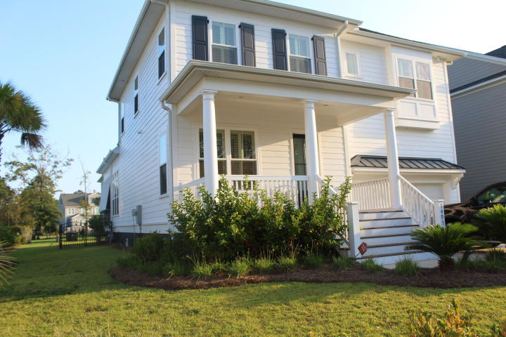
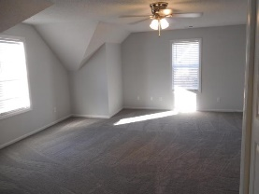
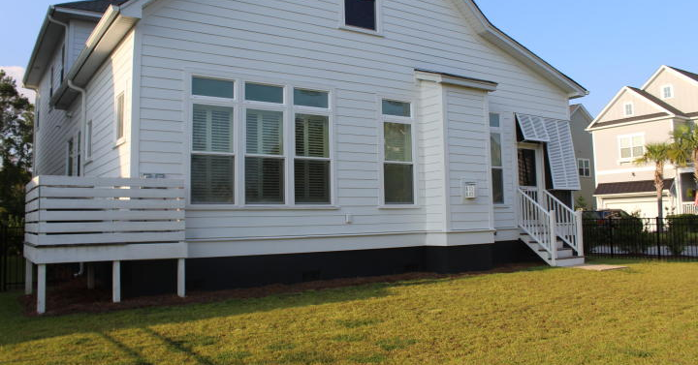
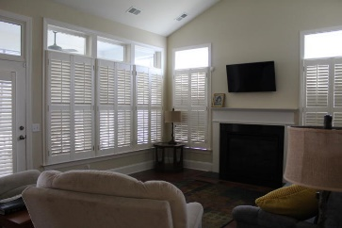
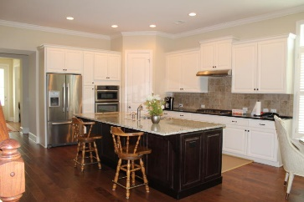
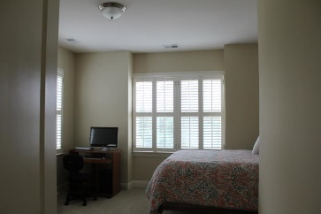
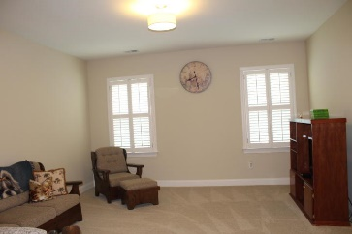
Kim Katich
(843) 754-8060
kimsellschs@gmail.com
Immaculate
Move-in Ready
1403 Masthead Drive
Dunes West
Mount Pleasant, SC 29466
MLS# 19025739
$575,000
Gorgeous open floor plan home, located in desired subsection of The Harbour in Dunes West. As you enter the home you will see beautiful hardwood floors, just off of the foyer is a separate dinning are that could be an office/flex space. The Gourmet Kitchen has a huge granite island, SS appliances, gas cooktop and plenty of kitchen cabinets. There is an eat in dining area that is open to the family room with a gas log fireplace and vaulted ceilings. Master bedroom is located off of the family room on the 1st floor with spacious master bath with dual vanity, garden tub/ shower, multiple walk in closets. The second Floor has a huge flex/loft area and 3 other spacious bedrooms with 2 more full baths. The home has many upgrades such as plantation shutters throughout the home, Bahama shutters on the screened porch for privacy, crown molding throughout most of the first floor, 10'ceilings on the main floor and 9' on the second floor. This home has been taken care of, the owners lived on the main floor so the second floor has never really been lived in. Off of the garage is a mud room and laundry area, there is also an additional full bathroom off of the kitchen. The fenced in back yard and screened in porch are great for entertaining.
Real Estate Advocates LC
7613 Hwy 544 | Myrtle Beach, SC 29588
www.realestateadvocates.com

