Slide 1
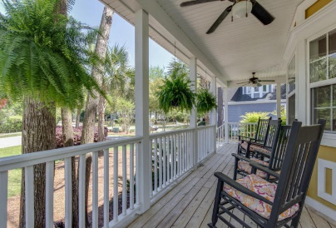
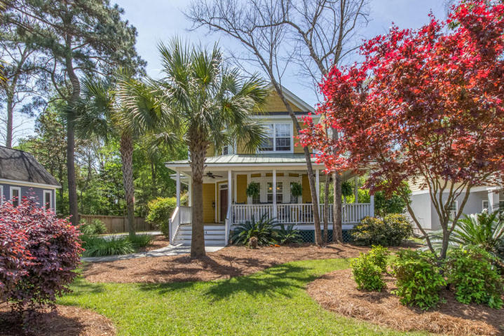
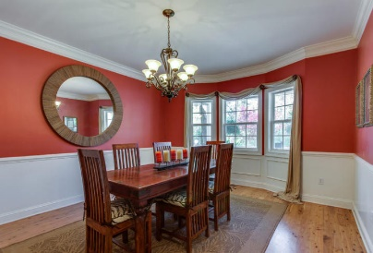
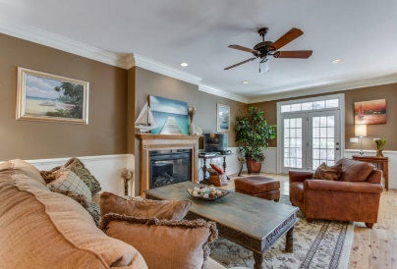
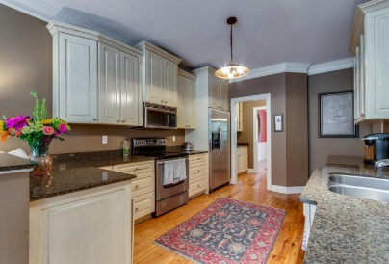
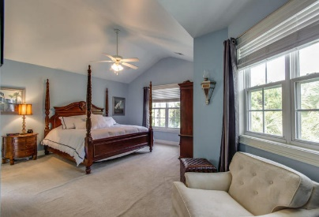
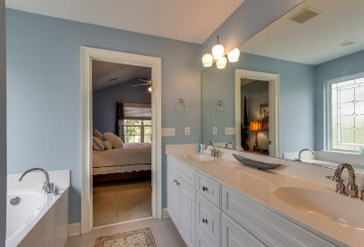
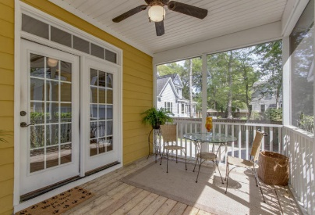
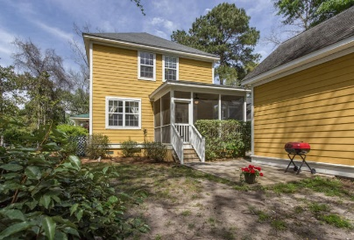

1404 Appling Drive
Mt Pleasant ~ MLS# 16010156 ~ $668,000
Shell Point
Open House
Sunday
May 1st, 3-5p
Beautiful, custom built two story home on a large lot in the heart of Mt Pleasant. Less than five miles to the beach! First floor has open floor plan with beautiful Australian Cypress wood floors. Butler's Pantry with wet bar and sink joins the separate formal dining room to an open eat-in kitchen with custom cabinets and granite counter tops. 3 bedrooms and 2 1/2 baths. Upstairs Master includes an airy and bright bath with garden tub, separate shower, water closet, and walk-in closet. Two other spacious bedrooms offer walk in closets. Separate Linen Closet and lovely laundry room upstairs with built-in cabinets. Relax on the generous front porch or on the screened in back porch. The detached two car garage includes a FROG and full bath! A great place for a studio or office. The garage also has a utility sink, washer, dryer connections and separate water heater for the bathroom in the FROG.
Robin Windham
(843) 991-6672
robinwindham67@gmail.com
www.BrennamanGroup.com

