Slide 1
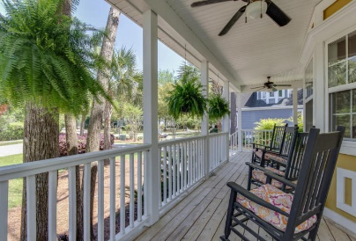
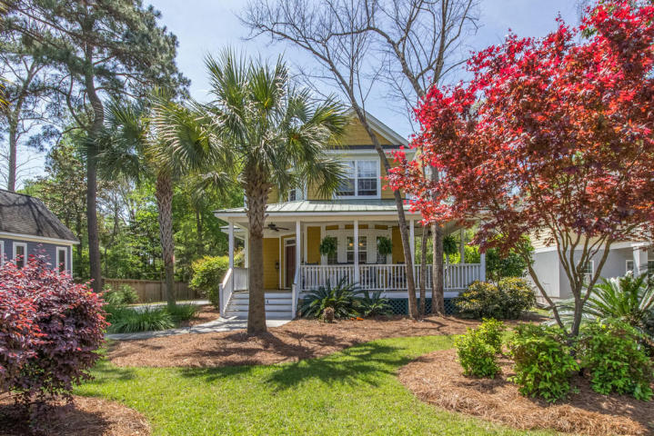
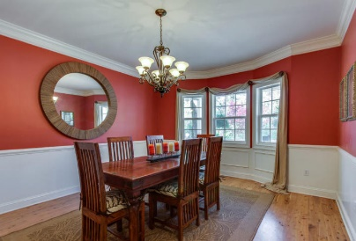
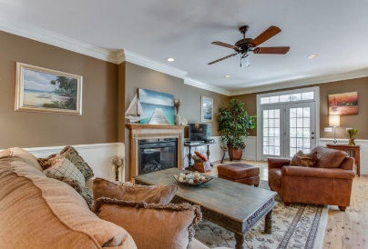
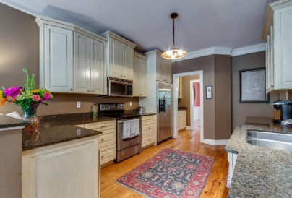
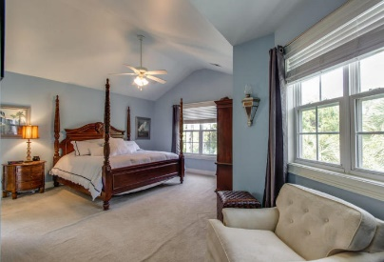
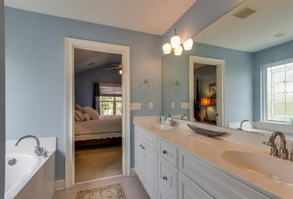
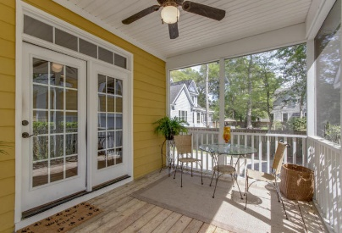
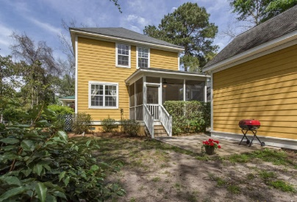

1404 Appling Drive
Mt Pleasant ~ MLS# 16010156 ~ $640,900
Just Reduced!
Hurry before this desired location is no longer available. Classic, custom home in Mt Pleasant is waiting for you to make it your own. Beautiful, mature landscape and trees grace this large lot. No need to drive far to anything. Close enough to ride your bike to Coleman Blvd, the Old Village, and Sullivan’s Island. Shops, grocery stores and 526 are all minutes away.
A 300 sq ft room over the detached garage with a full bath can be your work studio, office or play area. Australian Cypress wood floors on the first level are gorgeous. Butler’s pantry, large laundry room, open kitchen, garden tub and more. Come see this gem today! The garage also has a utility sink, washer, dryer connections and separate water heater for the bathroom in the FROG.
Robin Windham
(843) 991-6672
robinwindham67@gmail.com
www.BrennamanGroup.com

