Slide 1

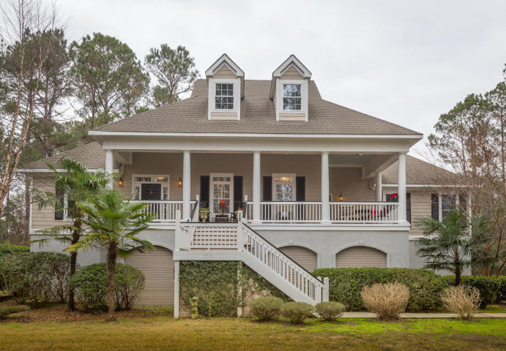
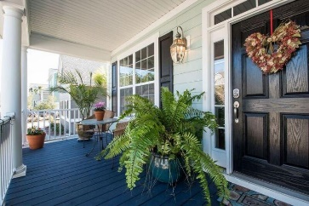
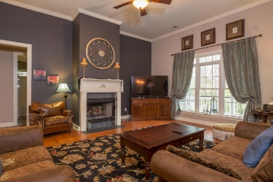
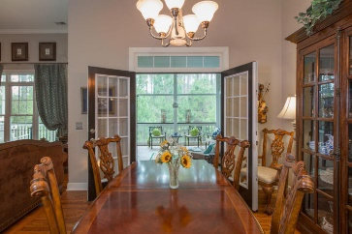
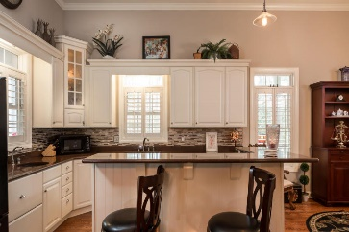
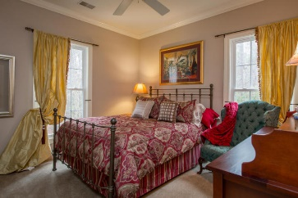
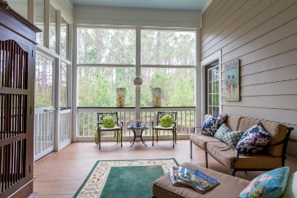

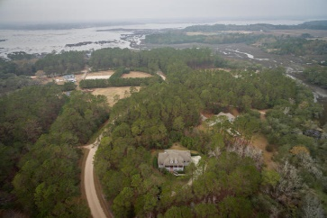
1404 Polly Point Road Polly Point Plantation Wadmalaw Island, SC 29487 MLS# 17003912 $599,000
Beautiful home in paradise
Whether it is your retirement home, your weekend retreat, or your full time home, heaven awaits you beyond the private gates of Polly Point Plantation, home to a dozen homes, each on a minimum of three acres of land. Once inside the gate, you will travel down the main winding passage through the live oak lined woods of the Plantation. Along the winding dirt road you will find homes are purposely secluded from the road for peace and privacy. Upon arrival up the long driveway of your Island getaway, you will be greeted by a well landscaped home with a Gone with the Wind style southern porch. There you can enjoy, lazy afternoons (almost year round) quiet evenings, celebrations with family and friends, and even holiday meals. Inside you will find an open layout with 12 foot ceilings, hard woods throughout the main areas and crown molding throughout the home. Open the French doors from the dining room to gorgeous treetop living on the screen porch which serves as another sitting room complete with sounds of nature. Also outside, enjoy additional outdoor space on the back porch. From the screen porch, step inside your spacious master suite with a huge bathroom and a walk in closet the size of a fourth bedroom, complete with windows. On the other side of the home are two guest bedrooms with a guest bathroom between also providing natural daylight. Downstairs has an over-sized 2 car garage with plenty of storage. On the other side of the garage, there is a storage area more spacious than the 2 car garage with future man cave specs written all over it. From that space, there is a walk out to a backyard patio area. The attic also has additional space for an additional room(s). Down the road, a couple country blocks, enjoy the community dock on the Wadmalaw Sound where crabbing, fishing, launching a small boat or being a spectator of the dolphins at high tide are all part of the Island life in Polly Point Plantation. Golfers enjoy your 20 minute drive to the famous Kiawah Golf Resort. Fine diners, enjoy the many fine dining restaurants in downtown Charleston, a mere 30 minutes away. This home is that one heavenly temptation you owe yourself to consider.
Carolina One Real Estate
628 Long Point Rd.
Mt Pleasant, SC 29464-3032
Marsha McKinney, GRI
(843) 303-5444 | fsboladysc@gmail.com
Creative Real Estate Services Team
www.creativelistingservices.com

