Slide 1
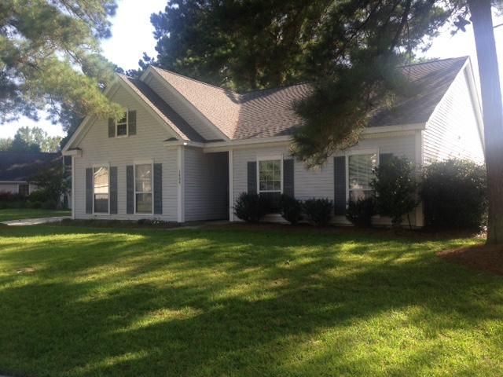
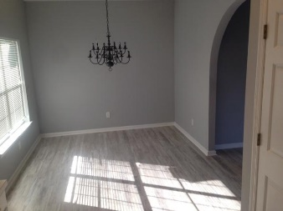
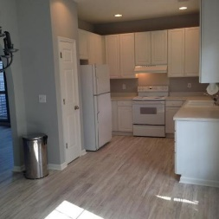
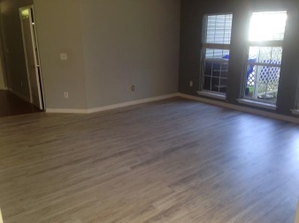
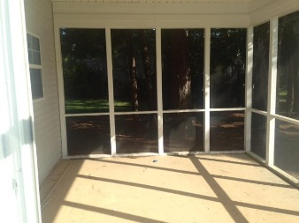
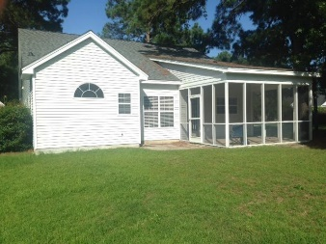


Dunes West Rental Ready for a New Family
1404 Water Oak Cut
Dunes West ~ Mount Pleasant ~ MLS# 17017950 ~ $2,175
Brand new "weathered-wood" look plank flooring throughout the house. Interior has just been fully painted a calming gray. The house has a particular "cozy cottage" look and feel. Large walk-in closet in master bedroom. Screen porch is shaded and breezy under the large pines. The Palmetto Hall neighborhood subsection is outside the entrance gates at Dunes West. Tenant has option to join Dunes West Swim & Racquet Club, if desired. 4 ceiling fans. Enjoy a full-size 2-car side-load garage. Washer, dryer and refrigerator included. Lawn care is included in the monthly rental rate, tenants may opt to do their own yard work for a $70 monthly rent deduction. The Listing Agent is the owner of this property.
John Crowley
843-819-4951
john.crowley@agentowned.com
AgentOwned Preferred Group | 1400-G Palm Blvd | Isle Of Palms, SC 29451

