Slide 1
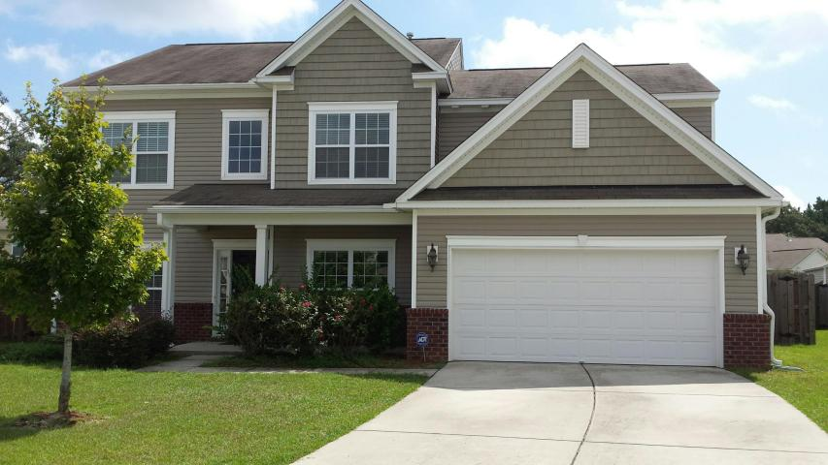
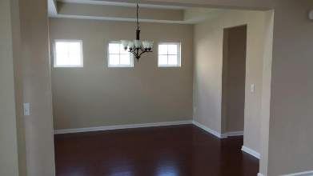
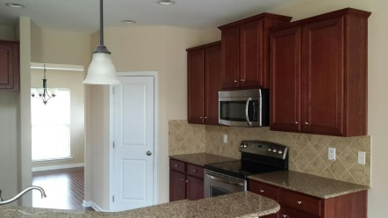
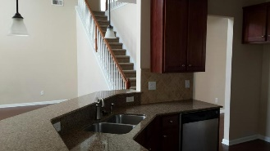
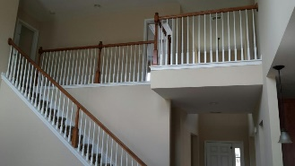
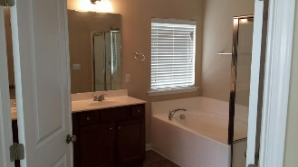
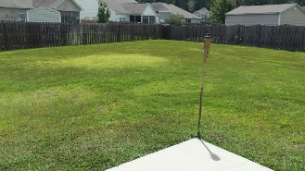
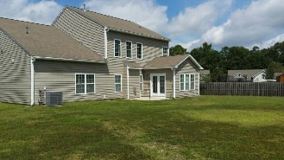


1405 Edmund Court Summerville, SC 29483 MLS# 15024063 ~ $266,900
Dual Masters ~ 5 Bedrooms ~ Myers Mill
4 BEDROOMS | 3½ BATHS | 3,600 SQ FT
Beautiful home located on a cul-de-sac drive offers comfortable living quarters for the entire family. Master bedroom on the first floor guest Master Bedroom on the second floor with three additional bedrooms. Formal dining room and living room/office. Large open 2 story great room with gas fireplace. Kitchen has upgraded cabinets, tiled back splash and SileStone counter tops. Breakfast area opens to a large sun room with exit to the patio and large fenced in yard. Home is in great shape with remarkable potential for your life style of living. Great family neighborhood with many fun amenities!
Randy Spear
843-568-2800 M
rspear@carolinaone.com
Carolina One Real Estate
1530 Trolley Road
Summerville, SC 29485

