Slide 1
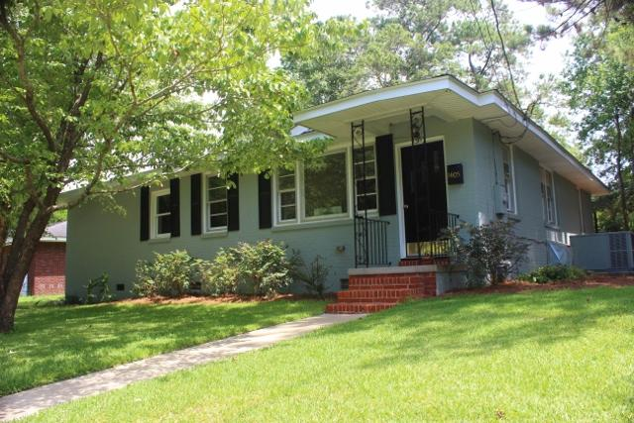
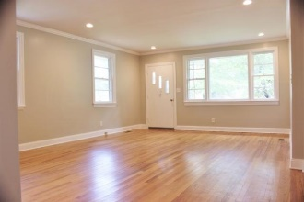
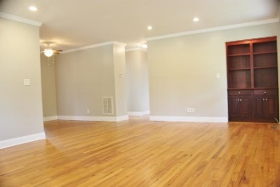
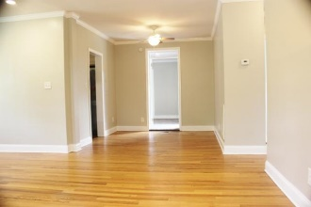
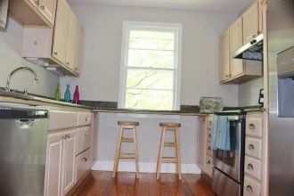
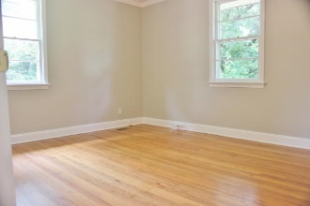
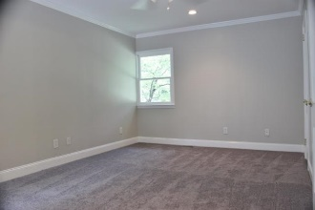
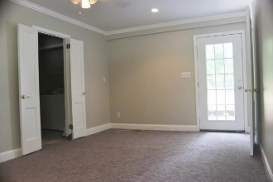
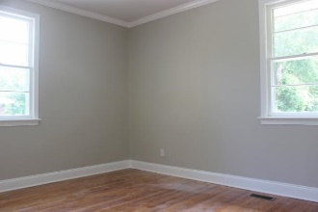
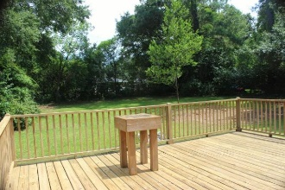
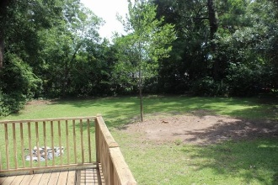


Park Circle Open House Thursday August 3rd 12-1:30
1405 Iroquois Street North Charleston
MLS# 17018499
$282,400
1405 Iroquois is the perfect home for living in the popular Park Circle with a large fenced back yard. The house was fully renovated about ten years ago and recently updated for immediate move-in. In June 2017, interior painted soft grey, exterior pressure washed and painted, deck pressure washed, new appliance package of stove-dishwasher-refrigerator installed, new carpet in Master bedroom installed, new glaze in hall bathroom applied to tile and bath, windows washed. New roof 2017. Huge deck. Backyard can accommodate additions to house, boats, garage, whatever zoning allows on this large 0.34 acre lot. Abundant natural light shines into roomy living/dining room combo. Granite counter-tops compliment wood cabinets. Nearby I-26 and I-526 nearby makes Park Circle central for Chas. Area
Kay Kennerty MBA, ABR, CRS, GRI
843-345-5011
KKennerty@aol.com www.KayKennertyHomes.com
The AgentOwned Realty Company
824 Johnnie Dodds Blvd, Mt. Pleasant, SC 29464

