Slide 1
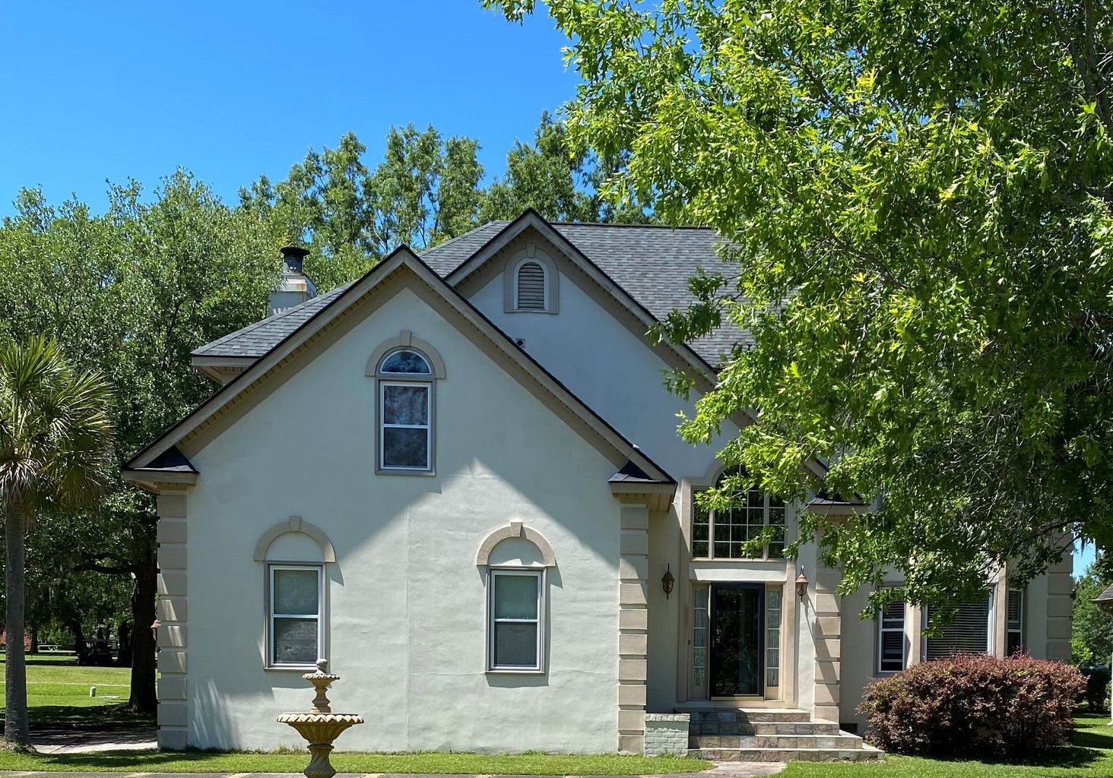
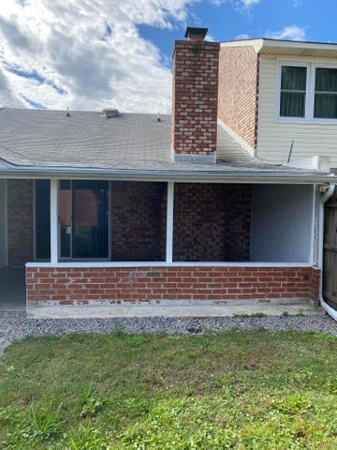
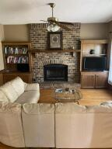
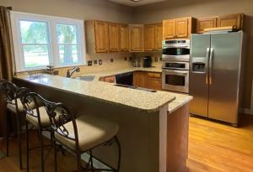
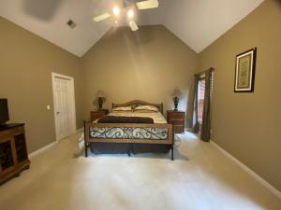
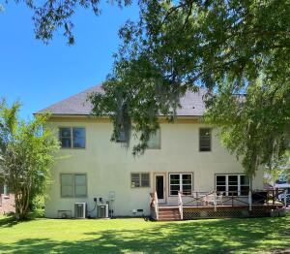
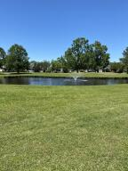


1405 Eagle Landing Boulevard Eagle Landing | Hanahan, SC 29410 | MLS# 21018441 | $424,900
Open House Saturday
12:00 until 4:00
Beautiful Home With Lovely Views
Open House Saturday 8/24/19
12:00 until 4:00
Beautiful home located in the highly desired Eagle Landing subdivision. This home has a very comfortable feel, 4 bedrooms and 2.5 baths. All of the rooms are spacious. The home backs up to a former Golf course which is now a lush park green space, with wonderful views. A perfect venue for morning and evening walks. Eagle Landing is convenient to shopping and restaurants. Just 20 minutes to downtown Charleston and 8.5 miles to the Charleston International Airport. Come see this home today. This is the right home in the right place for a perfect new beginning.
James Hopkins
(843) 708-5930
James.Hopkins@AgentOwnedRealty.com
AgentOwned Premiere Group
1800 Trolley Rd
Summerville, SC 29485

