Slide 1
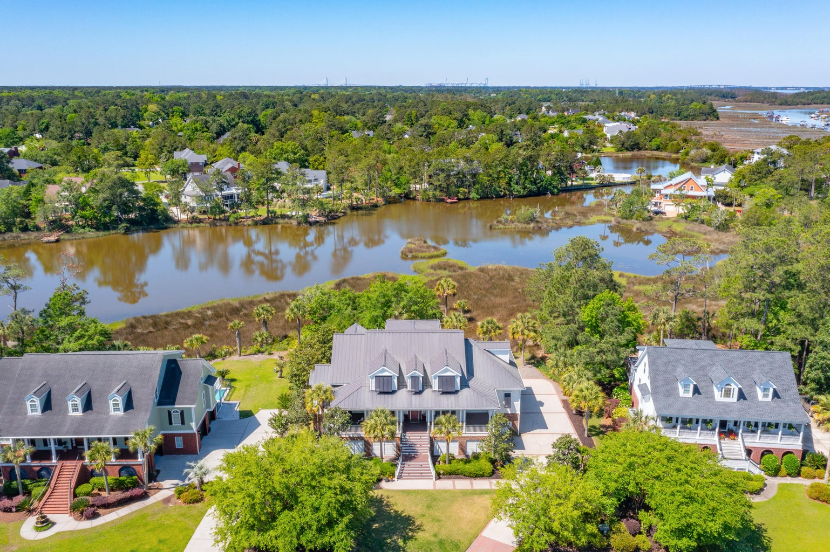
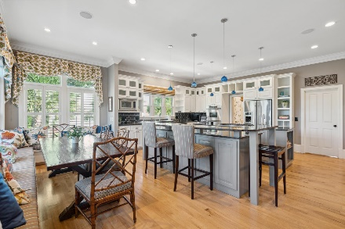
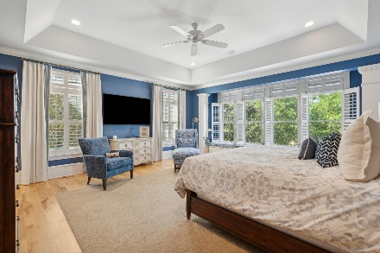
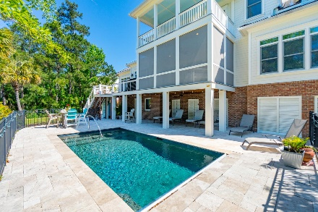


Major Price Reduction
1405 Pointe Bluff Court | Brickyard Plantation
Mt Pleasant, SC 29466 | MLS# 24014440 | New Price $2,100,000
Welcome to luxury living in this gorgeous custom-built home, nestled within the prestigious Brickyard Plantation community of Mount Pleasant, SC. Tastefully designed with abundant outdoor living, this elevated 2-story residence, featuring 5 bedrooms, 3 full bathrooms, and 2 half-baths, spans nearly 4,900 square feet with impeccable marsh and sunset views. This coastal masterpiece is breathtaking, boasting grand front and back porches, Bahama shutters, a standing seam metal roof, and a luxurious pool that creates a captivating view of the surrounding marsh.
Brickyard Plantation offers a host of exclusive amenities, including a boat ramp and dock, boat storage, 5 lighted tennis courts, an Olympic-sized pool, a play park, a soccer field, and paved jogging trails.
Situated on a quiet cul-de-sac, this home provides easy access with minimal traffic. The stunning beaches of Isle of Palms and Sullivan's Island, along with the vibrant Downtown Charleston, are just a short drive away, offering endless opportunities for luxury entertainment, shopping, and dining. Seize this rare opportunity to own a true Lowcountry masterpiece!
Greg Boger
843-277-5845
gboger@avenuerealtyco.com
Avenue Realty Company
www.avenuerealtyco.com

