Slide 1
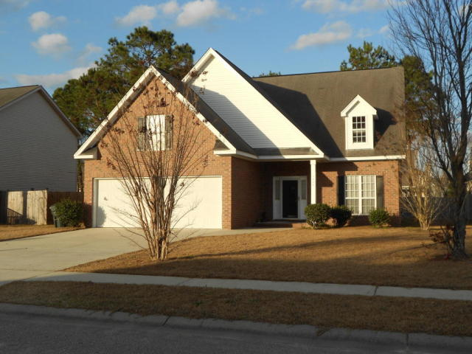
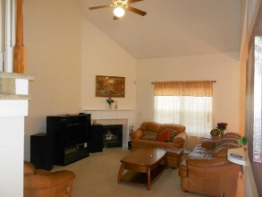
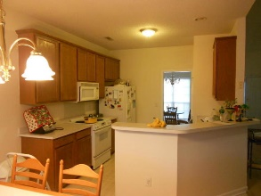
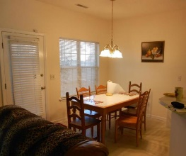
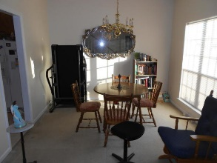
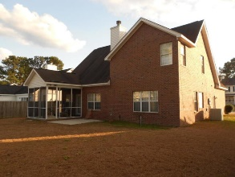


End Unit Townhome on Golf Course w/ Screened Porch
Starbucks card to first 10 agents
1406 Blue Pine Drive
Tall Pines ~ Ladson, SC 29456 ~ MLS# 20001512 ~ $269,000
New Roof & New HVAC in 2019 on this Brick house in Tall Pines with No HOA! Bright, Open, Spacious floor plan with a soaring two story living room with fireplace that opens to the kitchen and breakfast eat in kitchen area. Large master bedroom and full ensuite bathroom on the main level and 2 bedrooms with a FROG (Finished Room Over Garage) that can absolutely be used as a 4th Bedroom, Home Office with door, Playroom, or 2nd Living Room! Complete with 2 Car Garage, Screened Porch, Wooded Privacy Fence, and No HOA! What more do you need to know, come and check out this brick home, its ready for your finishing cosmetic touches and is a great house! Recent upgrades include the roof, hvac, as well as a new stove, microwave and vinyl flooring, all totaling over $20,000. Excellent location convenient to I-26 and great restaurants and shopping.
Jerod Coulter, ABR, REALTOR
(843) 513-3741
jerod@realtor.com | www.HomesOfMountPleasant.com
The Boulevard Company, LLC | 35 Broad Street | Charleston, SC 29401

