Slide 1
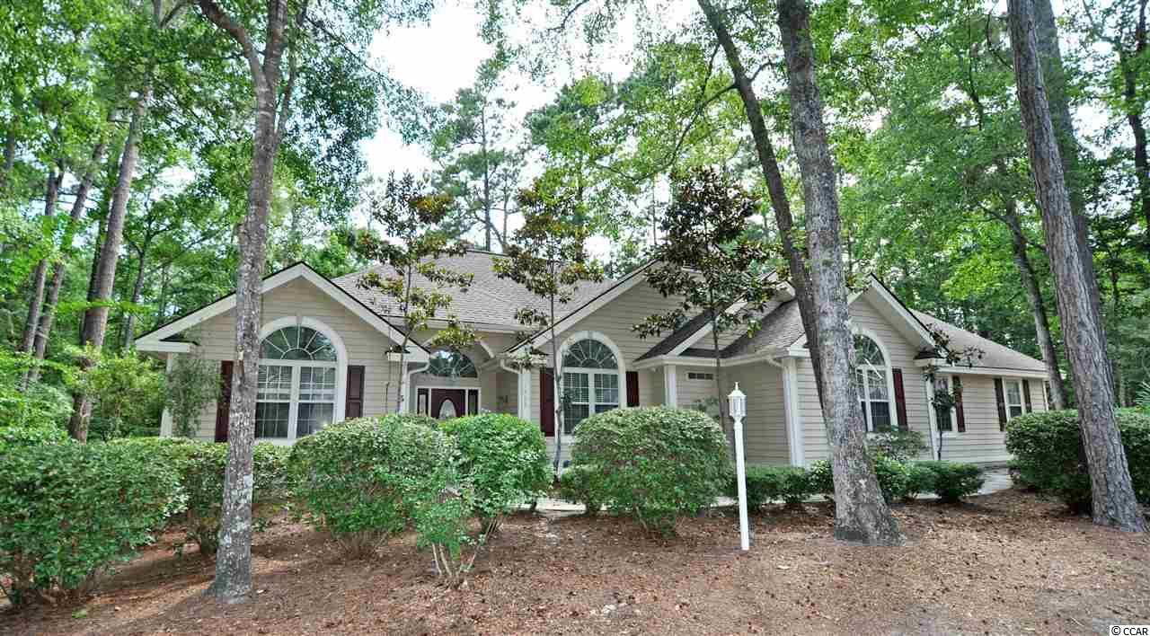
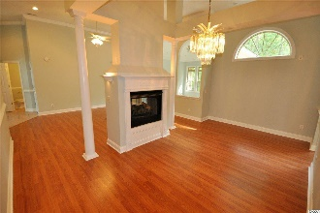
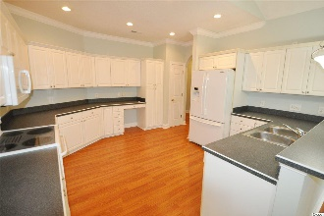
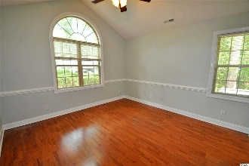
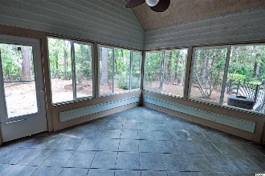
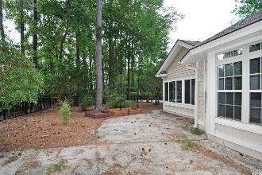
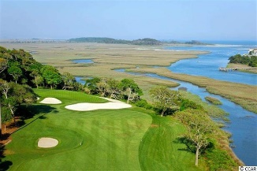
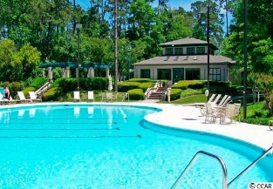
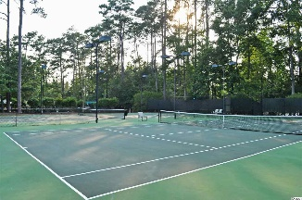
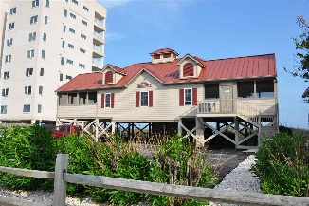


1406 Brigantine Rd
Tidewater Plantation
North Myrtle Beach, SC 29582
MLS# 1914185 ~ $389,900
Home just cleaned and refreshed to welcome the Buyers' personal taste. Fresh paint, gleaming new hardwood floors and so much more! You pick your finishing preferences, as the home is being sold AS IS and priced accordingly. It is on a wonderful, private, large cul-de-sac lot with a handsome black wrought-iron fence. Perfect for pets. Plus there is room for a hot tub and pool; and there is plenty of space to still garden, too, including two big planter boxes. The yard landscaping is mature and pretty. It backs up to a wooded area. The inside is remarkably unique, with touches that would tantalize a designer -- double-sided fireplace in living and dining areas, a Carolina room with views of the nature enclave and direct exit to the rear yard, lots of square footage with flex space, big kitchen with pantry and with breakfast nook and entry to the super-3-season porch with access to the backyard as well. Big enough for a family or for entertaining the whole family, enjoy 4 - 5 bedrooms, one currently used as an office and one a bonus room with full bath. Two bedrooms in a split-bedroom floor plan share a jack & jill bath. There are 3 and a half baths in the house. The half bath is just off of the main living area, a great location for a powder room for the guests who are bound to visit. After all, you will be living in one of the premier resort communities in the Carolinas...And at the Beach! The master bedroom suite, however, will be your own retreat getaway, as it is private and spacious and has a tub and stand up shower in an over-sized master en suite. It has a tranquil view of the natural beauty of the backyard. And closet space is plentiful in the master and throughout. No storage dilemmas here, even a double-car side-load garage and floored attic for more storage. The house offers what everybody wants: It is wonderful living space on one level, with that bonus room upstairs for another master, a 5th bedroom, den, hobby room or a man-cave. It lives seamlessly from the indoor to the beautiful outdoor surroundings, the best of all worlds; and it is in Tidewater...Its location in Tidewater is one of the most preferred. The street ends in a peaceful cul-de-sac with virtually no vehicle traffic. What it does have is space for play, bike-riding, walking and more. Whether you have children and grand children or you are young at heart, this open area is appealing. There is so much to recommend this interesting home. The owner is even offering a top-of-the-line Old Republic Platinum Warranty with HVAC coverage for a full 12 months. So bring your imagination to envision what singular plans you might have to make this fabulous property your own. Personality welcome. Amenity-rich Tidewater is on a tree-lined road to oceanfront Anne Tilghman Boyce Coastal Reserve, a nature conservancy, including Waties Island, with access for managed recreational use. Tidewater itself is on an elevated peninsula of live oaks and southern pines between the ICW and the Cherry Grove Inlet to the Atlantic Ocean. The plantation also preserves the singular look of its own historic origins. It is minutes from the beach, shopping, medical services, entertainment and access to major highways. Amenities include an oceanfront beach cabana for owners' use with open/screened porches, bathrooms, showers, and kitchen. The cabana is located on the wide, white-sand of Cherry Grove Beach, awarded 11th Best Beach in the Nation in 2019! Residents enjoy the use of several pools/hot tubs. Other amenities include a driving range, golf shop, clubhouse with bar/dining and event facilities, clay and hard surface tennis courts, pickle ball court, fitness center overlooking a pool, bocce courts and amenity center for public/private events. Tidewater has a gated storage yard for boats, jet skis, motorcycles, and kayaks. Tidewater Plantation Resort reflects a classic golf/beach lifestyle in safe, popular North Myrtle Beach, just named one of the TOP 10 Beach Towns in the U.S.
Deborah Collins
843-424-9013
dctidewater@yahoo.com
Connie Ross-Karl
702-306-2643
conniesross@aol.com
NEW WAY PROPERTIES MYRTLE BEACH

