Slide 1
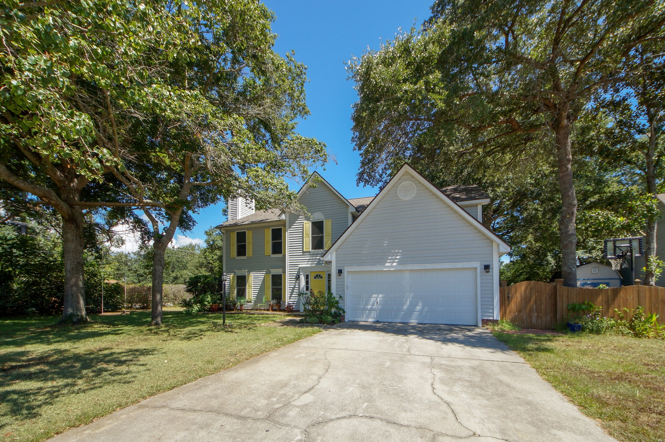
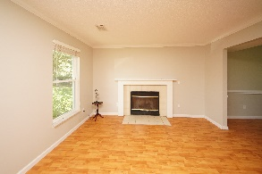
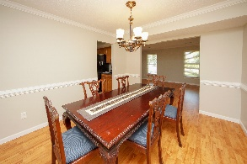
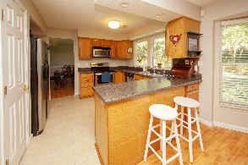
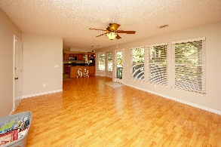

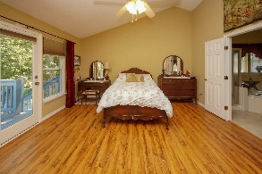

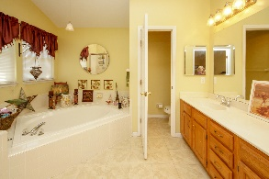
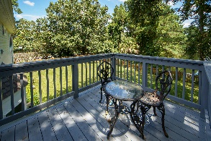
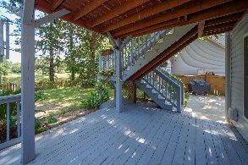
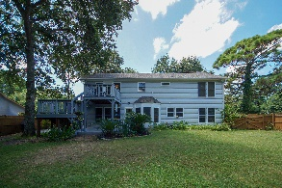

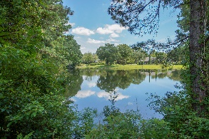
4 Bed / 2.5 Bath 1406 Diamond Boulevard Crown Pointe in Mount Pleasant MLS #18014766
PRICE REDUCED
$410,000
Greg Flanagan
Broker/REALTOR/CLHMS
843-952-4444
greg@flanaganhometeam.com www.FlanaganHomeTeam.com
Price Reduced for immediate sale. Large Secluded home at head of the neighborhood. New paint downstairs, wood floors throughout, a new roof, new Low-E doors and Low-E windows, this home is ready to serve you for the next 20 years. Home Warranty Included. Spacious, true 4-bedroom home located only minutes by bike or car, from Isle of Palms Beaches and Towne Center Shopping Center or 15 minutes to Historic Downtown Charleston. More than enough room inside and out for entertainment. The large master suite is complemented with its own private deck and stairway to the large fenced in backyard for entertaining. Amazing location central to everything East of the Cooper and the beach.
Keller Williams Realty Charleston | 496 Bramson Ct Ste 200 | Mt. Pleasant, SC 29464

