Slide 1
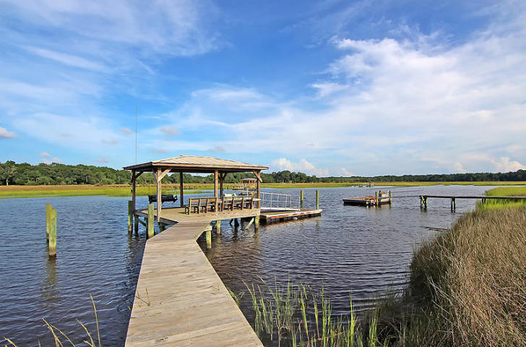
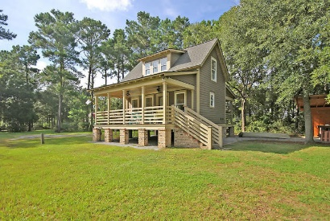
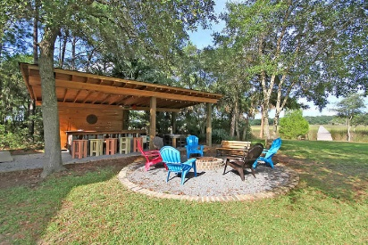
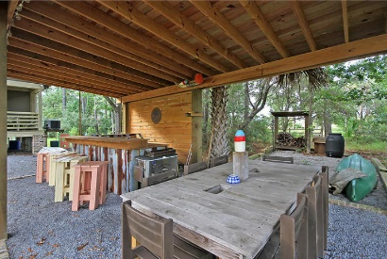
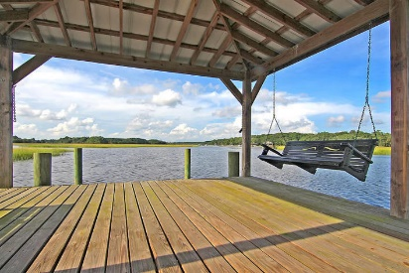
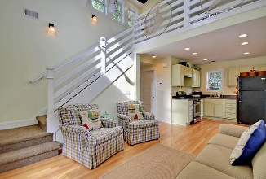
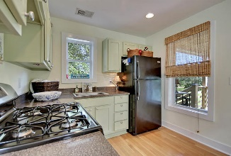
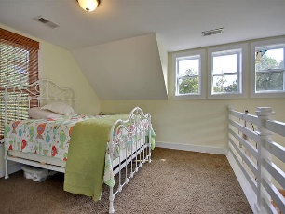
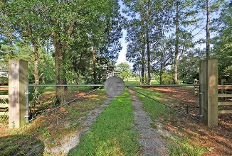
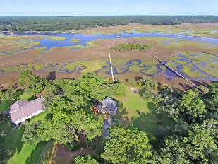

1406 Marshwind Island Road Woodville | Awendaw, SC 29429 | MLS# 15024041 | $875,000
Private Dock-Relaxing Escape!
Spectacular! This property fittingly is called ME, because once you get there it is all about you. The owners use as a RETREAT for their families and close friends to relax, unwind, entertain, boat, fish, and crab! Wonderful investment opportunity for several families to own and share this property. UNBEATABLE, large private lot with DEEP WATER DOCK on the Wando River with quaint bright open floor plan cottage and outdoor party shed with bar and sink. All this is only minutes from Towne Center. Covered dock in place with floater-approval and pilings in place for a boat lift. This property has a very cool island on the walkway to the pier head which would make an awesome spot for oyster roasting. Cottage is 760 sq. feet, 300 square feet of porches, 480 sq. feet of party shed.
Stan Huff
843-670-2835 stan.huff@agentowned.com
Jill Marcacci
843-297-5590 jill@agentowned.com
www.agentownedrealty.com
AgentOwned Realty Co. Preferred Group, Inc. | 824 Johnnie Dodds Blvd | Mt Pleasant, SC 29464

