Slide 1
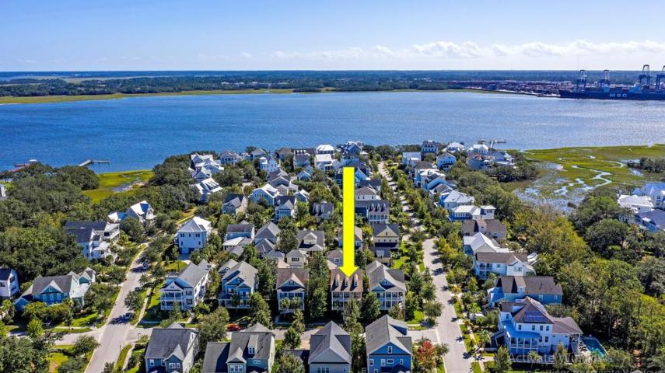

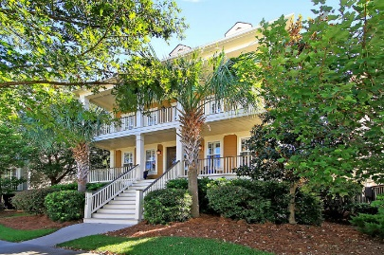
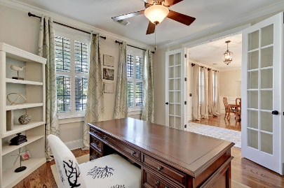
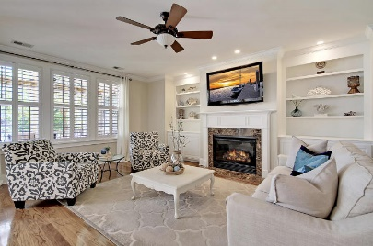
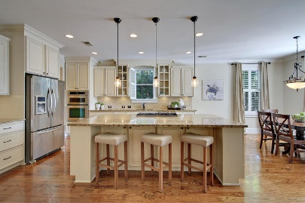
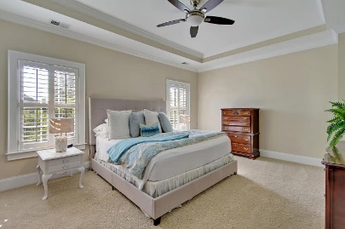
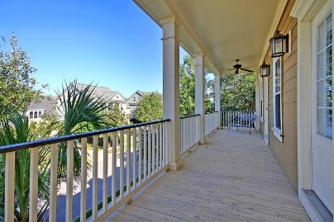
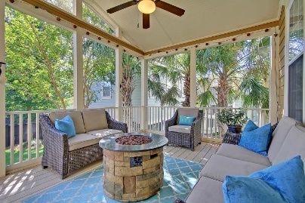
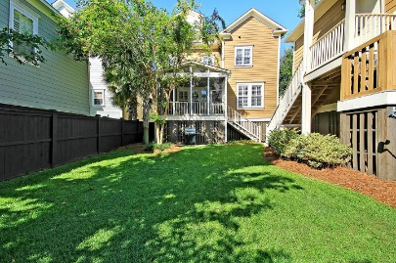
Great Downtown Investment Opportunity
Open House Sunday 1-3
1406 Wando View Street Daniel Island, SC 29492 ~ MLS# 19027401 ~ $870,000
Custom home by Allen Custom Homes
Master bathroom has his and her vanities and large soaking tub
Tray ceiling in Master Bedroom
Second floor features two bedrooms with ensuite baths in addition to a second Master suite
Large storage area located on unfinished 3rd floor of home
Custom built in shelves and cabinets in home office
Kitchen features granite counter tops, Bosch appliances, double ovens, and a large center island breakfast bar with seating
Living room features fireplace with granite surround and custom built-ins
Brazilian Cherry hardwood flooring throughout the entire home
Surround sound with individual volume control in each room throughout the main level of the home
Wainscoting and crown moulding throughout the home
Hurricane shutters for all windows and doors which are easily installed from INSIDE the home
Lawn Irrigation System
Gutters with Leaf Guard
Great location close to Smythe Park, Daniel Island schools, public Library and community pools.
Community amenities include - miles of walking/biking trails, pools, multiple playgrounds and community boat dock, shops, restaurants and the Family Circle Tennis Center - a great venue for sporting events and concerts.
Immaculate Charleston style home on desirable Daniel Island, a short drive from historic Charleston, great beaches and the airport. This 3-story home features 5 bedrooms 6 baths, with a lovely fenced yard, and is just steps away from Smythe Park. Smythe Park features an 11-acre lake with walking trails, picnic area and a children's play area. Home is walking distance to schools and community library. This home has the perfect layout for families of all ages and for entertaining friends. The open floor plan features a coastal kitchen with tons of storage, stainless appliances and a center island with seating. There is a breakfast area, formal dining room, Butler's pantry and walk-in pantry. Home office is conveniently located on the first floor.
Upstairs you will find an open loft area perfect for a playroom or additional work space, master bedroom and 2 additional bedrooms. Owner's retreat boasts a tray ceiling, massive walk-in closet & ensuite bath with dual vanities, jetted tub and walk-in shower. Spacious bonus room on the 3rd floor with full bath would be make a guest suite, game room or media room. The 5th bedroom with full bath is in the FROG above the 2-car detached garage, and is an additional 506 square feet. It has a separate entrance, an ensuite bath and would be ideal for mother-in-law suite, guests or potential rental income. The front porch and screened in porch overlooking the backyard are perfect for year-round enjoyment.
Buyer pays a one-time neighborhood enhancement fee of .5% x sales price to Daniel Island Community Fund at closing. Daniel Island Resale Addendum will be required on offer to purchase. Daniel Island Resale Addendum, Property Disclosure and Community Fund Disclosure are attached.
Book your viewing today!
Paige Rhodes 843-830-3281 paige@mattoneillteam.com
Ben Laaper 843-642-3546
ben@mattoneillteam.com

