Slide 1
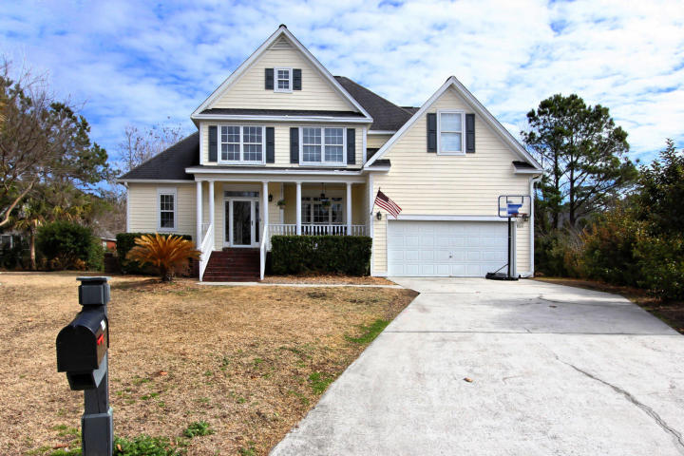
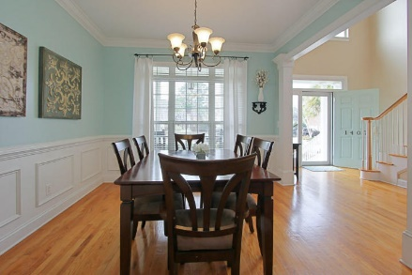
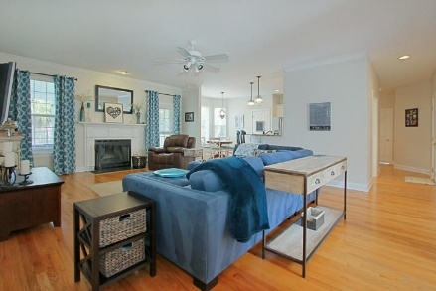
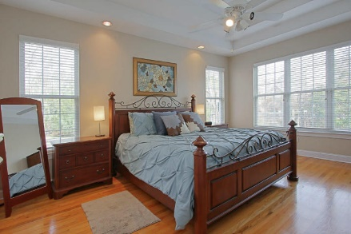
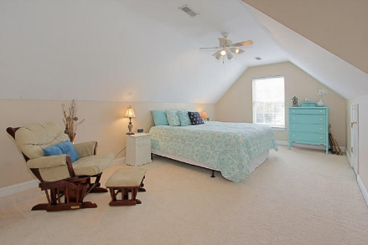
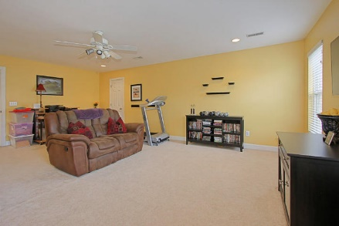
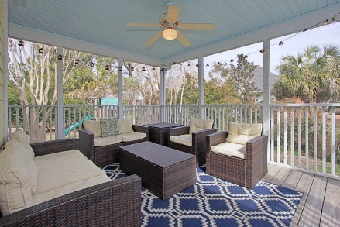
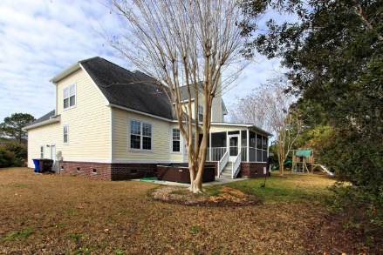


1407 Wayward Court Mount Pleasant, SC 29466 MLS# 18003022 $549,000
5 Bedroom + FROG
In Brickyard Plantation
Don't miss this beautifully maintained 5 bd plus FROG situated on a small, quiet cul de sac in the Landing section of Brickyard Plantation. Seller has just recently updated the open concept kitchen to feature white shaker cabinets, subway tile backsplash, granite countertops, and stainless steel appliances.
This home features a spacious downstairs master bedroom as well as secondary bedroom and full bath. Upstairs there are 3 large bedrooms, full hall bath and bonus room. Enjoy the many amenities that centrally located Brickyard has to offer including Olympic sized pool, tennis courts, boat storage, dock/boat ramp, exercise area and more!
Mary Beth Bennett
(843) 367-1774
marybeth.bennett@agentownedrealty.com
www.chsarealiving.com
AgentOwned Preferred Group | 824 Johnnie Dodds Blvd | Mt Pleasant, SC 29464

