Slide 1
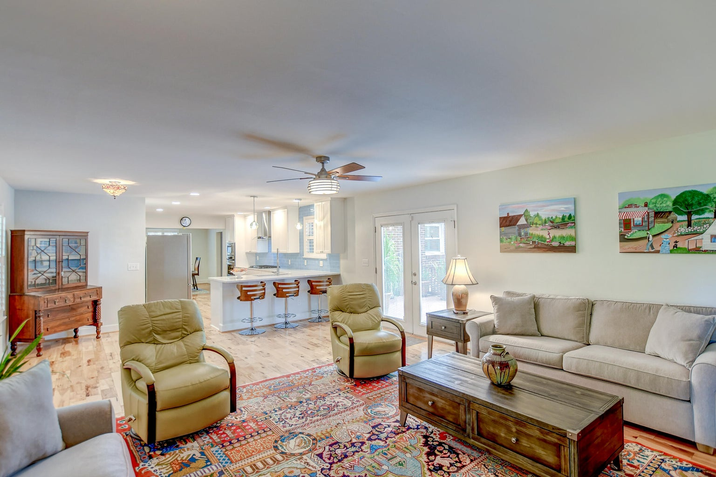



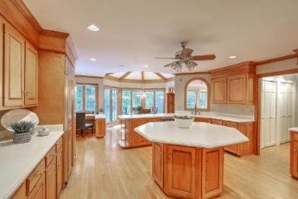
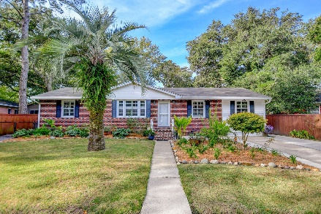



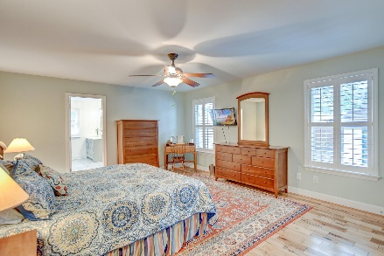

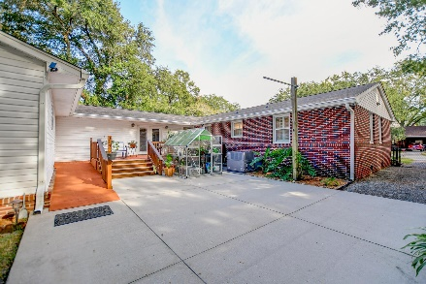
Parkshore Marshfront
Price Improvement!
1407 Downing Street
Ashley Hall Manor | Charleston, SC 29407 | MLS# 23023342 | $624,900
Welcome to this spacious and remarkable West Ashley home featuring dual owner's suites and NO HOA! This charming ranch-style residence boasts a picturesque exterior and beautifully landscaped surroundings. As you step inside, the home welcomes you with a wealth of delightful features and an abundance of natural light. Upon entering, your eyes will be drawn to the original wood flooring that graces much of the interior. Crown molding and plantation shutters add a touch of elegance to the space, creating a warm and inviting ambiance. The formal living room seamlessly flows into the dining room, making it the perfect setting for entertaining guests. The heart of this home is undoubtedly the stunning, fully remodeled kitchen, & laundry room completed in 2022. All 3 bathrooms have been completely updated and renovated, along with the family room. The fully remodeled kitchen features crisp white cabinets, exquisite countertops, stainless steel appliances, a gas cooktop, a stylish backsplash, and a convenient breakfast bar. The kitchen seamlessly opens to the family room, where hickory flooring adds warmth to the space. From here, you can access the spacious deck and backyard, perfect for enjoying outdoor gatherings and barbecues.
This home offers not one but two owner's suites. The first owner's suite includes two spacious closets and an en suite bath with dual vanities. A unique pocket door leads to a huge walk-in closet, providing ample storage space. The second owner's suite offers a private sanctuary with its own en suite bath, featuring a modern sink and a stand-up shower. In addition to the owner's suites, this home boasts two additional bedrooms, making it ideal for families or guests. There is an additional room that can serve as an office space/entertainment room. A lovely full bathroom and a conveniently located laundry room round out the interior of this sprawling home.
Step outside into your private oasis. The fenced-in backyard features a large deck for outdoor dining, a generously sized patio for relaxation, two storage sheds for your tools and equipment, and even a charming greenhouse for those with a green thumb. Additional noteworthy features included a new roof (2023), remodeled bathrooms (2021 & 2022), two HVAC units, new hardware on the doors, canned lighting (2022), and a tankless water heater. The location of this home is hard to beat. Here you are just a half a miles from Publix, 2.5 miles from I-26, 5.6 miles from downtown Charleston, 9.5 miles to Mt Pleasant, and 12.9 miles to Folly Beach. This West Ashley gem is the perfect place to call home, with its stylish updates, abundant living space, and a backyard retreat that's sure to impress. Don't miss the opportunity to make this fantastic property your own. Schedule your showing today and experience the allure of this remarkable home!
Joshua Perry jperry@mattoneillteam.com 843-367-6943

