Slide 1
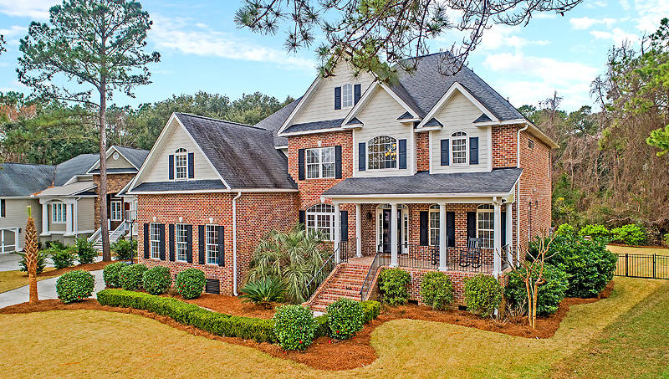
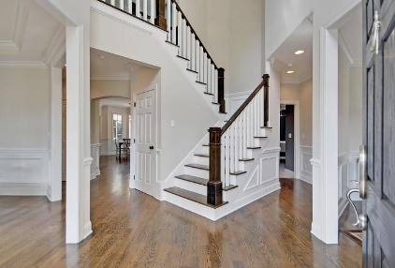
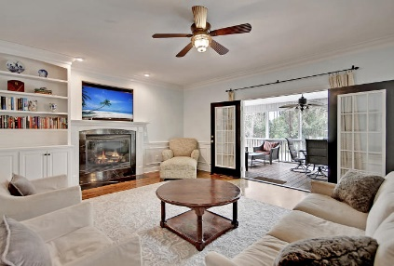
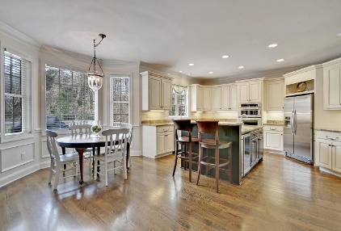
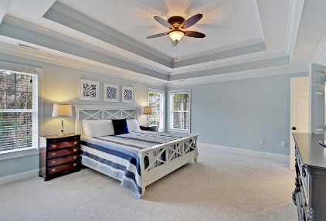
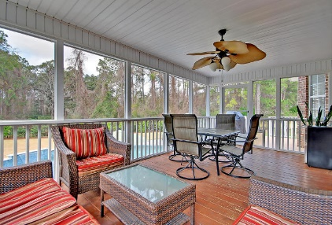
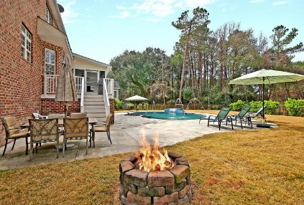
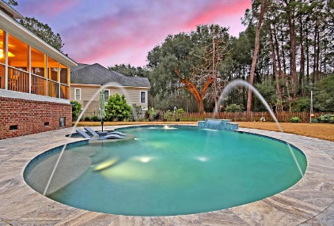
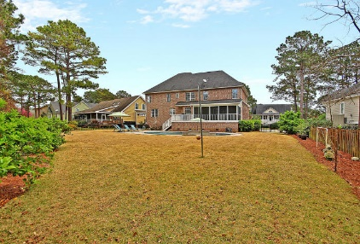


Gorgeous All Brick Home
With Pool In Hamlin Plantation
1408 Walking Trail Court
Mount Pleasant, SC 29466
MLS# 19005790
$850,000
5 Bed · 4½ Bath · 3,821sf
All brick and fantastic curb appeal, this home is situated in the wonderful Sound section of Hamlin Plantation. A beautiful front porch & foyer welcome you into this spacious floor plan that has a guest room with full bath on the main level. The kitchen is open to the family room & includes an island + space for a huge dinner table. Wine chiller, separate ice maker, a 2nd prep sink & double convection ovens round off this space. Out back there's a screened porch & beautiful saltwater pool with travertine deck and there's still a lot of yard space too! The pool has a 'tanning ledge', water fountain, jets/sprayers, colored lighting options & a heater/chiller. Upstairs you'll find brand new carpet in all 4 bedrooms & in the massive FROG. The main level LR could serve as a office or playroom.
The home has many extras including: hardwood on main level, stairs & upper level hallway, fresh paint, 3 car garage, double tray ceiling in master and crown & decorative moldings. Great closet space throughout and a well appointed laundry room with utility sink. Lots of great space to cover all of your needs!
Community amenities leave nothing to be desired: Jr. Olympic pool with water slide, full fitness center, walking/jogging path, nature trails, basketball & volleyball courts, an active tennis league & courts, playground & a clubhouse that can be used for private functions. Many social events throughout the year for adults and kids.
Lauren Zurilla
(843) 991-9149
laurenismyrealtor@gmail.com
LaurenZurilla.com
Carolina One Real Estate
628 Long Point Rd.
Mt Pleasant, SC 29464-3032

