Slide 1
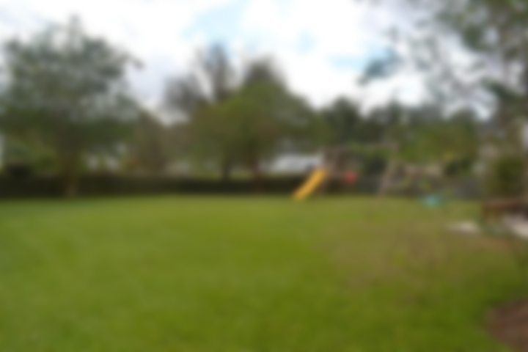
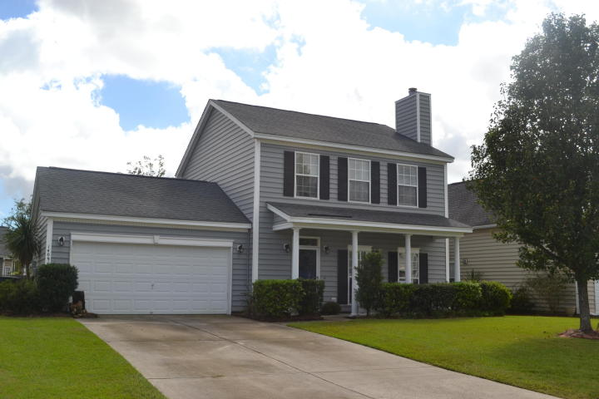
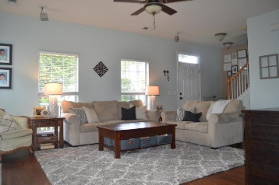
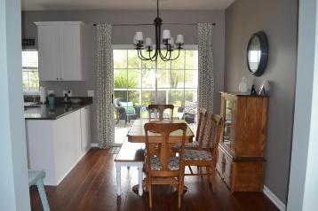
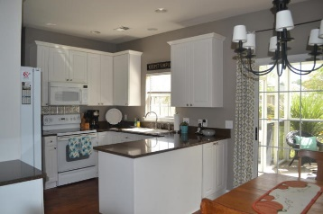
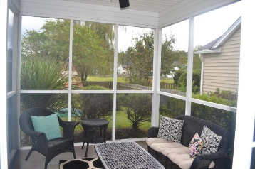
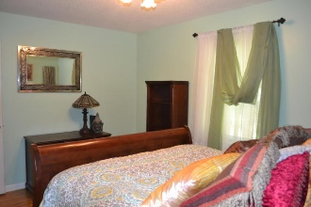
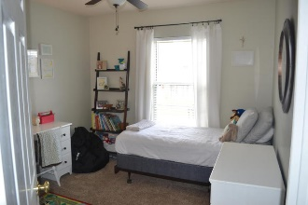

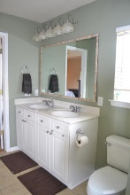
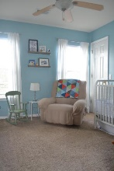
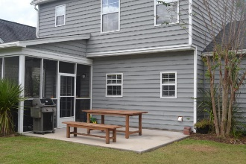
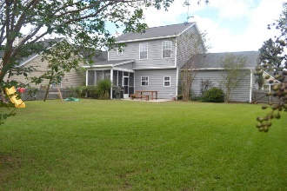


Tanner Plantation ~ Motivated Sellers Ready to Sell!
Ibis Glade under 240K!
1409 Chimney Swift Lane
Tanner Plantation • Hanahan, SC 29410 • MLS# 17027456 • $239,900
Fantastic opportunity to purchase this wonderfully maintained home in desirable Tanner Plantation! Upon entering the home, you are welcomed by a spacious and bright living room with gas fireplace and marble surround. Living room has surround sound wiring with speakers and leads to the open kitchen with eat in area. Kitchen has plenty of cabinets, separate pantry, white appliances including refrigerator and granite counter-tops. Sliding glass doors lead you from kitchen area to screened porch with large patio area perfect for grilling. Downstairs is complete with gorgeous engineered hardwood flooring throughout, half bath with pedestal sink and a laundry room leading to two-car garage. Flow and openness of this home from living room to kitchen to screened porch and patio is perfect for entertaining! Backyard provides more entertaining space as expansive with plenty of room for kids to play, wooden fence and a pond view! Upstairs you will find the master bedroom with vaulted tray ceiling, walk-in closet and large master bathroom. Master bathroom provides large vanity with dual sinks, separate walk-in shower and garden tub. There are two guest bedrooms upstairs with plenty of light as well as a hall bathroom with shower/tub combo. Ceiling fans in all bedrooms and living room, home is wired for security system, brand new HVAC system with 12 year warranty and home is currently zoned for new school opening 2018!
Pride of ownership is clearly seen with this home and it won't last long!
Megan Schwerin
(843) 478-5867 | mkschwerin@gmail.com
Elaine Brabham and Associates, LLC • 1890 Sam Rittenberg Boulevard, Suite 217 • Charleston, SC 29407

