Slide 1
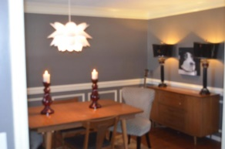
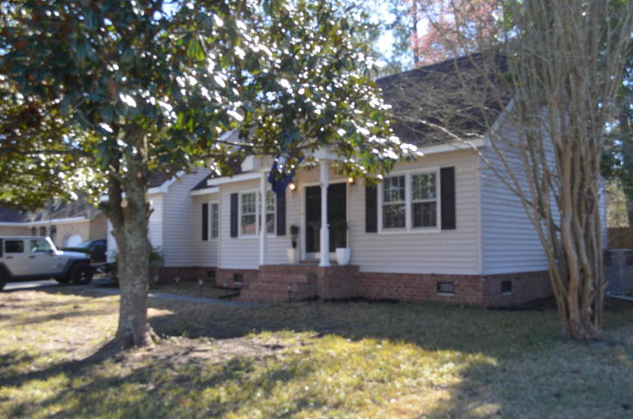
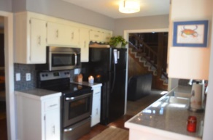
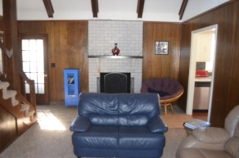
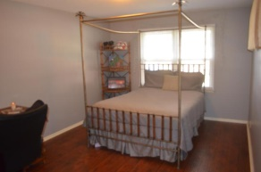
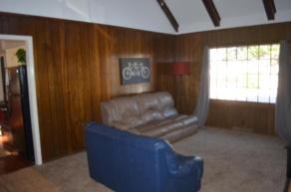
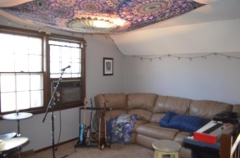
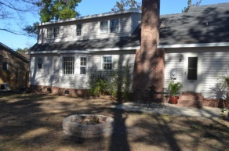
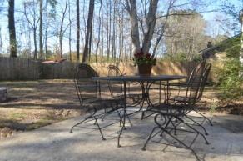


Great Buy In Tall Pines
140 Ponderosa Drive
Tall Pines
Ladson, SC 29456
MLS# 15002641
$149,000
Bring your clients to see this great 3 bedroom, 2 bath home in Tall Pines! It has lots of curb appeal with the magnificent magnolias in front of the house. When you walk in the front door, you are greeted with a beautiful dining room on the left. Down the hall, the updated kitchen with new appliances overlooks the huge, fenced backyard. The yard/patio would be a great place to gather with family and friends. The den/family room is located off of the kitchen and boasts wood beams and a wood-burning fireplace. There is a wonderful, multipurpose loft off of the family room. It could be used as a home office, a playroom, or an exercise area among many other things. The wood stairs take you up to 2 spacious bedrooms and a full bath. Both bedrooms offer closets/storage areas.
The current owners updated the house with
* new subflooring on the first floor
* added wood floors to the foyer dining room, kitchen, and eat-in kitchen
* installed all new kitchen appliances,
* new countertops and backsplash
* tile in bathrooms
* carpet in the bedrooms, family room, and loft area
* a NEW HVAC unit
* all new ductwork
* a moisture barrier under the house
These things certainly added a lot of value to the house.
Make an appointment to see this great home! Buyers to verify all things deemed important--schools, taxes, square footage, year built, lot size, and insurance.
Kea Whatley
Mobile 843-408-8704
keawhat@aol.com
AgentOwned Preferred Group | 824 Johnnie Dodds Blvd | Mt Pleasant, SC 29464

