Slide 1
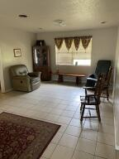
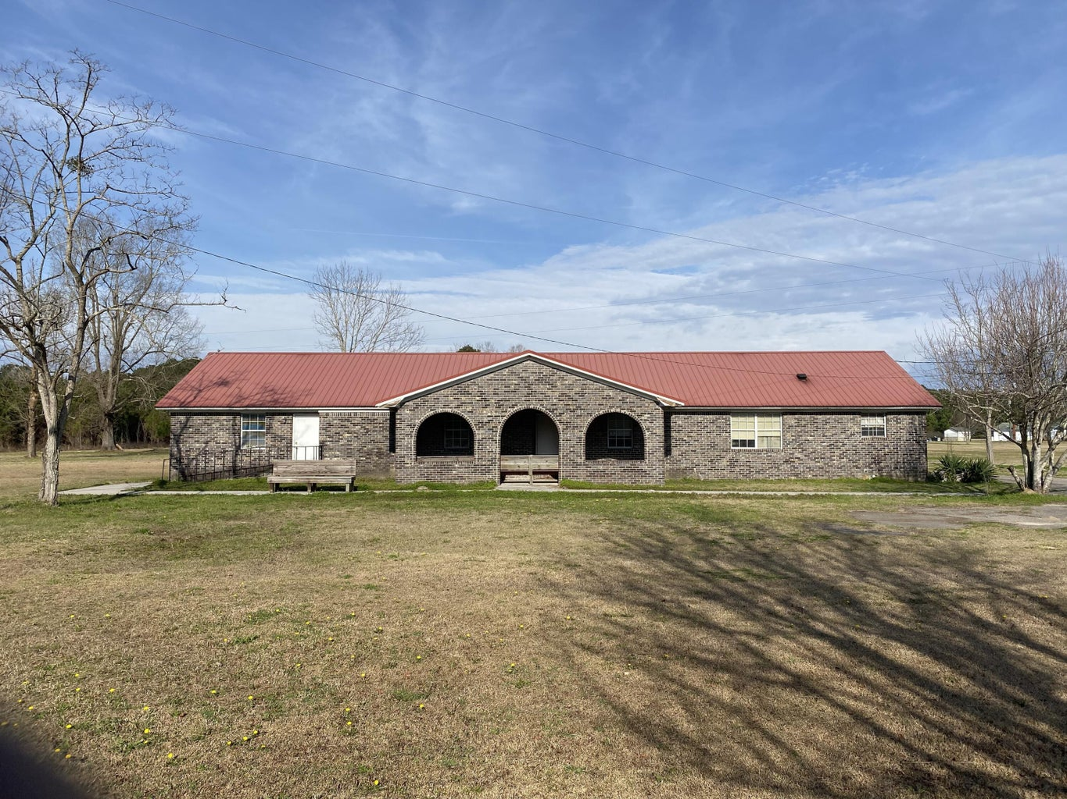
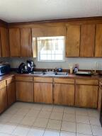
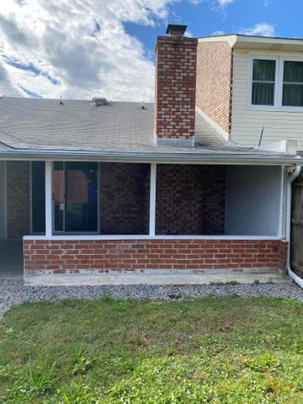
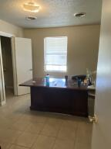
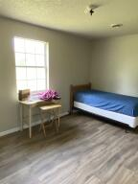
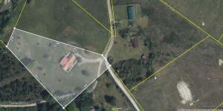
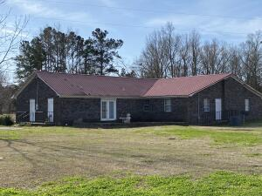
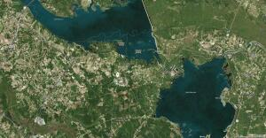


140 Checkerberry Road Eutawville, SC 29048 | MLS# 23004038 | $390,000
Open House Saturday
12:00 until 4:00
Unique Brick Home On 2.5 Acres Of Land
Open House Saturday 8/24/19
12:00 until 4:00
This is an opportunity to own a unique home/property. It is a brick home on 2.5 acres of land has 7 bedrooms and 4 half bathrooms and 2 full bathrooms with tub or shower. The home is a former group home for seniors. Most recently rented to a family of four. Come take a look, plenty of space and optional use possible.
James Hopkins
(843) 708-5930
James.Hopkins@AgentOwnedRealty.com
AgentOwned Premiere Group
1800 Trolley Rd
Summerville, SC 29485

