Slide 1
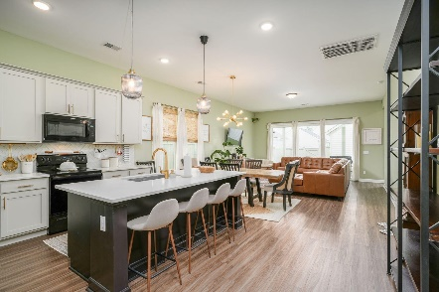
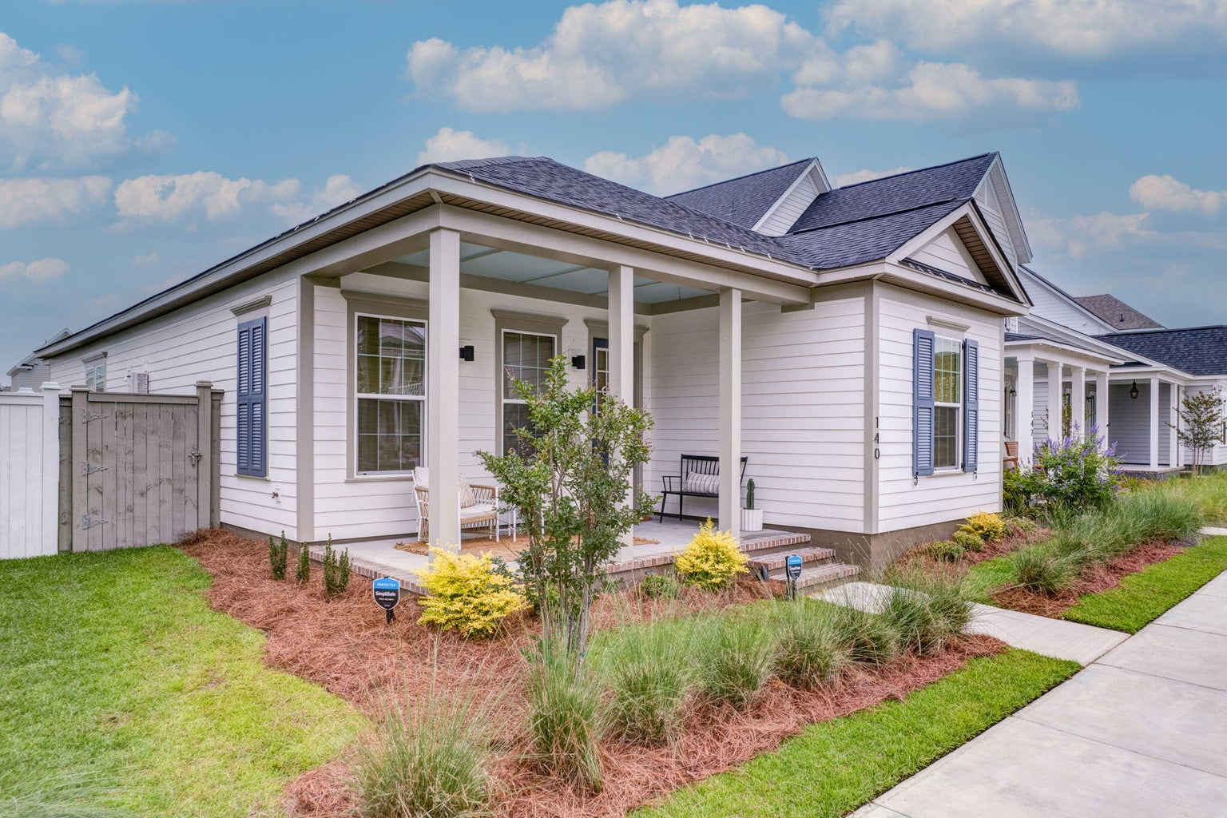
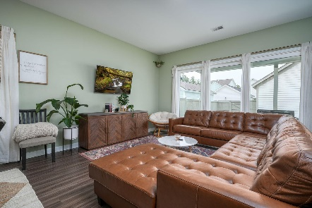
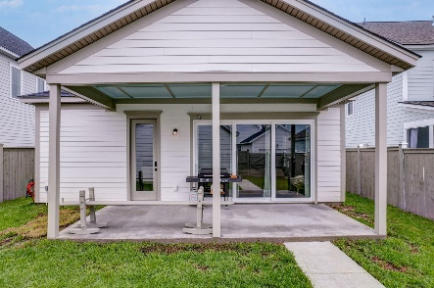
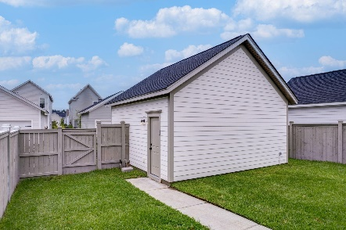
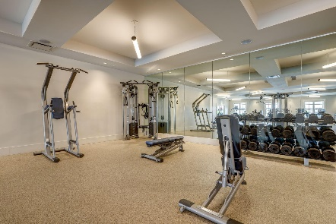
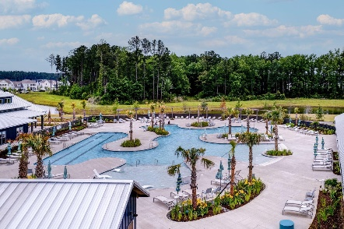
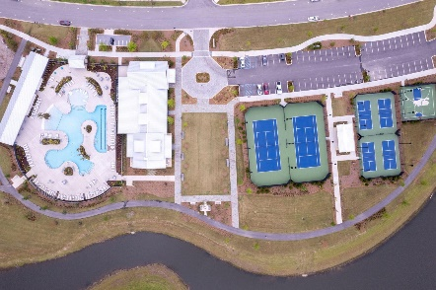
140 Midtown Avenue
Nexton | Summerville, SC 29486
MLS# 23011644 | $499,950
Darrell Creek Elevated Home With Elevator & Salt Pool
JUST LISTED
Open House Saturday 5/27 from 12-3PM
Welcome Home to 140 Midtown Ave in the desirable Midtown Neighborhood in Nexton! This Ashton Woods home is better than new, full of all the custom upgrades you would want and only a year old! The 1-level Witherbee is an extremely Open Floorplan with 3-bedrooms, 2-bathrooms, PLUS Den/Optional 4th Bedroom. The Master is very spacious, with en suite bathroom, complete with his & her sinks, quartz counters, large walk-in shower, and walk-in closet. The home also boasts a well- appointed Gourmet Kitchen with quartz countertops, custom cabinets, and tile backsplash. Also, not to be missed is the mud room/drop zone PLUS oversized pantry off the kitchen! The kitchen flows into the Dining Area and Family Room, upgraded with multiple sliding glass doors to let the light come pouring through!
The other wonderful aspect about this home is the walkability to the Midtown Community in Nexton. The Midtown Club is home to Summerville's best-known Resort-Style Pool...you'll instantly feel like you're on vacation! In addition, the Club boasts a state-of-the-art gym and yoga studio, media room, and the largest and most beautiful work-from-home space, the Living Room. In addition, Midtown offers Pickleball, Tennis, and Basketball Courts, as well as miles of walking/jogging trails. Midtown Residents also can use Brighton Park's Pool, Pavilion, and Dog Parks at no extra charge! And if that isn't enough, hop on your golf cart or bike to head down to Nexton Square. Get your shopping on and then unwind at Taco Boy or Halls Chophouse or any of the many Nexton Square Restaurants!
This beautiful home will truly not last, book your showing today!
Take a Video Tour
Elissa Campbell
843-853-1433 | elissa.campbell@agentownedrealty.com
AgentOwned Realty Preferred Group | 824 Johnnie Dodds Blvd | Mt Pleasant, SC 29464

