Slide 1
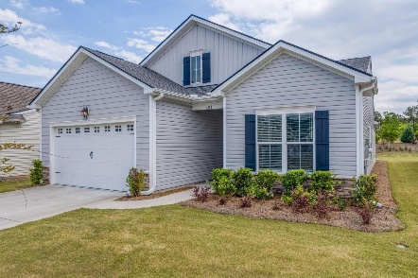
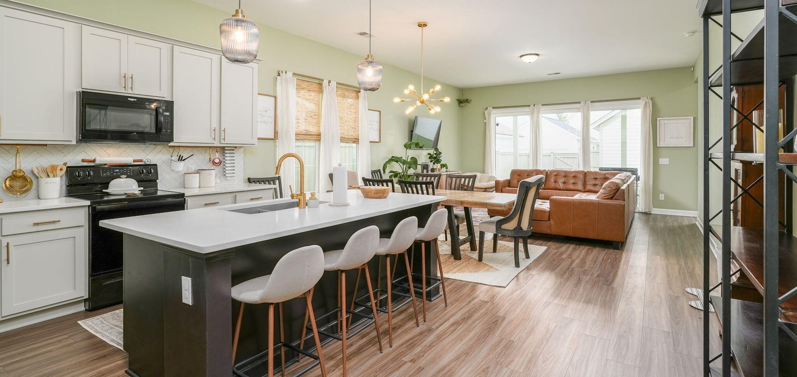

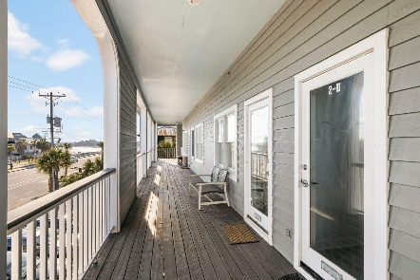
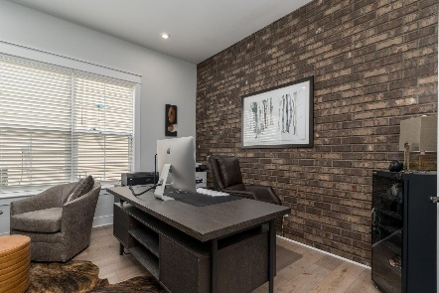
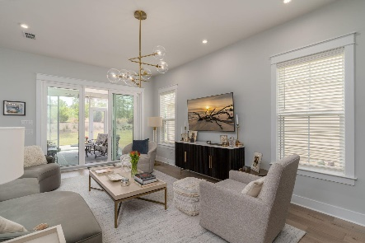
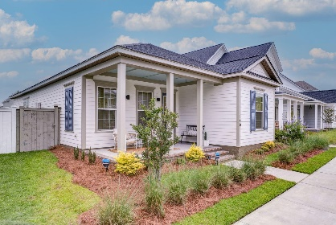
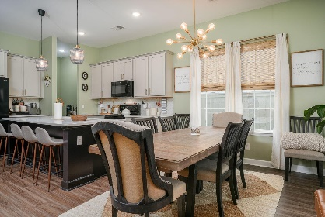
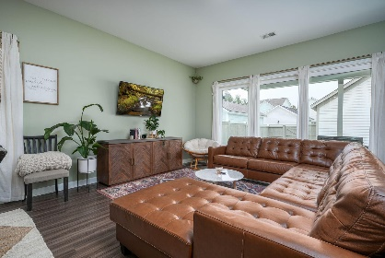
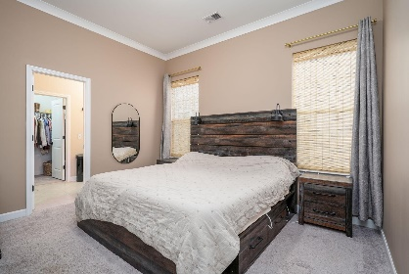
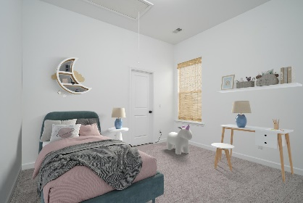
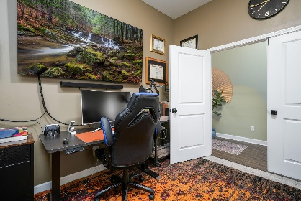
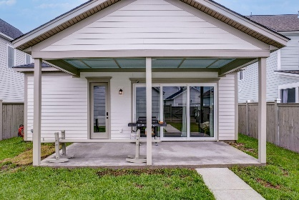
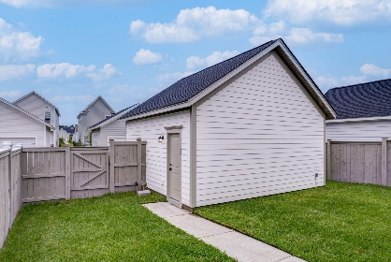
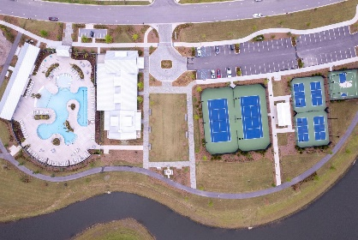
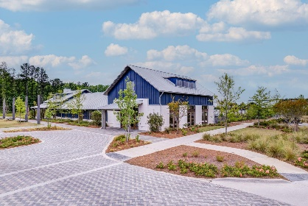
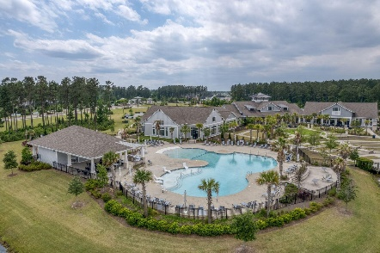
140 Midtown Avenue Nexton | Summerville, SC 29486 | MLS# 23011644 | NEW PRICE! $480,000
Darrell Creek Elevated Home With Elevator & Salt Pool
$10k in closing costs + $1,500 Realtor Bonus
with an acceptable offer by 7/31
Co-sponsored by
Offering $3000
Lender Credit
Open House Saturday 12-2PM
Take a Video Tour of this home
Midtown Amenities Tour
Elissa Campbell
843-853-1433 | elissa.campbell@agentownedrealty.com
AgentOwned Realty Preferred Group | 824 Johnnie Dodds Blvd | Mt Pleasant, SC 29464

