Slide 1
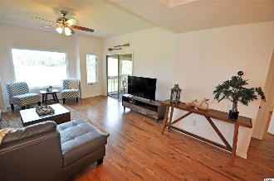
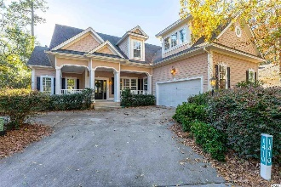
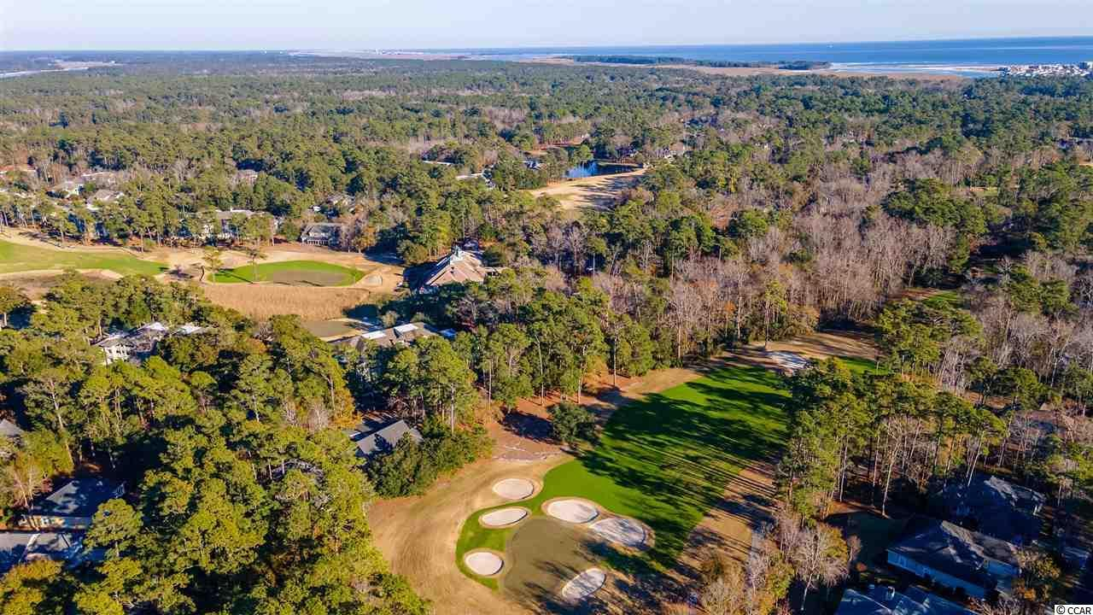
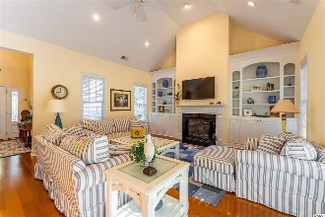
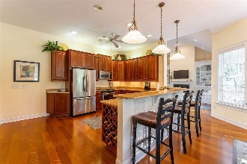
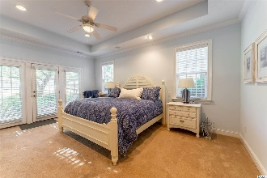
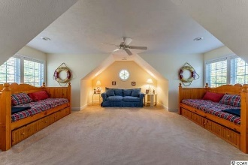
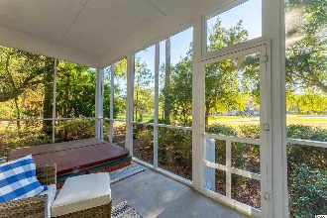
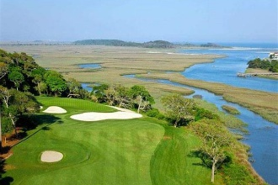
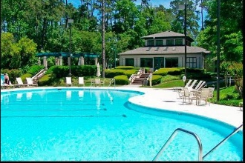
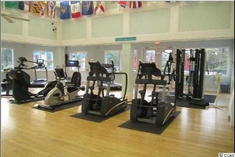
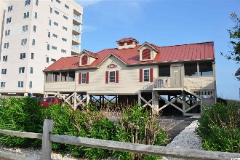


Welcome To The The Best Of The Beach
1410 Lighthouse Drive
Tidewater Plantation ~ North Myrtle Beach
MLS# 2100358 ~ $545,000
Long-time second owner reluctantly parting with impeccable, never rented Tidewater vacation home. This top-of-the line, custom-built luxury home is professionally furnished and decorated. All furniture and contents are negotiable! Timing is everything, and this is your moment: Just move in! This spacious Tidewater Plantation Resort beach house with traditional wrap-around, Southern-style front porch is immediately inviting. It boasts a private, lightly wooded unique location on one-and-1/2 lots and on the signature 7th hole of world-class Tidewater Golf Course, along with a pretty, 75'-road-frontage-presentation that also allows a nice driveway and a big, side-load garage. No close neighboring homes visible from that front view. Enter into a beautiful entry foyer, overlooking the heart of the home, the magnificent great room with fireplace, surround shelving & cathedral ceiling. Look straight through the wall of windows to the screened porch and on to the golf course. Much natural light throughout to enjoy, too! To the right is a first-floor open office, study of just flex space to personalize. Ahead and to the right is the informal dining area seating eight off the great room and adjoining the magnificent upscale kitchen. The luxury kitchen has it all, plus breakfast bar, work desk, granite countertops, stainless appliances, walk-in pantry, more. Most closets are walk-in, and there is much planned storage on both levels. The master is off the kitchen on the main level. It has a peaceful, secluded patio, tray ceiling, large walk-in closet & shower, separate vanities & water closet. Nearby is a half-bath for guests, fully equipped laundry room with soaking-sink and a convenient rear entry from the garage directly to the kitchen. The big garage has a separate door to the yard and a defined workshop area. An upstairs with dual-access to the front foyer or to the kitchen is simply unbelievable! There are two huge bedrooms, two full baths, an enormous bonus room, additional closets & attic-storage space...seeing is believing! Tidewater boasts rich amenities close to this wonderful home on the 7th hole of world-class Tidewater Golf Course, including owners' beach cabana on the Cherry Grove Beach named the 11th best in the nation, pools & spas, clay & hard-surface tennis courts, pickle ball, bocce, horseshoes, amenities center, fitness center, driving range & putting green, 24-hour gated manned security, and clubhouse with bar & restaurants. There is even a complimentary gated storage yard for boats, campers, recreational vehicles and the like. The on-site, convenient HOA building has rooms for business and other meetings and events and a lending library. There are many clubs and activities year round. In Tidewater, you can do it all, or just relax in the luxurious Tidewater lifestyle. Tidewater itself is on a tree-lined road to oceanfront Anne Tilghman Boyce Coastal Reserve, a nature conservancy, including Waties Island, with access for managed recreational use. Tidewater, a historic plantation, is on an elevated peninsula of live oaks and southern pines between the Intracoastal Waterway and the Cherry Grove Inlet to the Atlantic Ocean. The Plantation also preserves the distinctive look of its own origins. It is close to the beach, shopping, entertainment, medical services, outstanding schools and parks and access to major highways. The jewel in the crown of the development is that private owners' beach cabana on the wide, white sands of the Cherry Grove Beach, just a few minutes drive. This spacious charming custom-built home enjoys a lovely, indigenous peaceful environment, along with the excellent reputation of the Tidewater Golf Course, the Pebble Beach of the East. Tidewater Plantation, in one of the U.S.'s top-10 beach towns, North Myrtle Beach, reflects a "way of life." Do not let this very rare, singular Tidewater Plantation home with VIEWS!
Video Tour: https://youtube.com/embed/phjPWJAqb4Y
3D Matterport Tour: https://my.matterport.com/show/?m=LFuQ5AC5z9e
Deborah Collins
843-424-9013
dctidewater@yahoo.com
Connie Ross-Karl
702-306-2643
conniesross@aol.com
NEW WAY PROPERTIES MYRTLE BEACH

