Slide 1
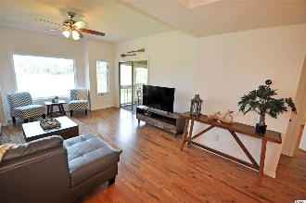
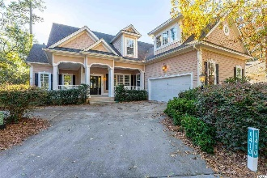
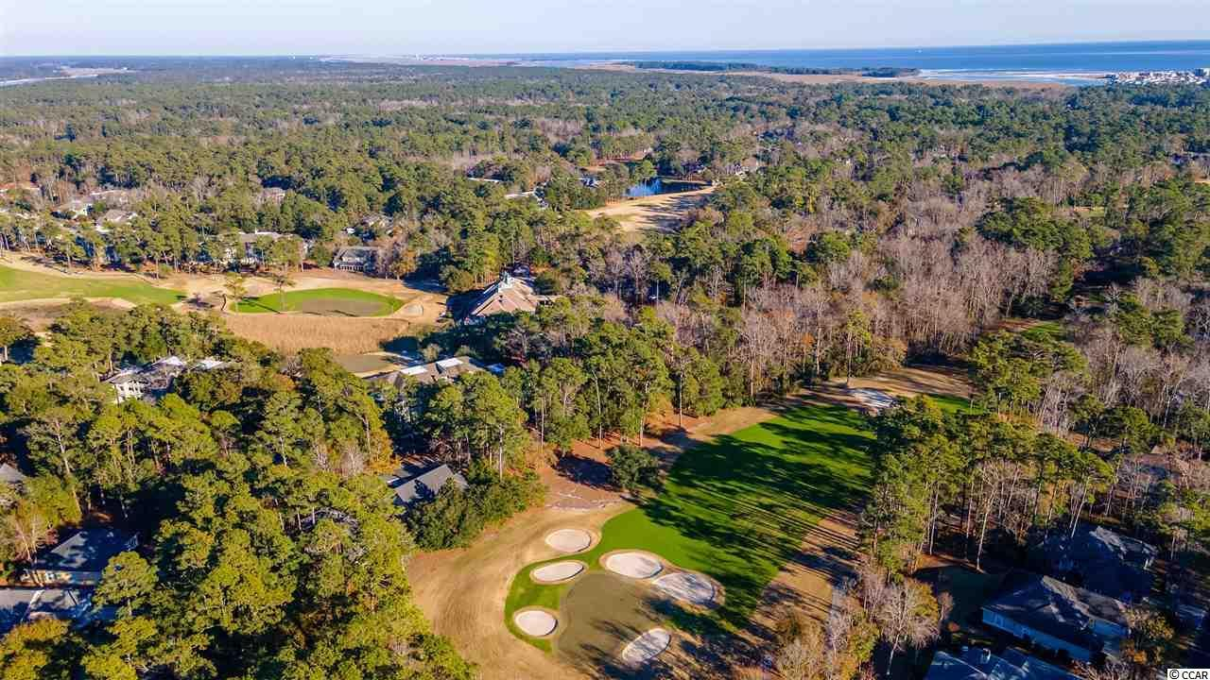
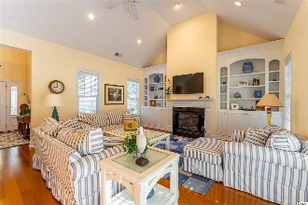
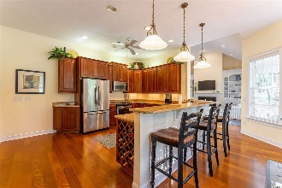
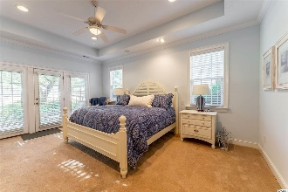
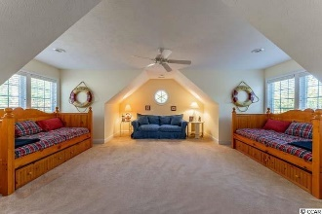
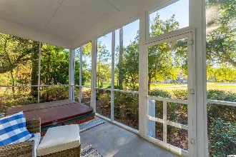
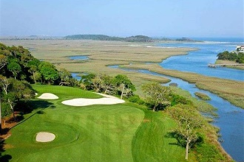
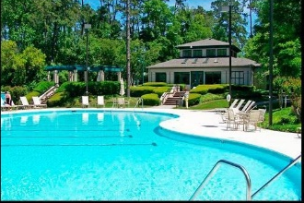
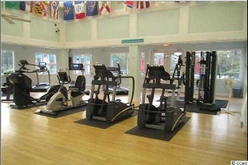
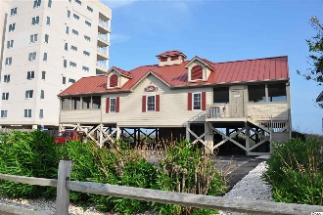


Welcome To The The Best Of The Beach
1410 Lighthouse Drive
Tidewater Plantation ~ North Myrtle Beach
MLS# 2100358 ~ $545,000
Features and Convey List
Hardiplank siding
Oversized, one and 1/2 lots affords much privacy and lovely views
On the 7th green of world-class Tidewater Golf Course
Large Southern-style wrap-around inviting front porch
Open floor plan for easy living, some unique design elements
Laminate wood-inspired floors
Fireplace with custom-built-in shelving surround
Master has tray ceiling, walk-in closet, en suite with big walk-in shower, double vanities and private water closet with bidet
Door and patio overlooking the golf course -- yet private -- from the large master bedroom with lots of natural light
3 & 1⁄2 baths baths
Spacious walk-in pantry and lots of walk-in closets, much storage throughout
Gorgeous screened porch off of the great room, with a built-in hot tub and views of the signature 7th hole you just have to see!
Dual heat pump
Note upscale light fixtures throughout
The great room/kitchen enjoys beautiful window treatments and much light.
The kitchen boasts granite countertops, stainless steel appliances, a work desk, undermount lighting and rich, cherry-colored cabinets. There is both a breakfast bar and a wonderful informal dining area that can sit up to eight comfortably, great for families and entertaining
There is a huge bonus room upstairs and a first-floor open office, study or just flex space off of the beautiful formal front entry foyer
All furniture and contents are negotiable!
This is a top-of-the-line professionally furnished and decorated home. Furniture, decor, bedding, kitchen content, bath linens, washer/dryer, chest freezer in the garage and workbench in the garage are offered. There’s more, a Mercedes SUV and wonderful bikes are likewise negotiable.
Video Tour: https://youtube.com/embed/phjPWJAqb4Y
3D Matterport Tour: https://my.matterport.com/show/?m=LFuQ5AC5z9e
Deborah Collins
843-424-9013
dctidewater@yahoo.com
Connie Ross-Karl
702-306-2643
conniesross@aol.com
NEW WAY PROPERTIES MYRTLE BEACH

