Slide 1
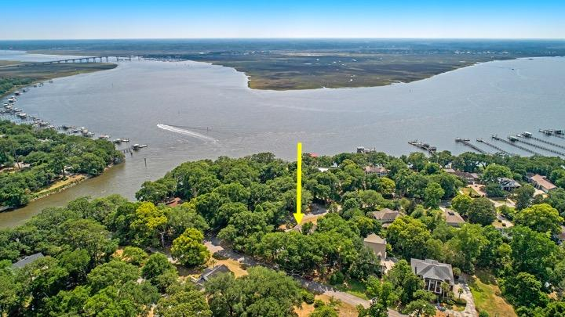
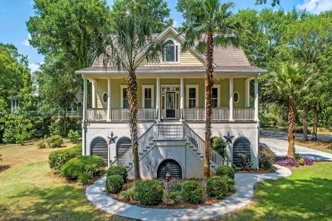
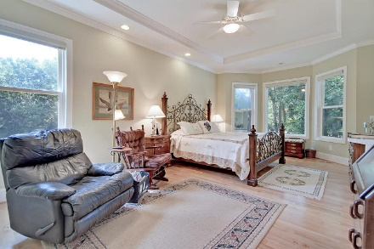
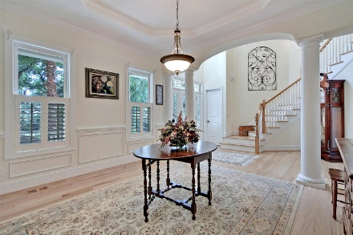
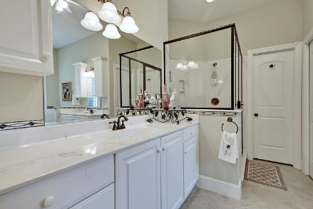
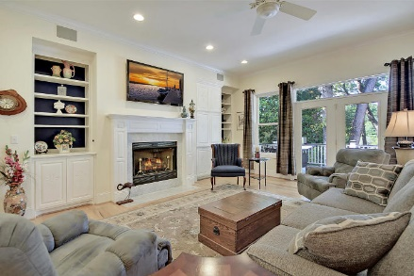
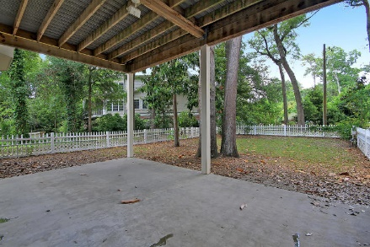
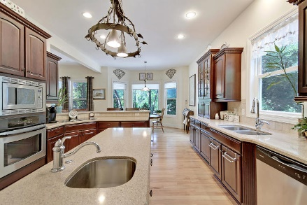
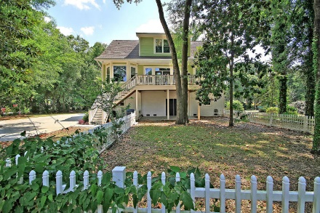
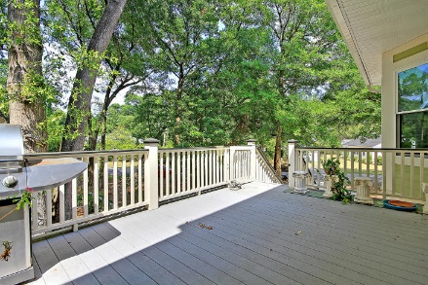
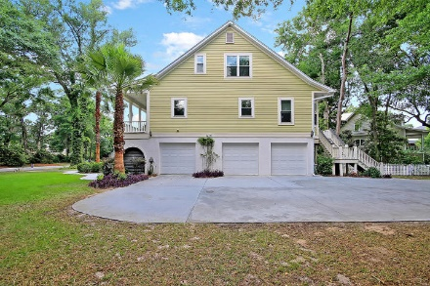
Hidden Gem In West Ashley
Price Reduced!
1412 S Edgewater Drive Edgewater Park ~ Charleston, SC 29407 ~ MLS# 19016017 ~ $820,000
Commonly described as West Ashley's hidden gem, Edgewater Park is a highly desirable community that's tucked away from the hustle and bustle with a private boat ramp and access to the Stono River. Situated on a large corner lot, this custom elevated home has an elevator granting access to all three levels. You'll be welcomed by the two story foyer with a partial view of the Stono River, gorgeous hardwood floors and high ceilings. There is a gas fireplace surrounded by built-ins in the living room, columns, wainscoting and a tray ceiling in the dining room. This home has an incredible eat-in kitchen with ample seating at the breakfast bar, a center island, stainless steel appliances and beautiful cabinetry.
With two master suites, the first level suite features a tray ceiling, in-suite bath with dual vanities, walk-in shower and two walk-in closets. There is a second master suite upstairs and 2 large bedrooms and full baths. The upstairs was designed with a very functional layout so that rooms can be used as office space, library or an entertainment room. The large cab elevator stops on each level of the property. The spacious garage with an easy drive-through access is ideal for a boat or a trailer, and is capable of accommodating five vehicles. With ample space, there is a room to convert part of the space into a workout room or workshop. There is a half bath located in the garage that is convenient for outdoor parties or when working in the yard.
Many other special features come with this Lowcountry home! Please see the list under the Supplement in MLS or contact us for your additional information!
Additional features include:
Full front porch
Back deck (also plumbed with natural gas for grilling)
Back patio under the deck with a fenced-in portion of the yard
Elevator
Central Vacuum
Rinnai Tankless Water Heater
Kitchen appliances, washer, dryer, refrigerator and Upright Freezer convey. Flatscreen TV in living room convey
Kitchen bar stools convey
Surround sound and exterior speakers
Pre-wired for 220V generator (generator conveys)
Impact Resistant Windows
Garage has a 1/2 bath
Drive-thru on one of the garage
Partial view of the Stone River from the front porch
Private community boat landing/launching
Book your showing today!
Verna Bunao-Weeks verna@mattoneillteam.com (843) 364-2447

