Slide 1
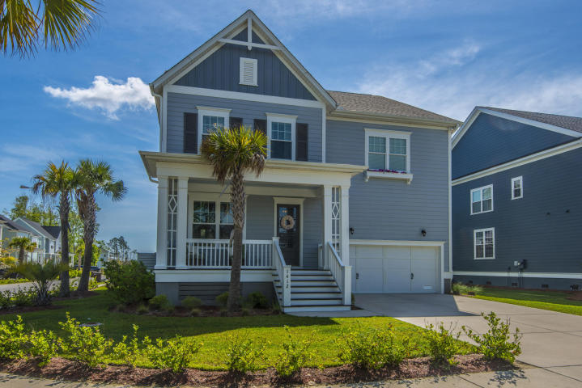
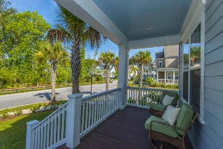
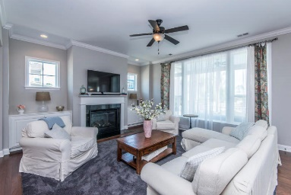
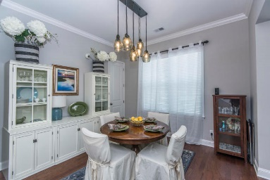
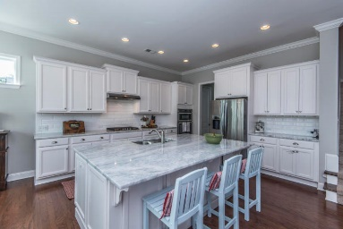
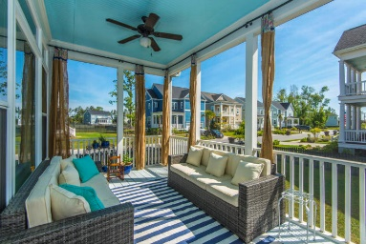
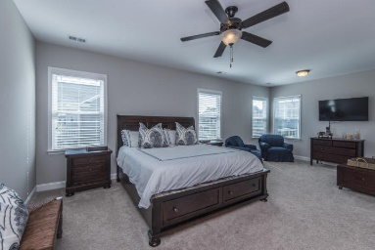
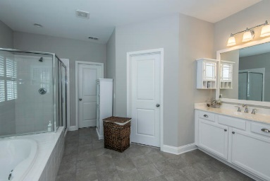
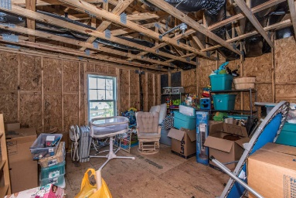
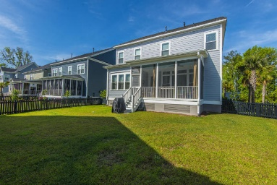


Reduced $10,000 For A Quick Sale!
1412 Trip Line Drive
Dunes West ~ Mount Pleasant
MLS# 18012446 ~ $549,900
This stunning 4 bedroom, 3.5 bath home sits on a fenced in corner lot behind the gates of the highly sought after Dunes West. Open floor plan with 10' ceilings and tons of natural light. Gourmet kitchen boasts white cabinets, stainless steel appliances including gas stove, granite counter tops, walk in pantry and huge island. Spacious family room with custom built ins and gas fireplace. Eat in kitchen, formal dining room, study with French doors, mud room off 2 car garage and screened in porch complete the downstairs. Large master suite with additional sitting area, 2 walk in closets, garden tub w/ separate shower and his/hers vanities. 3 additional bedrooms, full bath, Jack and Jill bath, loft area and laundry room all located upstairs. The 3rd floor is currently used for storage, but has been framed out for an additional 2 rooms and bathroom, perfect MIL suite. This well cared for home has all the extras including irrigation, 2nd meter for irrigation, gas hookup on porch, tankless water heater, custom lighting and shelving in the closets. It shows like a model and is sure to impress. School bus stop right near home.
Jennifer Frampton Pait
843-568-9509
jenniferfp@carolinaone.com

