Slide 1
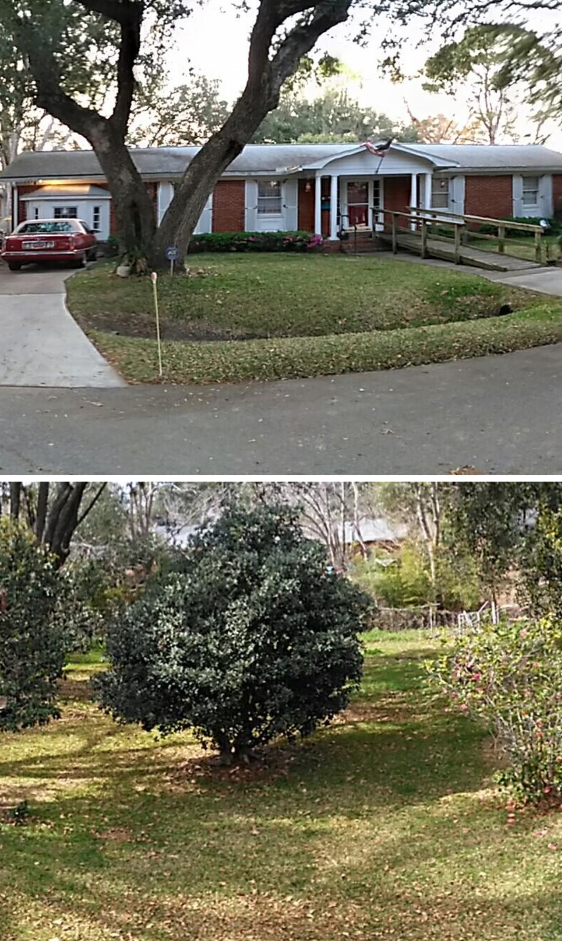


1412 Tara Road
Charleston, SC, 29407
Home for Sale NOT in MLS
This home is a handyman special and the sellers are looking for a quick sale.
It is a brick ranch built in 1961 located in Lenevar in West Ashley.
Current asking price is $900,000.
Carey Nikonchuk
843-276-1701
cnikonchuk@gmail.com
www.brennamangroup.com

