Slide 1
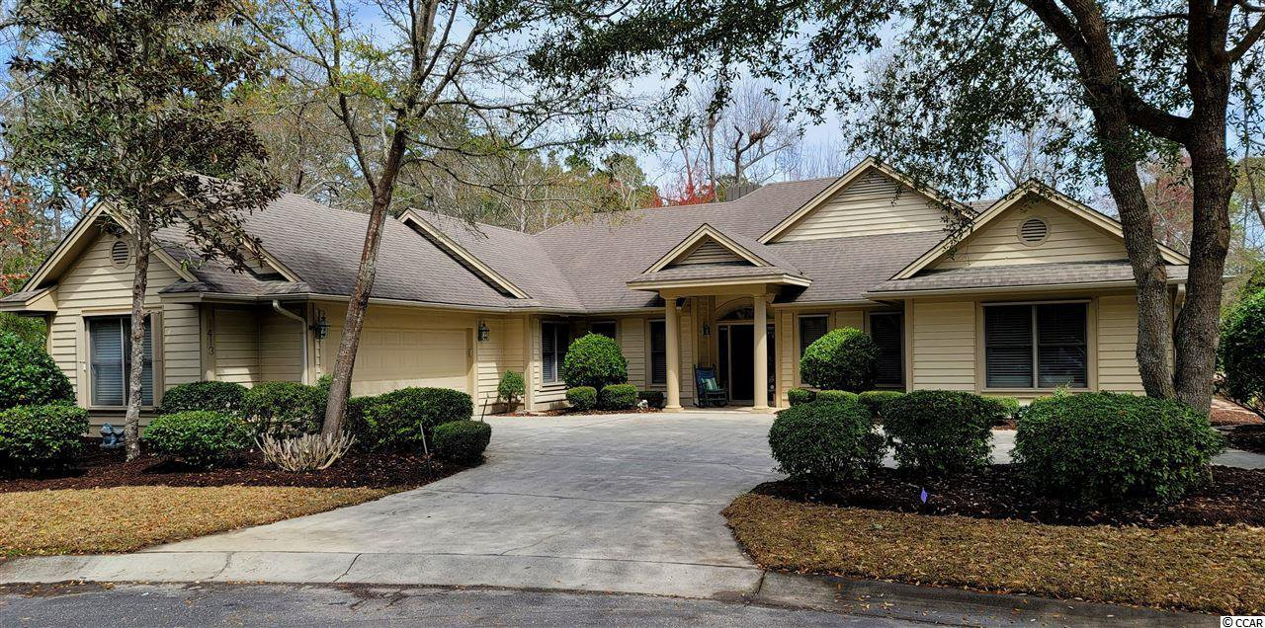
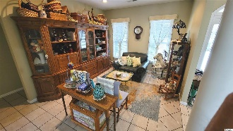
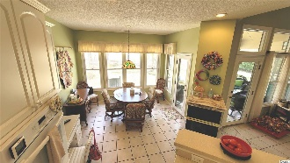
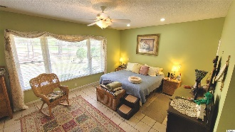
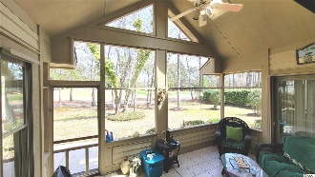
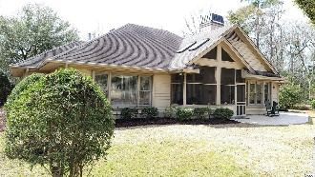
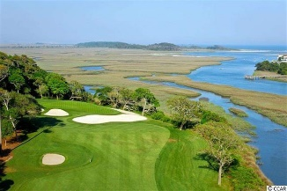
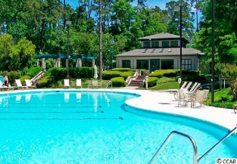
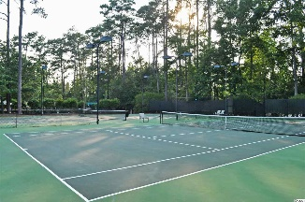
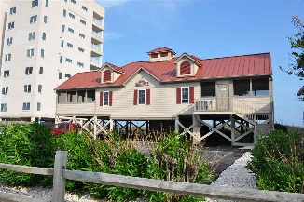



Spacious & Unique And On The Golf Course
1413 Brigantine Rd
Tidewater Plantation ~ North Myrtle Beach
MLS# 2106893 ~ $409,000
This home is well-loved, and its incomparable secluded spot in the Plantation of Tidewater Resort is singular, spacious, unique and on the golf course, too! Location, location, location! This wonderful lot is at the end of a lovely wooded cul-de-sac, nestled in the right corner with no one even close on the right-hand side and around the semicircle to the left, the ultimate in privacy and peaceful surroundings. These original owners hand-picked it for seclusion, natural beauty and preferred golf-course view to build a wonderful custom home -- the best of all worlds, and, of course, it is in Tidewater. The street ends in that quiet cul-de-sac with virtually no vehicle traffic. What it does have, in addition, is space, for play, bike-riding, walking and more. Whether you have children and grand children or you are young at heart, this open area and natural enclave is appealing. So bring your imagination to envision what singular plans you might have to make this fabulous, rare property your own. Personality welcome. Amenity-rich Tidewater is on a tree-lined road to oceanfront Anne Tilghman Boyce Coastal Reserve, a nature conservancy, including Waties Island, with access for managed recreational use. Tidewater itself is on an elevated peninsula of live oaks and southern pines between the ICW and the Cherry Grove Inlet to the Atlantic Ocean. The Plantation also preserves the singular look of its own historic origins. It is minutes from the beach, shopping, dining, medical services, parks, entertainment and access to major highways. Amenities include an oceanfront beach cabana for owners' use with open/screened porches, bathrooms, showers, and kitchen. The cabana is located on the wide, white-sand of Cherry Grove Beach, awarded 11th Best Beach in the Nation in 2019! Residents enjoy the use of several pools/hot tubs. Other amenities include a driving range, golf shop, clubhouse with bar/dining and event facilities, clay and hard surface tennis courts, pickle ball court, fitness center overlooking a pool, bocce courts and amenity center for public/private events. Tidewater has a gated storage yard for boats, jet skis, motorcycles, and kayaks. Tidewater Plantation Resort reflects a classic golf/beach lifestyle in safe, popular North Myrtle Beach. Speaking of golf, the backyard of this home looks out on the signature raised green of the 7th hole of world-class Tidewater Golf Course, from a guest bedroom, kitchen, screened porch, great room and master bedroom, the expanse from the entire rear of the home! And the landscaping is also mature and inviting all around this manicured, well-maintained beauty! The seasonal blooms will astound you! And inside is a fun, flex lay-out featuring an enty foyer and 360-view of the home upon entering: Great room, dining, kitchen, back porch and highlighted by an amazing 3-sided fireplace. Where to start? To the right is the big master bedroom suite & oversized, more than complete en-suite; second full bath; second bedroom with built-in Murphy bed and more. Check out even some hidden storage there... back to the heart of the home is a two-room great-room, dining room and magnificent planned views to the golf course. Go left to the kitchen with breakfast nook, lots of work space, the fireplace, gas range & exit to the spectacular screen-in porch with vaulted ceiling & skylights and, naturally, the golf-course view! Off of the kitchen is the split-floor-plan guest suite, bedrooms area and another full third bath. There is also a laundry/utility area with sink and egress to the double-car garage, large, with much storage such as for the clear-panel hurricane shutters. The driveway is well positioned to park a couple of vehicles easily. So, all bedrooms are oversized; closets are mostly walk-in; and there are even 2 mostly floored attics to hideaway treasures and for plentiful storage throughout. Make this nice, custom charmer your home, vacation home or investment property today. Welcome home!
View the Video Tour: https://www.youtube.com/embed/fjfnBw53zd0
Connie Ross-Karl
702-306-2643
conniesross@aol.com
Ronnie Nichols
Realtor
Broker in Charge
NEW WAY PROPERTIES MYRTLE BEACH

