Slide 1
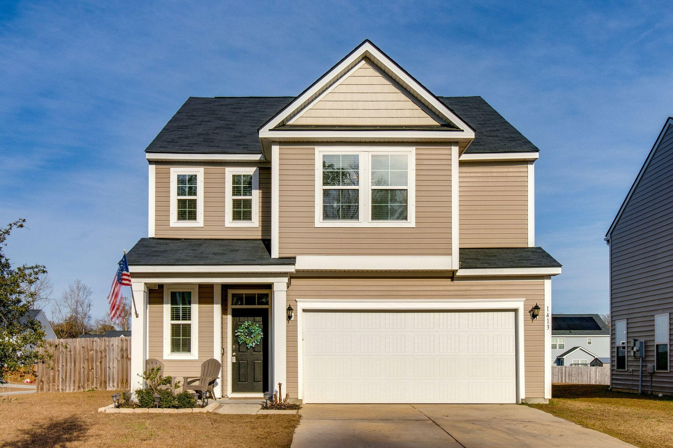
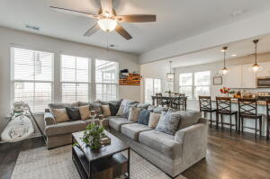
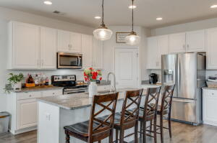
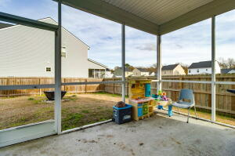
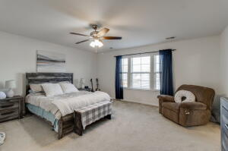
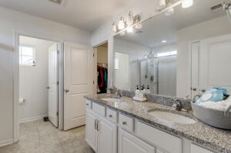
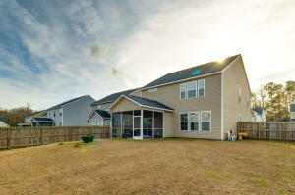
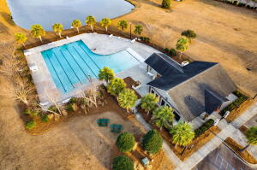


1413 Hermitage Lane
Hunters Bend | Ladson, SC 29456 | MLS# 23000422 | $359,999
NEW PRICE!
Fantastic opportunity for this beautiful 2-story open concept home, situated on a large corner lot. Step inside to a large foyer with upgraded wide-plank flooring throughout the first floor. Continue into the family room that connects to the kitchen and dining area. Gather around the large island with ample seating for dining and conversation. The kitchen offers granite counters, loads of cabinet space, a walk-in pantry, white 42''cabinets, recessed lighting along with stainless steel Whirlpool appliances. Upstairs you will find all 3 bedrooms. The primary suite offers a large walk-in closet, dual vanities, large shower, linen closet and enclosed water closet. The two additional bedrooms, both with walk-in closets, share a Jack and Jill bathroom. At the top of the stairs is a nook perfect for use as an office, reading area or craft area. Head outside to the screen porch and spacious fenced-in backyard. This neighborhood is conveniently located to restaurants, shopping, I-26, downtown Summerville and Charleston as well as the local area beaches.
Take a virtual tour: https://my.matterport.com/show/?m=vWwS9a5xeMV
Beth Mandell
M 803-463-7734 | O 843-871-2121
bmandell@century21properties.com
www.bestcarolinahomedeals.com
Century 21 Properties Plus of Summerville | 118 W Richardson Ave | Summerville, SC 29483

