Slide 1
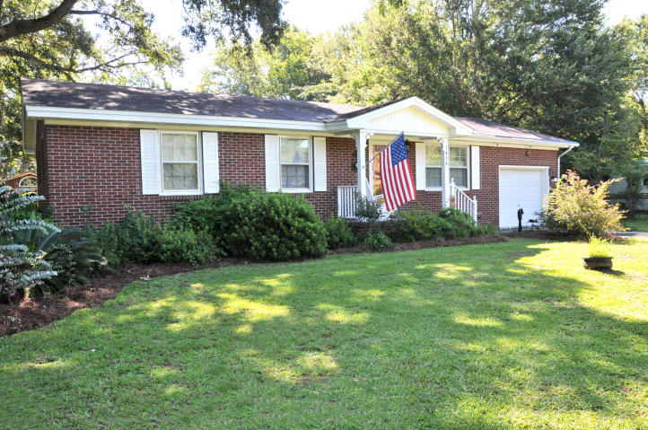
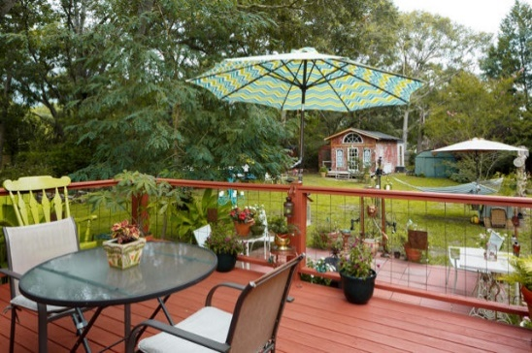
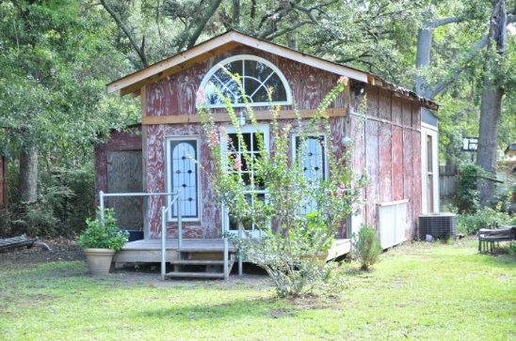
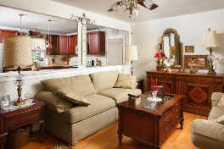
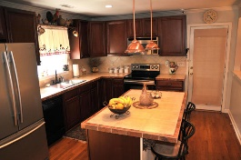
James Island
Updated and Upgraded Home
1414 Jeffords Street
MLS# 17020797 · $279,880 // MLS# 17024717 · $298,980
$40,000
Price Reduction!
LOCATION...LOCATION...LOCATION...Only 5 miles to Folly Beach and 5 miles to downtown Charleston. Property has been updated with upgraded kitchen to include kitchen island with cabinets/storage and seating for 3, hardwood oak floors, stainless steel appliances to include flat top range with convection oven, built-in microwave , refrigerator and double sink. Kitchen also included pendant lighting over kitchen island, also, recessed lighting and crown molding. Plus, ceramic tile counters and backsplash. Home has smooth ceilings, French doors in the dining area to the large deck and large rear yard. Eat-in kitchen has both a pantry and closet. The kitchen is open to the living room. Full bath has been upgraded to include granite top sink cabinet and ceramic tile in shower/tub. Hardwood floors in all areas of the home except bathrooms which are ceramic tile. The rear yard has both a large enclosed deck and patio and is fenced on 3 sides (wood and metal) Outbuilding is 12' x 31' and has electricity with some portion still needing flooring) with French door and palladium window above...Could easily be finished very inexpensively to be a guest room...."Mancave", kids play area or office. Ceiling fans in every room except kitchen.
Rick Willis
843-327-3017 Rick@RickWillis.com The Group, LLC

