Slide 1
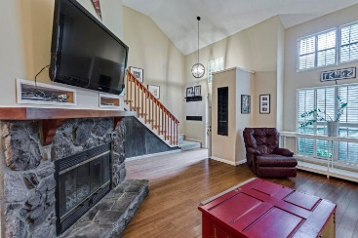
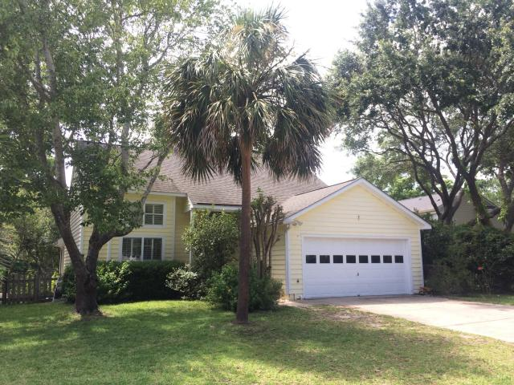
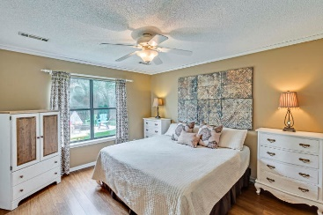
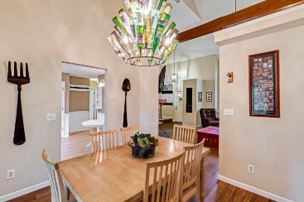
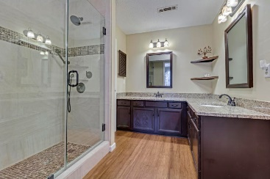
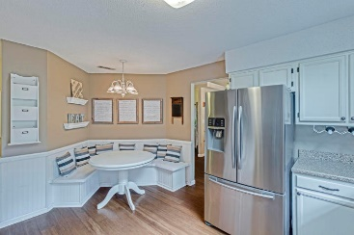
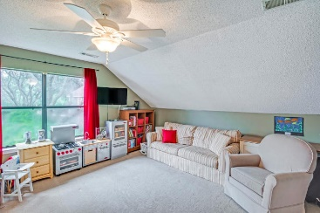
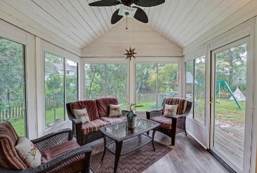
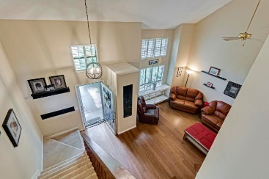


1415 School House Road
Oakhaven Plantation | Mount Pleasant
MLS# 17017347 |$410,000
New Price ~ $410,000
Open House Saturday, July 1st 1-3
**LOCATION** Don’t miss this charming home in the heart of Mt. Pleasant in desirable Oakhaven Plantation, only minutes from area beaches, Town Center, and I-526. As you enter this beautiful home, you’ll notice the spacious feel of the vaulted family room with a wood burning fireplace and beautiful hardwood flooring throughout the first floor. **UPDATING* This home has many updates including a recently remodeled kitchen with beautiful quartz countertops, stainless steel appliances, and a cozy corner bench seat in the breakfast area. All polybutylene plumbing throughout the house has been removed and replaced for your peace of mind. Off the spacious kitchen, you’ll find a formal dining room with French doors leading to a bright, cozy sunroom that can be used year-round. **FENCED BACKYARD** The sunroom leads out to a raised deck and private, fenced backyard with mature trees, bordered in the rear by a pond teaming with wildlife. Enjoy watching the kids play or roast marshmallows in your fire pit. **Master Down** The first floor master bedroom is spacious and features a walk in closet and private, upgraded bathroom with new tile shower and granite counter tops. Upstairs you'll find three bedrooms, one of which is plenty large enough to double as an office, playroom, or den ... and already includes a Murphy Bed! The hall bath has also been recently upgraded with new tile floors. **AMENITIES** Neighborhood amenities include a swimming pool, walking trail, tennis and basketball courts, a playground, clubhouse, and low HOA fee.
Jeanette Henderson
(843) 834-0068
jeanette.henderson@carolinaone.com
www.jeanettehendersonrealty.com
Carolina One Real Estate
628 Long Point Rd.
Mt Pleasant, SC 29464

