Slide 1
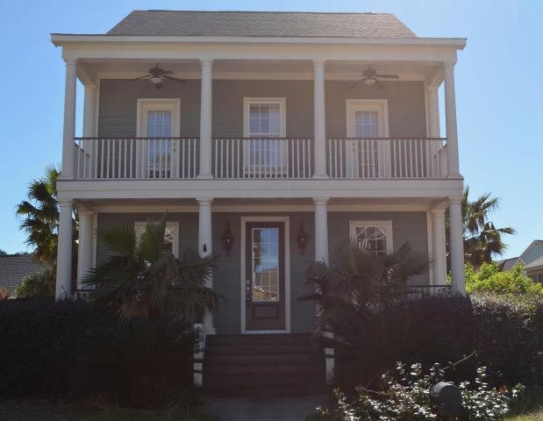
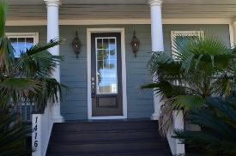
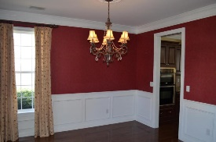
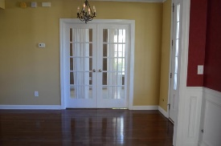
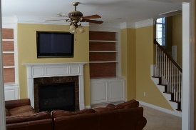
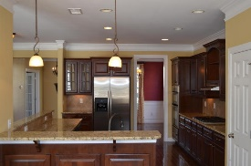
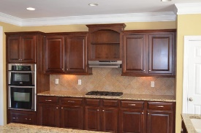
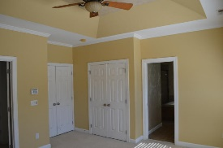
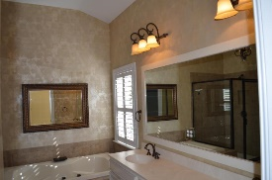
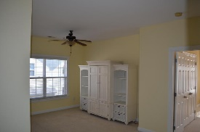
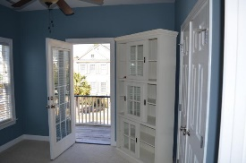
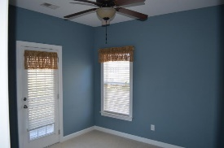
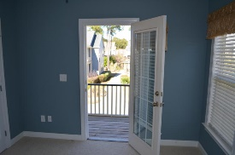
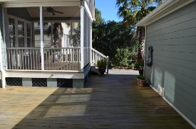
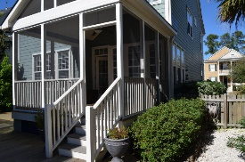
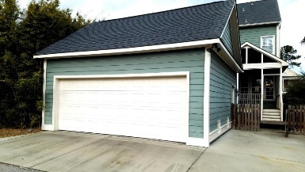

Executive Rental
1416 Clancy Road
Hamlin Plantation ~ Mount Pleasant
MLS# 17002264 ~ $3,200/Mo
Welcome home to this beautiful executive home in desirable Hamlin Plantation. With 2620 sq. ft. this home has tons of room. 4 bedrooms, 3.5 baths. 3rd floor has loft, full bedroom, and full bath which is perfect for guests or that ''older'' child who needs space and privacy. 2nd floor has rec room and 3 bedrooms. Elegant owners suite with spa bath and large walk in closet. 1st floor has office with French doors, formal living, open kitchen with raised bartop and breakfast area. Large family room with fireplace and build in bookshelves.
Rear screen porch with Ipe decking. Large Ipe deck / patio in fenced in backyard. 2 car detached garage. This home has many upgrades including mature landscaping, landscape lighting and stately gas lanterns. This home is in the Waverly subdivision and gives you access to Hamlin's neighborhood amenities which includes pool (with waterslide), gym, club house, tennis and beautiful nature trails. Schedule your showing today as this home will not last long!
Wendy Deitsch
O - (843) 491-1445
M - (843) 270-0433
wendy@lifetreeliving.com
LifeTree Real Estate, LLC
3094 Hwy 17 North
Mt. Pleasant, SC 29466
www.lifetreerealestate.com

