Slide 1

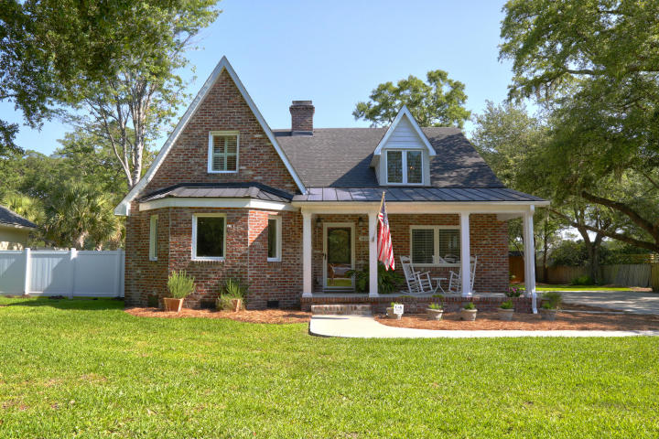
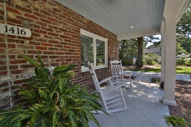
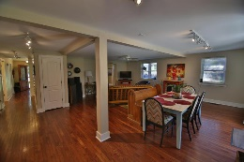
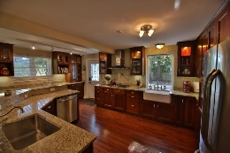
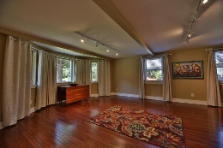
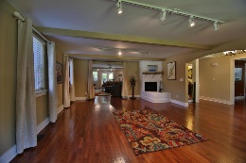
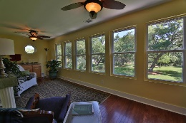
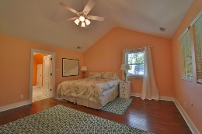
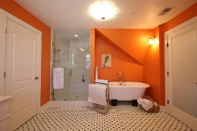
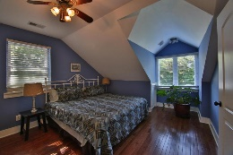
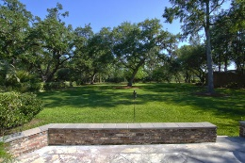
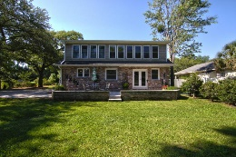
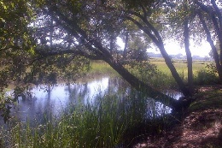


Agent Open House
Thursday, July 14, 11:30-1:00
Light Lunch Served
Open House Canceled
Home Under Contract
1416 Sasanqua Lane
Edgewater Park • Charleston • MLS# 16013622 • $635,000
Beautiful Unique Private Marshfront, Turnkey Brick home on nearly 3/4 quarter acre lot on Tidal Creek in desirable Edgewater Park. Recently updated and renovated, this special home has it all: Richly stained hardwood floors, Living Room/Dining Room combo has bay window overlooking beautiful front lawn exposed beams and gas fire place, spacious Kitchen, which opens to Den or eat in area, has granite counter tops, 2 Farm sinks and stainless appliances including a gas cooktop, French Doors open from Den to brick/stone Terrace overlooking spectacular back yard with tidal creek & march view, 1/2 Bathroom and 1 Bedroom with Full Bathroom downstairs. Upstairs is a wonderful Master Bedroom which has vaulted ceilings, Sun Porch and a wonderful Master bathroom including a soaking tub and shower, large walk in Closets, 2 additional Bedrooms and 2 full Bathrooms upstairs: Other Features also include: 2 tank less water heaters, sealed attic space, dehumidifier, central heat pump upstairs, package heat pump downstairs, all windows replaced in 2009, electric and water at rear of yard. Downstairs bedroom is knotty pine, and could be a Study or Office, Sun Porch off Master Bedroom has ice hook up. There is an Edgewater park Boat Club which conveys with the property allowing new Owner use of private neighborhood Boat Ramp. Edgewater park is a Waterfront Island Neighborhood yet only minutes to Downtown Charlestown and I526 & I26. The neighborhood is surrounded by the Stono River, Wappoo/Elliott's Cut and the IntraCoastal Waterway. Enjoy many hours of indoor and outdoor living in this special property!
Elaine Brabham
(843) 209-2347 | ebrabham@findyourcharleston.com
www.findyourcharleston.com
Elaine Brabham and Associates, LLC • 1890 Sam Rittenberg Boulevard, Suite 217 • Charleston, SC 29407

