Slide 1
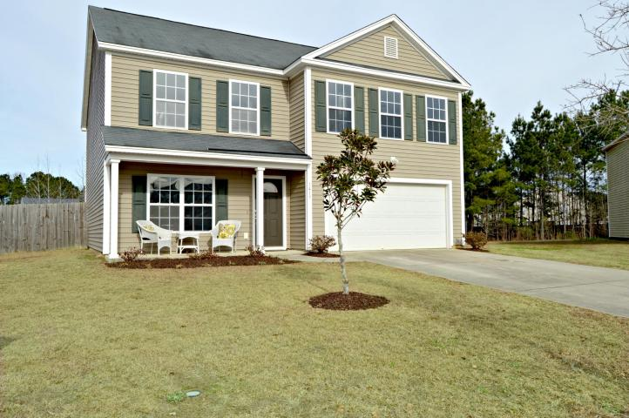
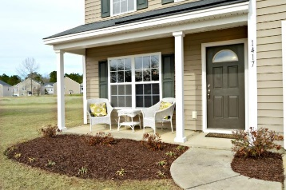
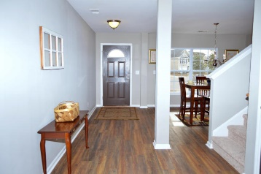
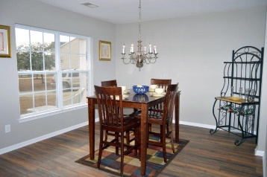
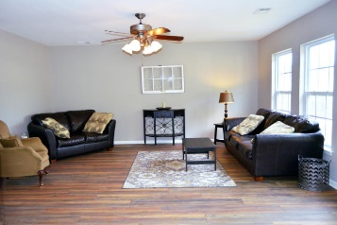
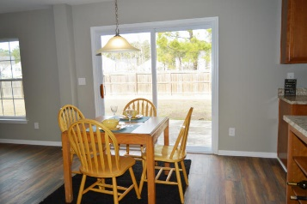
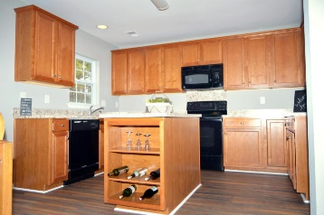
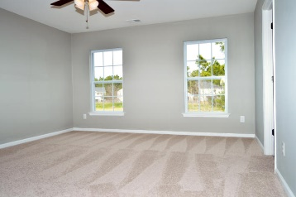
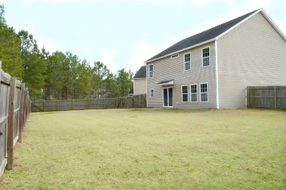


1417 Dabbling Duck Drive
Drakesborough ~ Summerville
MLS# 18003319 ~ $239,000
Open House Lunch ~ Friday, Oct 3 from 11 - 1
Handyman Special… Bring your hard hats!
JUST
REDUCED
When approaching this beautiful renovated home, you will be welcomed with a covered front patio that would be perfect for relaxing evenings.
Upon entering the home, you will be awed with the beautiful upgraded wood floors thru-out the entire first floor that complements the formal dining room, family room, kitchen, walk-in pantry, powder and laundry room.
Fresh new paint in a calming grey has been added thru-out. Custom painted dark interior doors bring everything together in this bright and airy home.
The second floor boasts brand new carpet in all 4 very large bedrooms, all with natural light.
This beautiful 2-story home is featured on a large fenced lot on cul-de-sac. District 2 schools.
Heather Herman
(843) 321-5803
hherman@rogcoastal.com | www.rogcoastal.com
Realty ONE Group Coastal | 1510 Trolley Rd | Summerville, SC 29485

