Slide 1
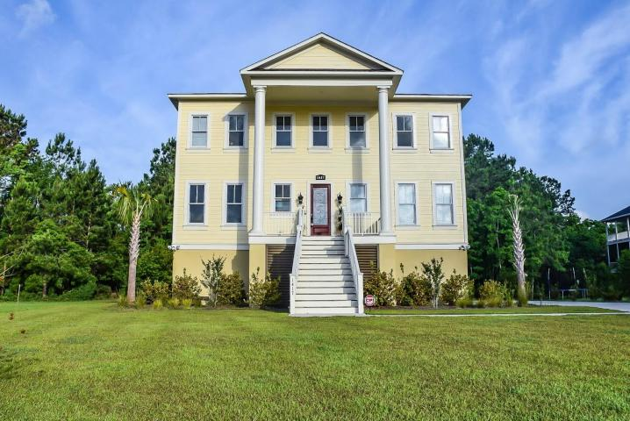
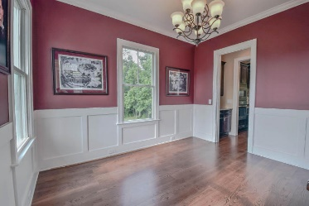
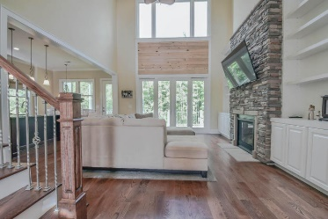
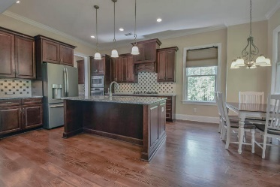
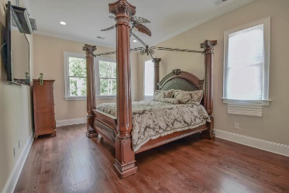
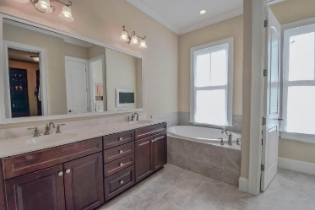
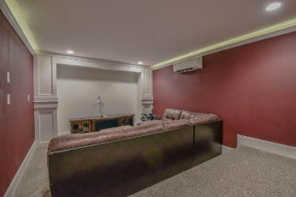
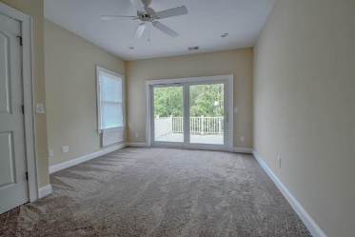
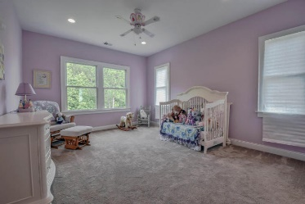
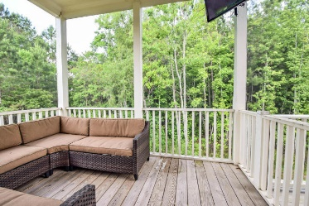
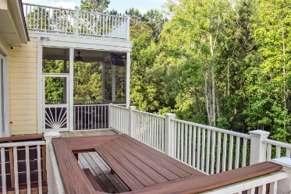


1417 Peach Blossom Lane Charleston, SC 29492 MLS# 17019670 $599,000
Beresford Creek Landing
Price Reduced !
OWNER RELOCATING, BRING ALL OFFERS. Comfort, beauty, space and security are featured in this custom designed and built residence, less than 2 years old. Enter through front porch into a spacious foyer and adjacent great room featuring high ceiling. Across an barstool friendly island lies ample food prep area with granite counter tops & built-in stainless steel appliances. The kitchen is open to a breakfast area & butler's pantry that leads to a separate formal dining room. The rear screened-in porch and open deck overlook a permanent wooded buffer and pond. Dual master suites with attached baths and walk-in closets are located on 1st and 2nd floors. A 3d bedroom and bath are on the 2nd flr. Bonus areas include a large 2nd flr office/storage area and garage lvl bedroom and media rm.
June Matzner
(843) 224-7308
june@agentownedrealty.com
www.chsarealiving.com
Mary Beth Bennett
(843) 367-1774
marybeth.bennett@agentownedrealty.com
www.chsarealiving.com
AgentOwned Preferred Group | 824 Johnnie Dodds Blvd | Mt Pleasant, SC 29464

