Slide 1
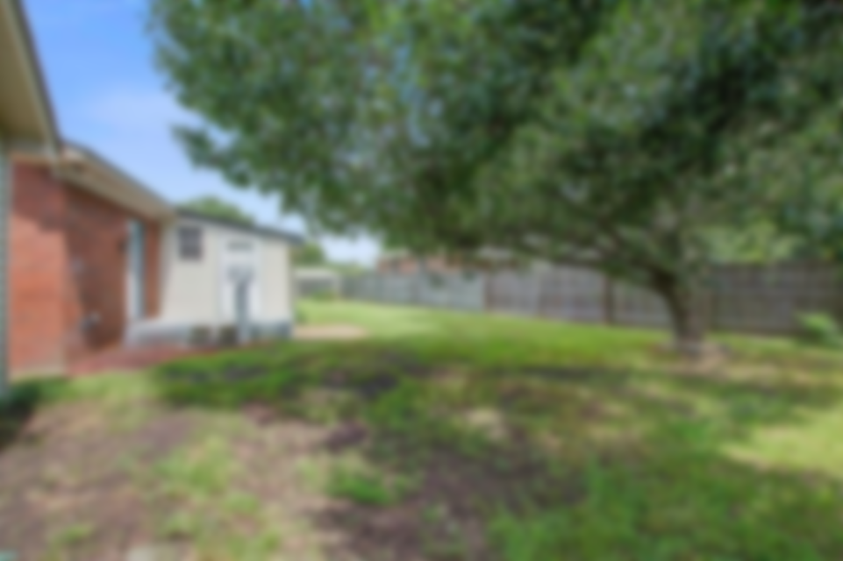
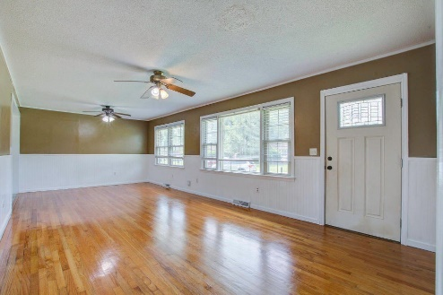
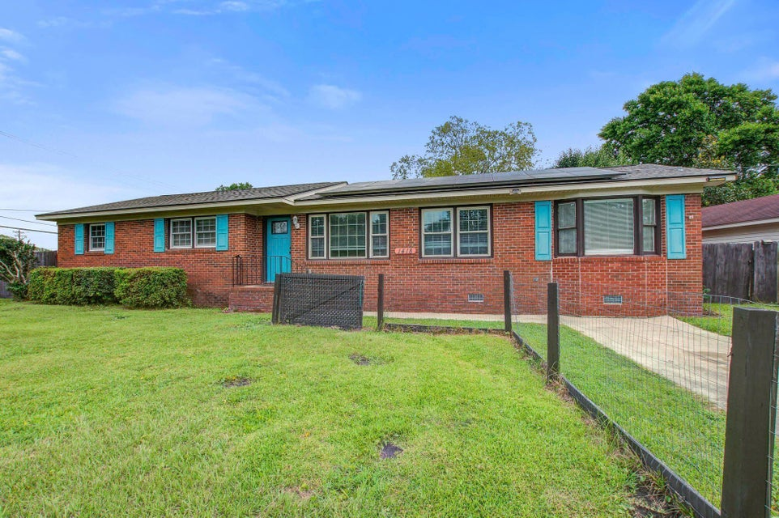
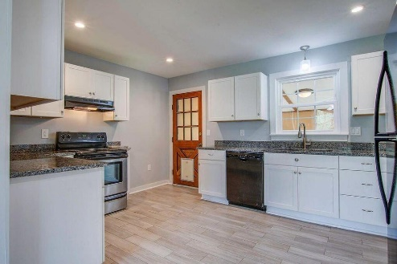
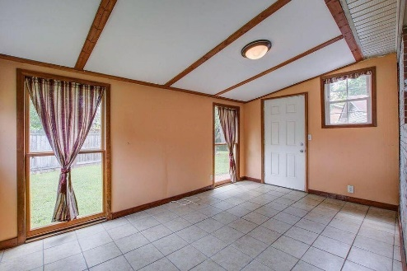
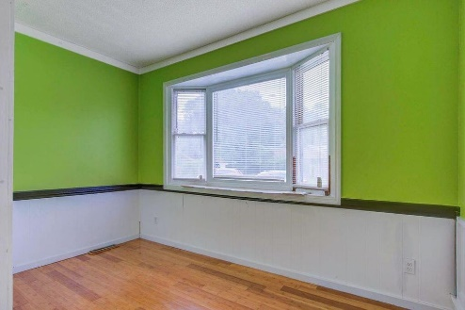
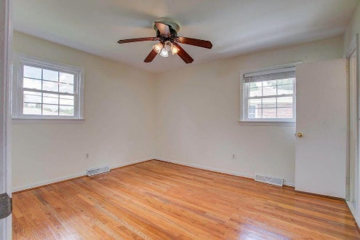
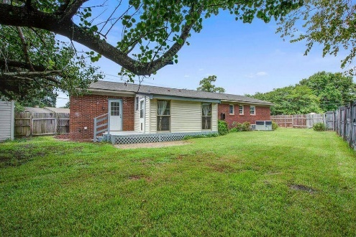


Prime James Island Location
Opportunity For An Investor To Flip
1418 Kentwood Circle
Lynwood | Charleston | MLS# 24018889 | $530,000
Don't miss this Brick home on a large lot, in a great location in Lynwood! Four Bedrooms with a bonus room separate from other bedrooms, for an office or convert to fifth bedroom, in addition to a flexible enclosed space in back. Large living area with dine in space and an attractive, updated kitchen. Lots of yard for children or pets or gardening. House gets lots of natural light and has wood flooring and tile, no carpet! Close to downtown and Folly Beach. Needs a little TLC that owner took into consideration when pricing. Prefers to sell in as is condition. New roof, (2023) solar panels will be paid off at closing. HVAC added 2023 and gas tankless water heater, installed 2020. Easy to see! So much potential this is a must see! NO Flood insurance needed.
Jan Miller
Cell (843) 345-9719 | Jan.Miller@nvrealtygroup.com
NV Realty Group | 91 Broad St, Ste A | Charleston, SC 29401
janmiller.nvrealtygroup.com

