Slide 1
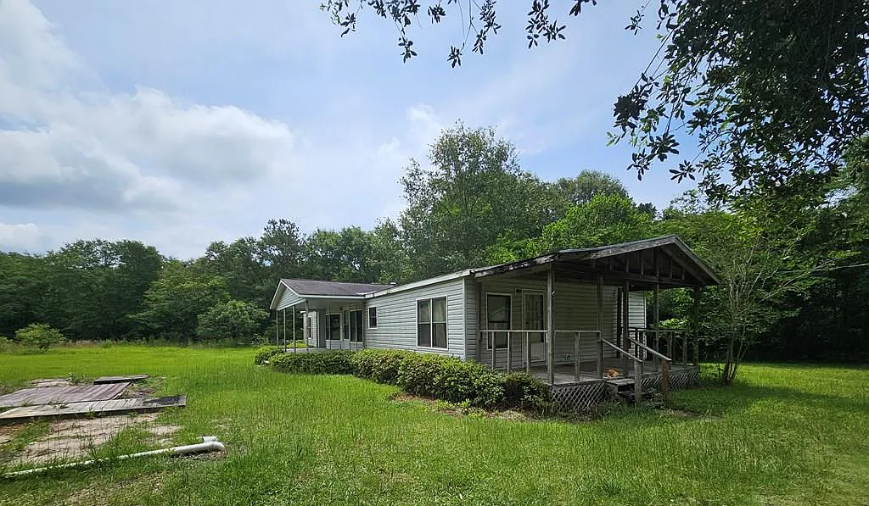
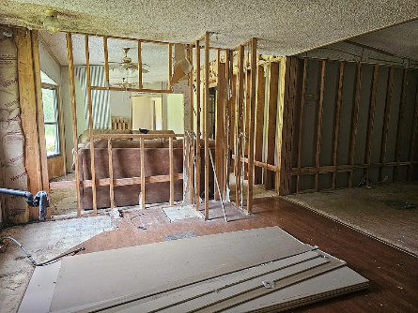
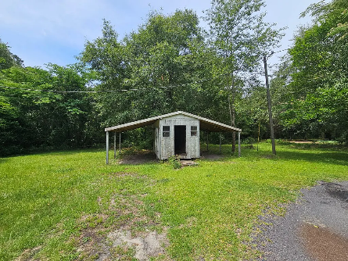
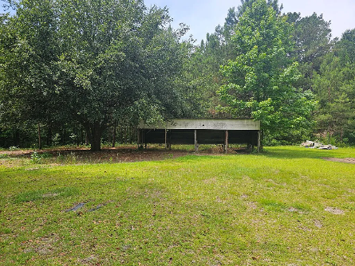
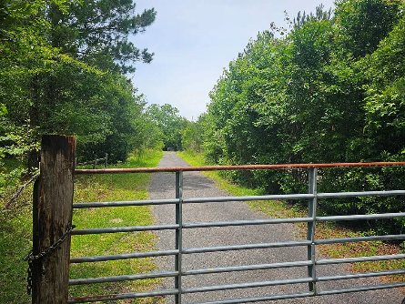

Handyman Special
14196 Raccoon Rd
Manning, SC 29102 ~ MLS# 157297 ~ $89,500
This is your HANDY MAN SPECIAL. 4 ac of land with a mobile home that needs a full rehab. This is an "AS IS" property. The property has Working well and septic (not inspected). Property has a open shed could be used for a horse barn and a workshop with a metal roof and cement floor. Mature trees on the property. This could be your retreat away from it all. If you have the handyman skills this could be your dream spot.
Lake Homes Realty, LLC
Elloree, SC 29047
www.SCLakeLife.com
Kristie Anderson
(803) 387-9459
kristie@sclakelife.com

