Slide 1


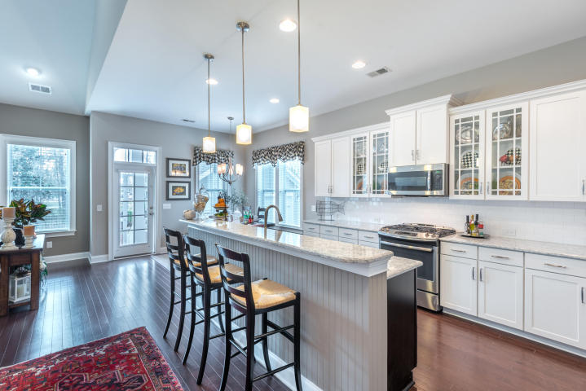
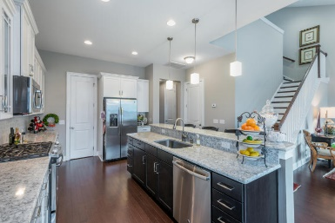
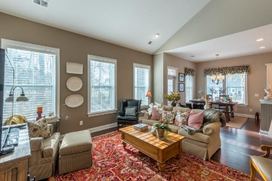
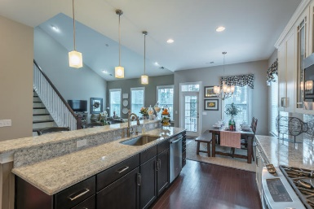
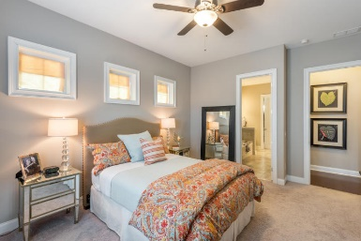
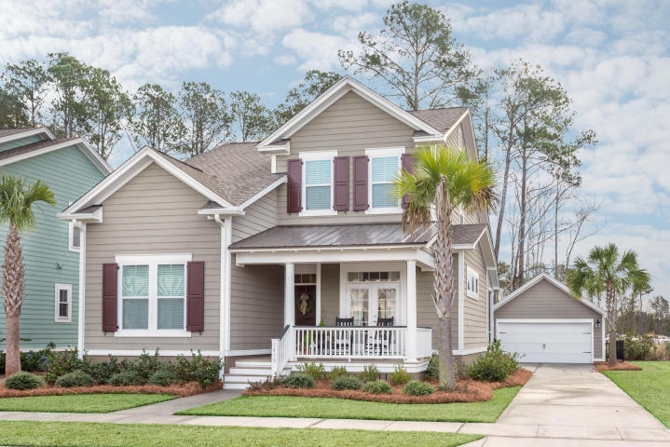




IMMACULATE & MOVE-IN READY!
$469,900
1419 Crane Creek Dr. (MLS# 18000680) | Carolina Park | $463,900
Virtual Tour Available at
https://www.youtube.com/watch?v=B-ZMWzHEJu0&feature=youtu.be
Don’t wait on new construction! THIS BEAUTIFUL, MOVE-IN READY HOME is located in the desirable Village section of Carolina Park. This LIKE NEW home has 3 bedrooms and 2.5 baths and many features you will enjoy. As you enter from the inviting front porch, you are welcomed with 10’ ceilings and beautiful wood floors. There is a large formal dining room with two sets of French doors (currently being used as an office). The SPACIOUS FIRST FLOOR MASTER SUITE features a tiled surround shower, separate garden tub, dual vanities with granite counters and a huge walk-in closet. Down the hall you are lead to the open family room and kitchen. The AMAZING GOURMET KITCHEN offers beautiful 42” white cabinets, Silestone countertops, Subway tile backsplash and stainless appliances that include a gas cooktop. There is also a HUGE PANTRY. Next to the kitchen is a large eat-in area that opens up to the spacious family room with the vaulted ceiling. Downstairs you will also find a generous laundry room. The beautiful wood staircase leads you to a huge loft area along with two more bedrooms and a full bath. Accommodating walk-in storage can also be found upstairs. Out back is not only a screened porch but also a beautifully landscaped fenced in yard with an inviting patio area. The two car garage is just a few steps away from the back door. Other features include a tankless water heater, lawn irrigation system and a HERS rating for energy efficiency. Close by you will find a neighborhood pool, tennis courts, schools, shopping & great restaurants.
This property SHOWS LIKE A MODEL HOME and can close quickly! Schedule your showing today....this one won't last long!
Exclusively Offered By
Bill Barnhill | 843-364-6903 | bill@billbarnhill.com
Keller Williams Realty | Charleston / Mt. Pleasant | 496 Bramson Ct., Suite 200, Mount Pleasant, SC 29464

