Slide 1
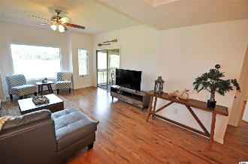
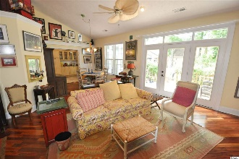
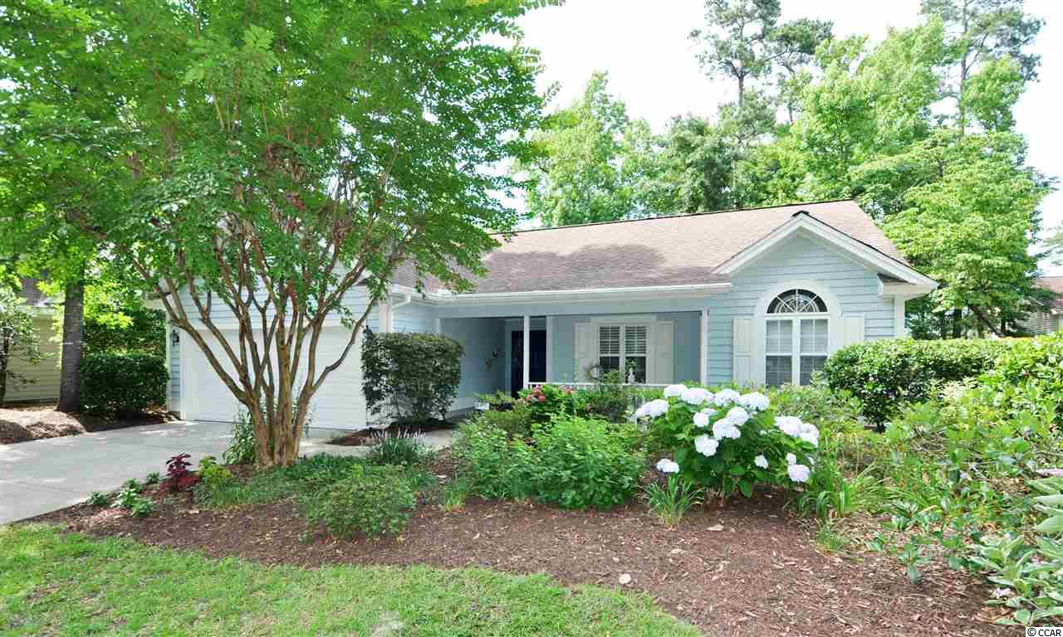
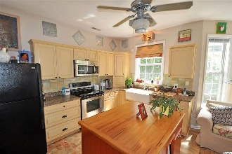
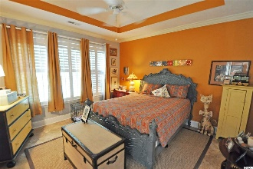
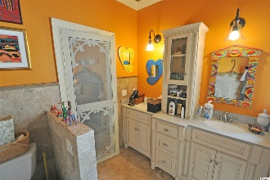
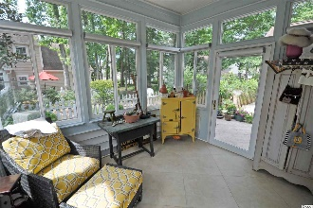
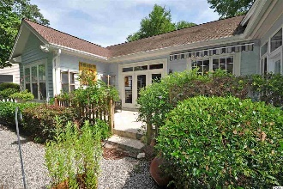
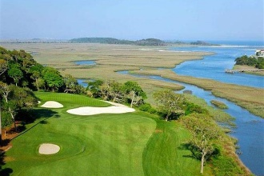
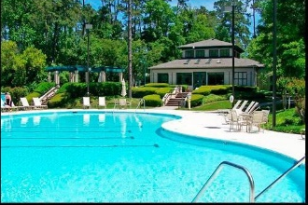
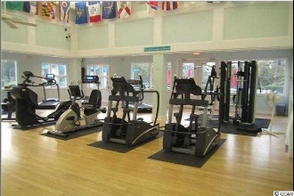
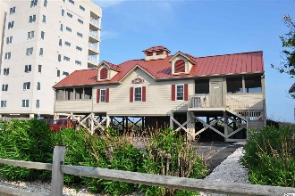


Charming, Cozy And Comfortable Beach Cottage
1419 Lighthouse Dr
Tidewater Plantation ~ North Myrtle Beach
MLS# 1913482 ~ $269,900
Fun, unique and wonderful details enhance this well-loved home, some with a bit of vintage, some whimsical, but with many really quality features to enjoy throughout. Well priced, too; so see today. Big value comes in surprising packages! This beautifully upgraded, charming, cozy and comfortable beach cottage is in one of the signature Tidewater Plantation neighborhoods on iconic Lighthouse Drive. It is BIG luxury wrapped in a wonderfully livable, about 1,500 square feet of planned function space and thoughtful design. Start at the street. View a pretty, light blue Charleston-inspired home with a BIG, multi-use front porch. There is a wide drive to a double-car garage and to that great tiled porch with magnificent, welcoming entry. Linger there with a view of the 7th hole of world-class Tidewater Golf Course, or come on in to the heart of the home: breathtaking decorative wooden floors, large great-room with cathedral ceiling, lots of light and an adjoining casual or formal dining-gathering area, great for a family or for entertaining. The indoor/outdoor space, so inviting and appealing, opens right from the living room onto the deck, fenced backyard and clever dog run. The floor plan is just perfect -- kitchen and laundry to the left toward the garage egress, sitting area and morning room straight ahead and split-bedroom layout to the right. The kitchen has a work island, farm-house sink and lots of cabinets and storage, including two pantry. It is kinetic and interesting, featuring a mesmerizing tiled floor and an exit to the relaxing, retreat-style back screened porch, also tiled, and onto the tiled fabulous back deck. The yard is nicely landscaped and manageable. The landscaping is robust -- indigenous flowers bloom front and back. Come back inside, though, and prepare to look carefully around -- check out ceilings, walls, shelving, sinks and doors. Surprises will astound you. The master bedroom has a spacious, customized closet, double sink vanity, tray ceiling and large walk-in shower. The other guest room is likewise good-sized. The third bedroom is being used an office. Airy fans, specialized touches and the unexpected in design and decor delight. The guest bath is another example. Sink, ceiling and walls astound! Do not miss a thing! This popular 3/2 home is on a single level and most of the appliances are newer; none the less, a full 12 months of coverage is offered with the top-of-the line Old Republic Platinum Home Warranty plan with HVAC. The best of easy but luxurious beach living, this house is unique and a rare find! With the proven value of Tidewater, this home is appealing for a permanent residence, vacation home or investment property. Amenity-rich Tidewater is on a tree-lined road to oceanfront Anne Tilghman Boyce Coastal Reserve, a nature conservancy, including Waties Island, with access for managed recreational use. Tidewater itself is on an elevated peninsula of live oaks and southern pines between the ICW and the Cherry Grove Inlet to the Atlantic Ocean. The plantation also preserves the singular look of its own historic origins. It is minutes from the beach, shopping, medical services, entertainment and access to major highways. Amenities include the jewel in the crown, an oceanfront beach cabana for owners' use with open/screened porches, bathrooms, showers, and kitchen. Residents enjoy the use of several pools/hot tubs. Other amenities include a driving range, golf shop, clubhouse with bar/dining and event facilities, clay and hard surface tennis courts, pickle ball court, fitness center overlooking a pool, bocce courts and amenity center for events. Tidewater is manned, gated & has a gated storage yard for boats, jet skis, motorcycles, and kayaks. Tidewater Resort reflects the luxury and comfort of a beach/golf lifestyle. And, in Tidewater, Big value often comes in surprising packages as well, such as this unforgettable cozy yet desirable cottage at one of the lowest prices in the community. Schedule a Private Showing
Deborah Collins
843-424-9013
dctidewater@yahoo.com
Connie Ross-Karl
702-306-2643
conniesross@aol.com
NEW WAY PROPERTIES MYRTLE BEACH

