Slide 1
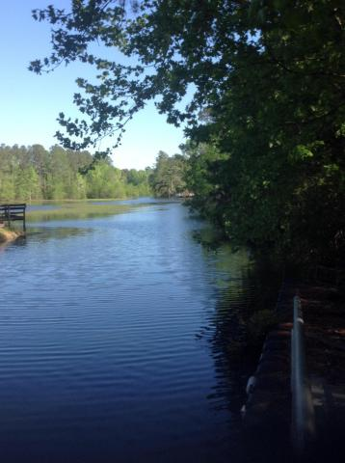
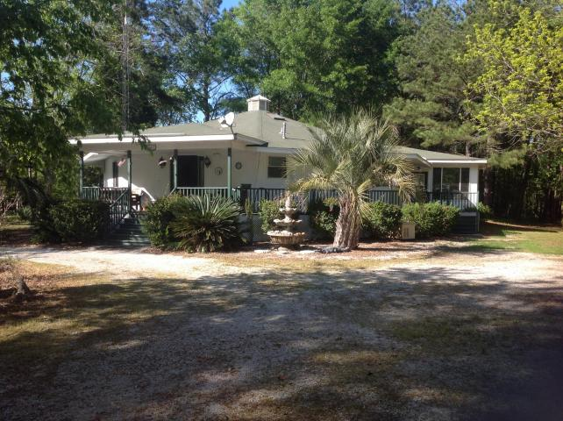
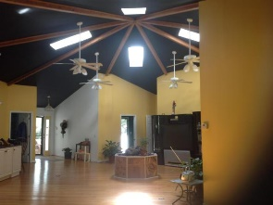
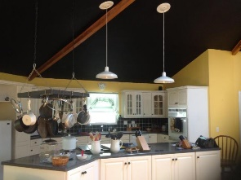
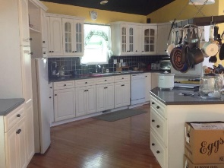
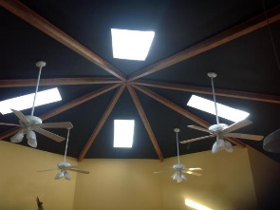
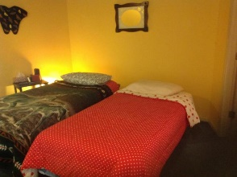
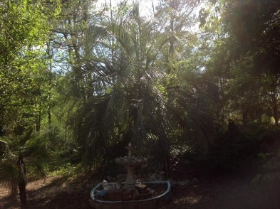
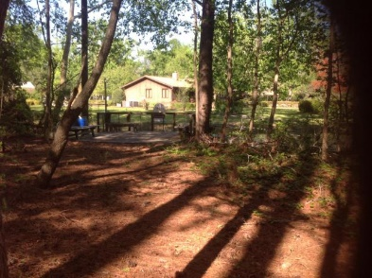
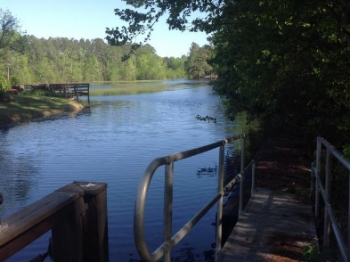
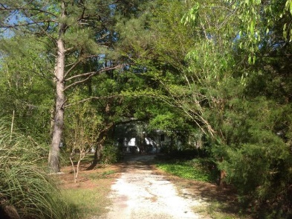

Unique Lakefront Property in Eutawville
141 Meredith Drive
Plantation II | Eutawville, SC 29048 | MLS# 17010414 | $425,900
3 Beds | 2 Baths | 4,000 Square Feet
Come take a look at this unique waterfront property on Lake Marion! This property has three bedrooms, 2 bathrooms, and an open floor plan! It has an in-ground heated swimming pool (4 feet deep) and its own dock! Each building has its own septic system. Building with one bedroom apartment and workshop/garage could be converted to second residence with permitted approval. Also emergency generator for power outages. Termite bond as well. All of this less than five minutes from Rocks Pond! Must see to appreciate the privacy and beauty of this property.
Carla C Davis
Mobile - (843) 437-4873
gaweber@tds.net
AgentOwned Premiere Group
141 A N. Main Street
Summerville, SC 29483

