Slide 1
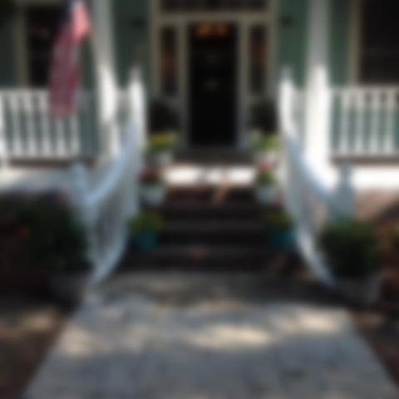
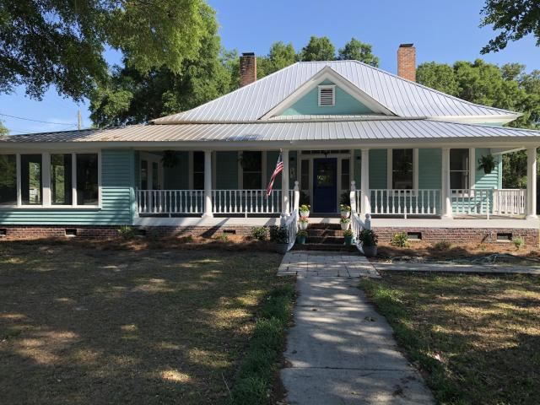
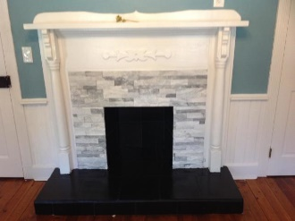
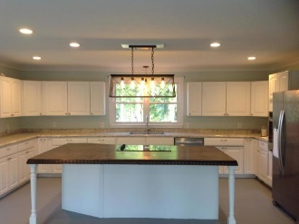
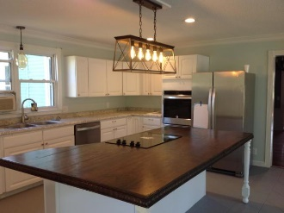
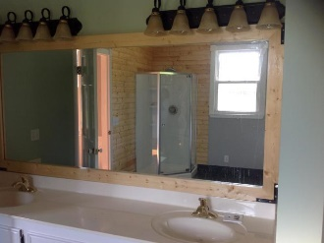
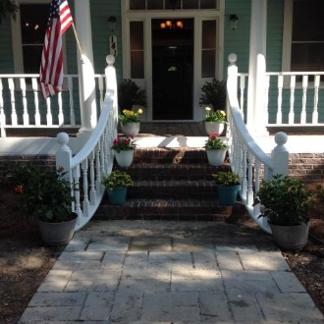
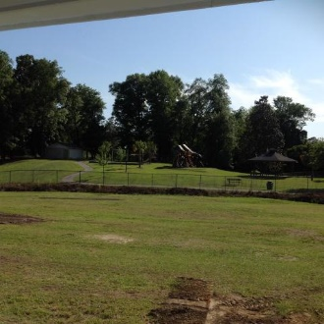

This Home Is A Must See!!
141 Porcher Avenue
Eutawville, SC 29048 | MLS# 20011304 | $269,900
3 Beds | 2 Baths | 2,455 Square Feet
Welcome to 141 Porcher Ave. This beautiful home has 3 bedrooms and two baths with a 1.5 acre yard and next door to the Town Park. This home has been newly renovated with new paint and custom lighting. There is new tile flooring in the hall bath and beautiful hardwoods in hall and bedrooms. The kitchen is a dream for those that enjoy cooking and entertaining. There is a large kitchen island for gatherings which overlooks the eat in dining area. Some renovations to include New Stainless Steel appliances, new switches and receptacles, custom LED lighting, new paint throughout, fireplaces all redone with stone, high ceilings, glass doors knobs and electrical has been updates as well as new metal roof. The bedrooms closets are big for a home of the era.
AgentOwned Premiere Group
141 A N. Main Street
Summerville, SC 29483
Carla C Davis
Mobile - (843) 437-4873
gaweber@tds.net

