Slide 1
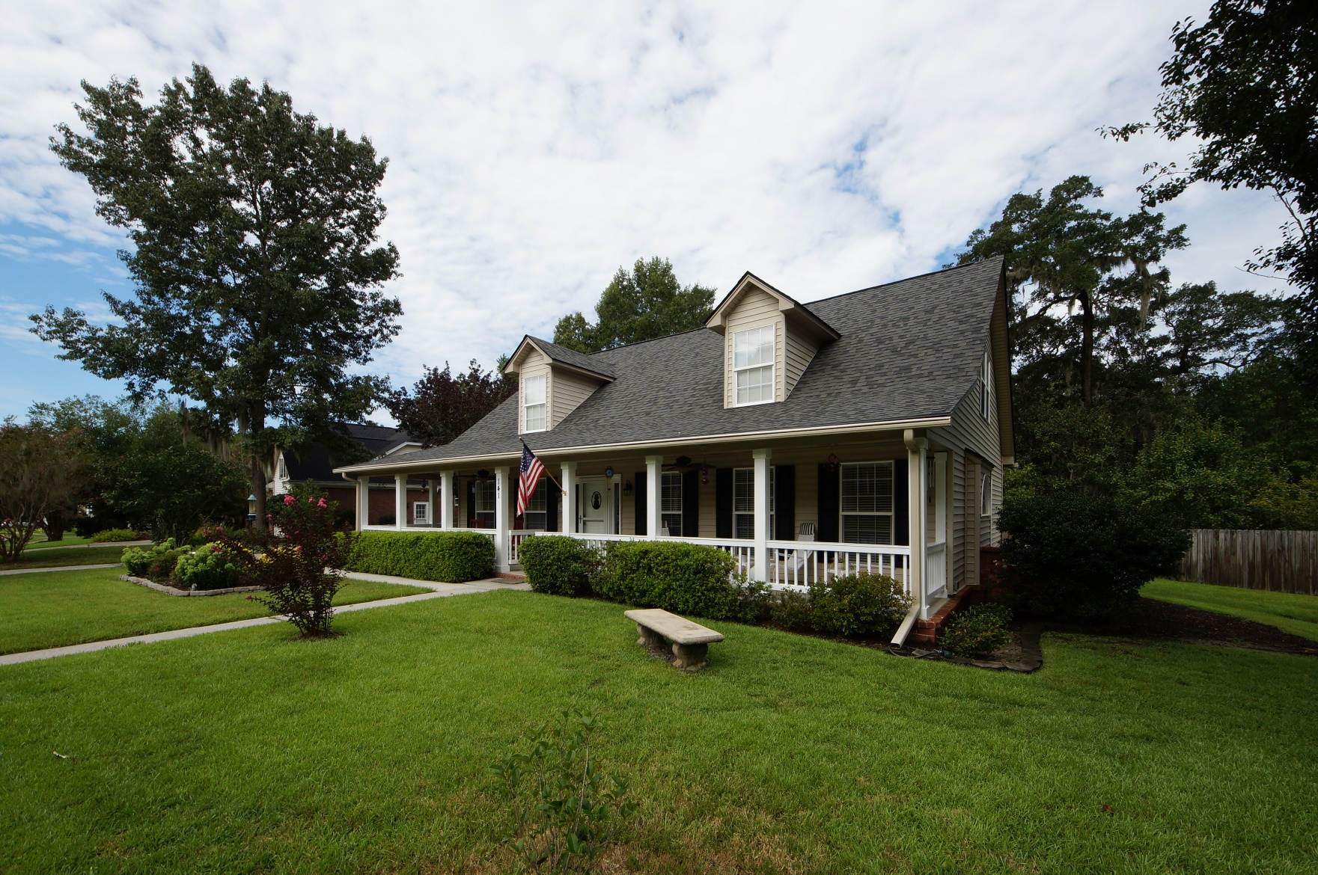
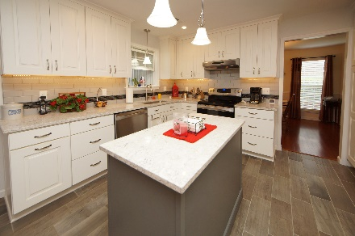
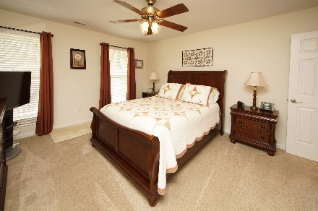
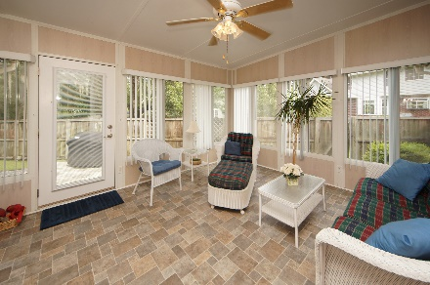


141 Winding Rock Road
Crowfield Plantation :: Goose Creek, SC 29445
MLS# 18022353 :: $294,500
3 Bed / 2½ Bath
Crowfield Plantation
Master Down
Just Reduced
Amazing upgrades, professional remodel, and master bedroom down stairs! Beautiful landscaped front yard leads to a full front porch and gorgeous interior! Professional paint, new cabinets, quartz counter tops, back splash, stainless chef appliances, tile flooring, new carpet and wood flooring is the beginning of an extravagant list of upgrades. Master bath has an amazing remodeled shower/soaking tub and cabinets. Bonus room over the garage could easily become a 4th bedroom and the sun room has heat/air. Sunroom flooring is fully encapsulated with a dehumidifier and trap door for access. Garage is equally as impressive with organization and cabinets. Sellers have taken pride in their home and ready for a new owner!
Connie White, Broker
843-532-3356
conniesyouragent@gmail.com
Charleston Homes · 597 Old Mt. Holly Road · Suite 301 · Goose Creek, SC 29445

