Slide 1
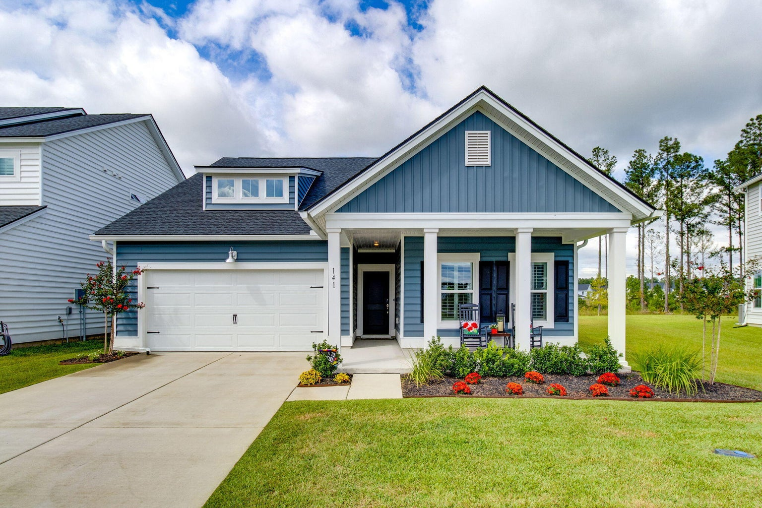
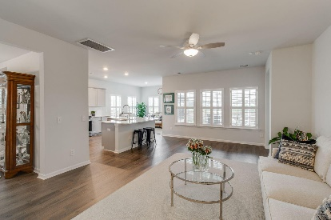
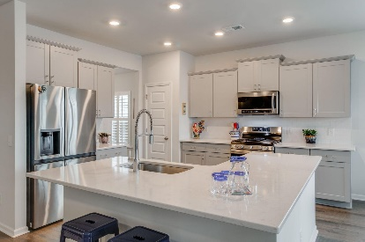
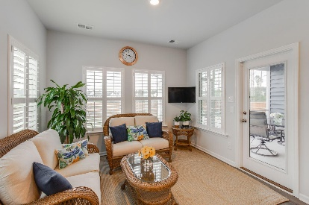
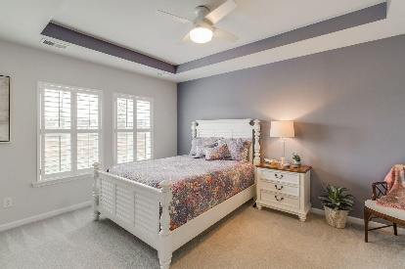
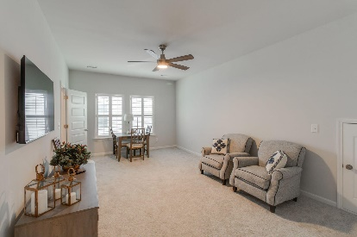
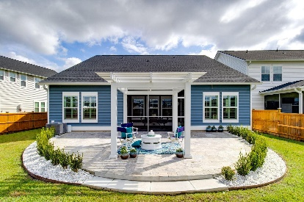
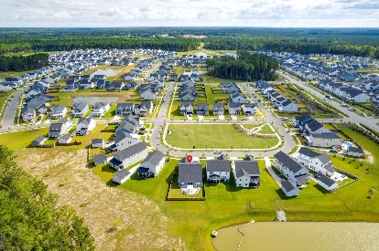


141 Greenbelt Court
Summers Corner | Summerville, SC 29485 | MLS# 23021861 | $455,000
Motivated Seller!
This beautiful home, 15 months old, better than new, offering over $80,000 in upgrades, such as plantation shutters throughout the house, modern fans in all of the rooms, freshly painted finished garage, and Christmas lights custom made for the house. Why wait to build or purchase a spec home when you can have everything you need right now! There is so much to love about this immaculate home from the open concept floor plan, spacious rooms, large kitchen with wrap around counter, and adjacent sunroom and separate dining room. Stove and microwave are upgraded from those originally installed by the builder. Experience peace and serenity in your owner's suite complete with large shower, dual vanities and a huge walk-in closet. Enjoy gracious outdoor living and dining in the screened-in porch, as well as on the beautifully designed expanded tile patio with free standing pergola. Appreciate the privacy of your fully fenced backyard oasis, enhanced by 37 post solar lights. Situated on a pond lot with no neighbors behind you. Need room for family or guests? Head upstairs to a second floor suite complete with a huge flex room, bedroom, full bathroom, walk-in closet and extra storage space. High-end refrigerator, washer and dryer to convey. This is a Smart Home with a Ring System. New Amenity Center in Azalea Ridge coming soon in 2024. Top DD2 schools close by, downtown Summervile about 6 miles away.
Take a virtual walkthrough!
Beth Mandell
M 803-463-7734 | O 843-871-2121
bmandell@century21properties.com
www.bestcarolinahomedeals.com
Century 21 Properties Plus of Summerville | 118 W Richardson Ave | Summerville, SC 29483

