Slide 1
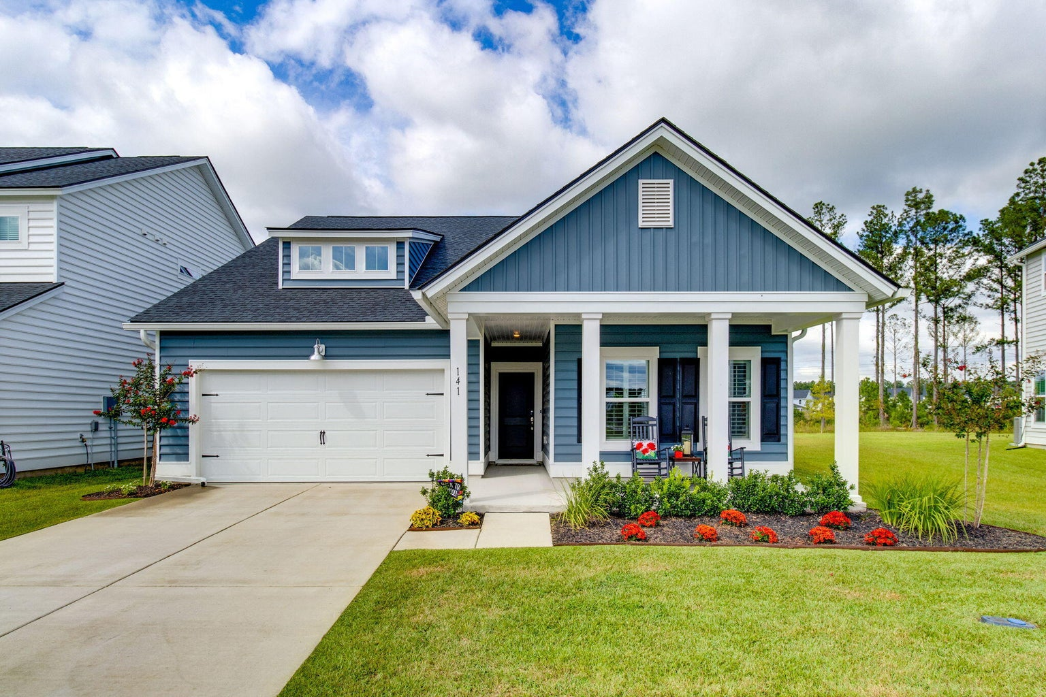
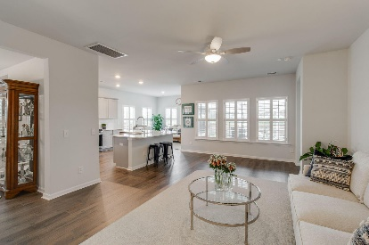
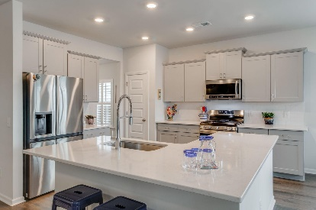
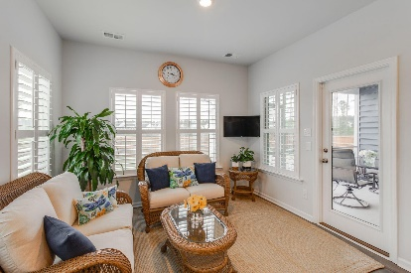
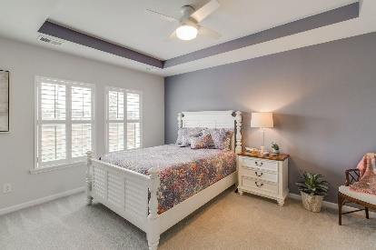
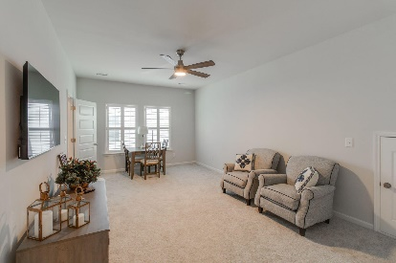
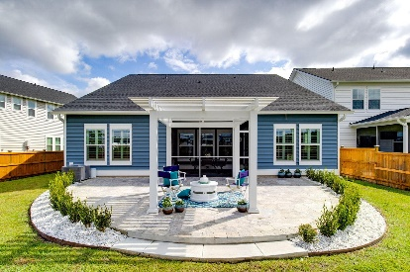
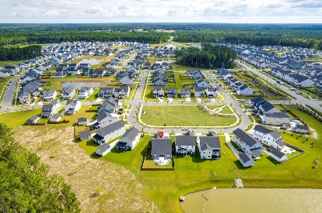


141 Greenbelt Court
Summers Corner | Summerville, SC 29485 | MLS# 23021861 | $455,000
OPEN HOUSE
Sunday, Oct 22 from 1-3
This sparkling gem of a home, nestled on a beautiful lot with fantastic curb appeal, is better than new offering over $80,000 in upgrades. Why wait to build or purchase a spec home when you can have everything you need right now! There is so much to love about this immaculate home from the open concept floor plan, spacious rooms, gorgeous gourmet kitchen with a large island, adjacent sunroom and separate dining room. Experience peace and serenity in your owner's suite complete with large shower, dual vanities and a huge walk-in closet. Enjoy gracious outdoor living in the screen porch as well as on the beautifully designed expanded tile patio with attached pergola. Appreciate the privacy of your fully fenced backyard oasis that is situated on a pond lot with no neighbors behind you. Need room for family or guests? Head upstairs to a second floor suite complete with a huge flex room, bedroom, full bathroom, walk-in closet and extra storage space. Modern fans throughout home. High end Washer and Dryer to convey. This is a Smart Home with a Ring System. New Amenity Center in Azalea Ridge coming soon in 2024. Top DD2 schools close by. Downtown Summerville about 6 miles away.
Take a virtual walkthrough!
Beth Mandell
M 803-463-7734 | O 843-871-2121
bmandell@century21properties.com
www.bestcarolinahomedeals.com
Century 21 Properties Plus of Summerville | 118 W Richardson Ave | Summerville, SC 29483

