Slide 1
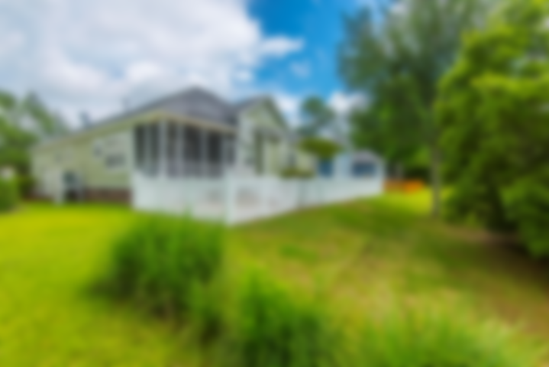
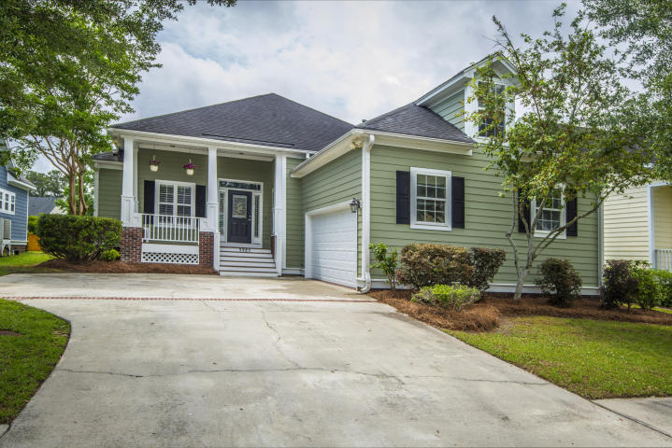

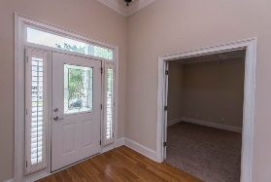
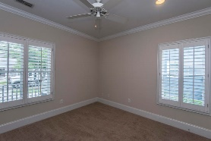
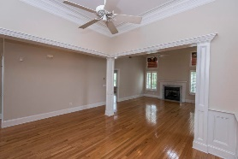
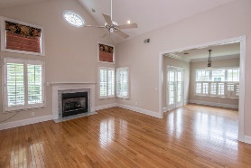
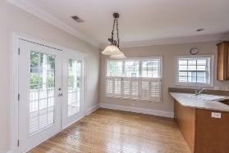
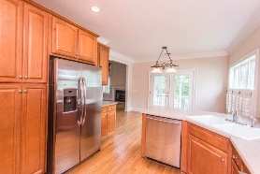
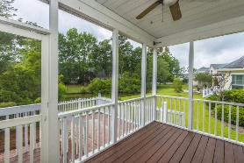
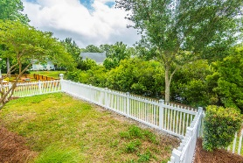
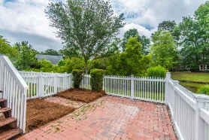
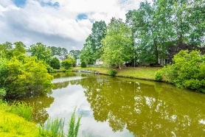


Just Listed in Park West
1421 Bloomingdale Lane
Mount Pleasant, SC 29466 | MLS# 18014111 | $415,000
Easy living in this 1.5 story home in Marsh Walk in Park West! Beautiful 3 bedroom, 2 bath home with a large FROG. Gourmet eat-in kitchen including breakfast bar with Corian counter tops, maple cabinets, all stainless steel appliances including a Delux Thermador professional gas range. Separate formal dining area with beautiful crown molding throughout. Main living space has hardwood floors. Family room has a gorgeous marble gas fireplace. Home has custom plantation shutters throughout that lets in plenty of natural light. Large master bedroom with en suite bathroom that has an amazing garden tub as well as stand up shower and dual vanities. Master bedroom offers a walk-in closet with custom built-ins. Two secondary bedrooms are large and have ample closet space. The large finished room over garage offers plenty of extra space. Sit back and relax on your front porch or on your back screened porch overlooking the pond. Two car garage offers plenty of storage. Park West amenities include 2 pools, a clubhouse, play area, six-lighted tennis courts, and bike and walking trails. It is just a short trip by bike or golf cart to stores, restaurants, and the highly desired schools that are right in the neighborhood. The Mt. Pleasant Rec Department and many sport fields are conveniently located in the neighborhood only a short distance away!
Lauren Courcoux
Mobile - (843) 224-8613
lauren.courcoux@carolinaone.com
www.laurendelucacourcoux.com
Carolina One Real Estate | 2713 Highway 17 North | Mt Pleasant, SC 29466

