Slide 1
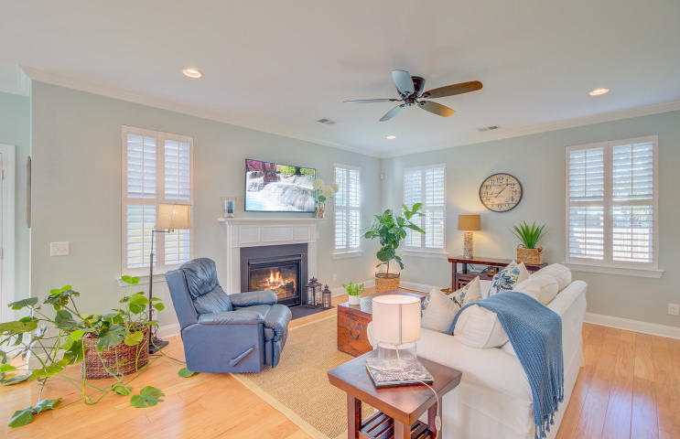
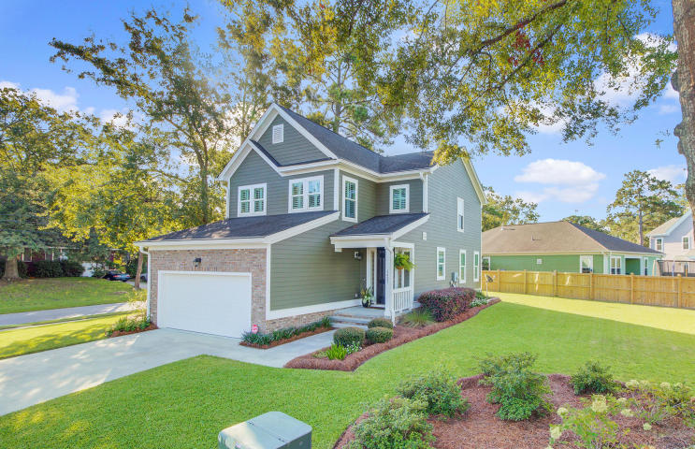
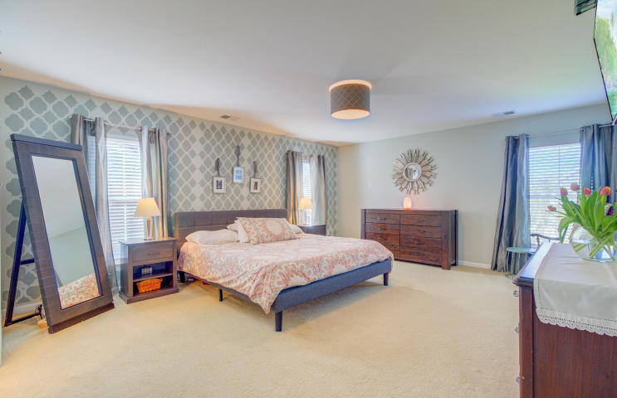
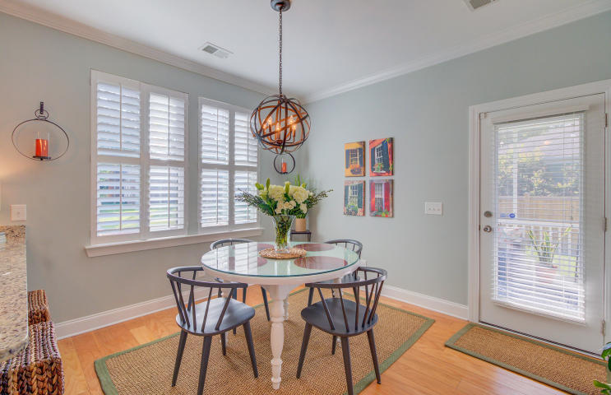
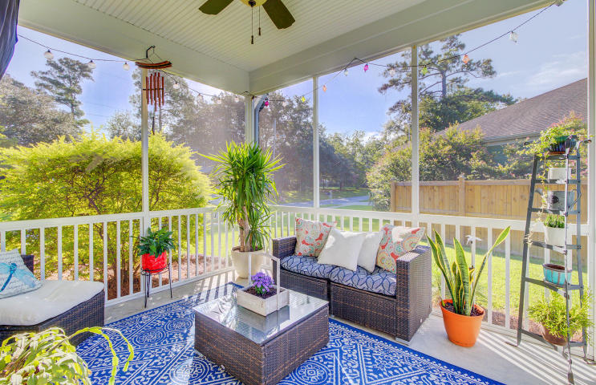
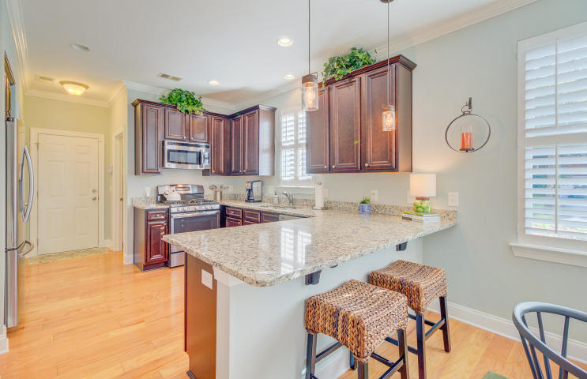
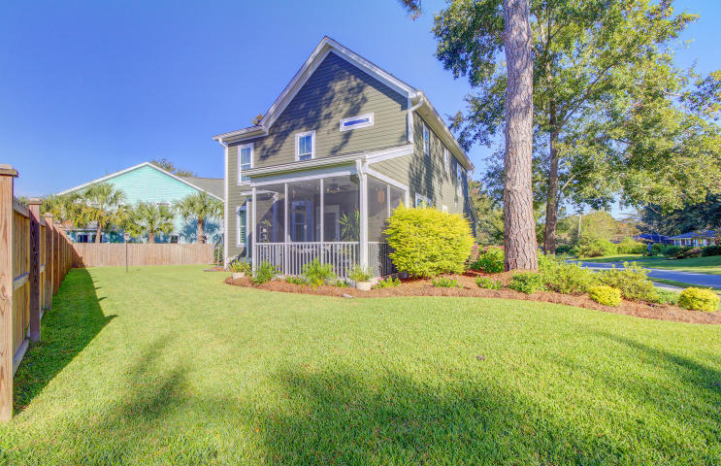


JUST LISTED Park Circle Home You've Been Looking For
1421 Jockey Court
Cameron Terrace Manor
North Charleston, SC 29405
MLS# 20026316 | $439,900
Who says you can't have it all? 1421 Jockey Court may just be that special Park Circle house you have been looking for! This home will feel like new construction. Meticulously maintained and lovingly enhanced, it is situated on a hard to find quarter acre corner lot! The home has a bright and open floor plan. Upon entry you will be impressed with the beautiful wood floors which flow throughout the main level. The living spaces are along the rear of the home and allow the owners to take in the views of the beautifully landscaped, private yard. The cook in your home will love the gas range and very spacious kitchen. Stainless steel appliances and granite counters grace the kitchen giving a sleek and classy appeal. A huge walk in pantry is an added bonus making this a kitchen everyone will love. The family room is large yet remains cozy due to the gas fireplace that adds warmth and ambience on chilly winter nights. With the wonderful weather we enjoy in Charleston your screened porch is an additional living space and it even has a tv mounted on the wall. As you venture upstairs, prepare to be WOWED by the master bedroom suite- you will be hard pressed to find a more sprawling, beautiful space to claim as your owners' retreat! The master bath offers dual sinks and a spa like shower while the walk in closet is more than generous in size. This is the suite of your dreams! Two additional guest bedrooms are on the front of the home and share a full bath in the hall. As you walk through the home and yard, be sure to take note of the fine features and enhancements made. The home has a tankless water heater and hurricane rated windows. Leaf guard gutters were added to the home and privacy fencing installed to enhance your enjoyment of the large, beautifully landscaped yard. Plantation shutters add a classy finishing touch. Neutral colors are throughout the home making it easy to move in and get right out there to enjoy all that living in Park Circle offers its residents. The Danny Jones Center with tennis and swimming is within walking distance or perhaps join the trendy Mixson Club and enjoy swimming, tennis, and bar/restaurant with poolside service. Jump on your bike and ride to Park Circle to enjoy a meal at any of the numerous restaurants, enjoy a glass of wine or visit one of the bars, ice cream shops or other attractions. Breweries, the new Firefly Distillery and more are at your disposal due to this home's incredible location. So if you want to enjoy the excitement of living by Park Circle without the hassle of updating or renovating an older home, then you really will have it all at 1421 Jockey Court!
Check out the virtual tour here: https://my.matterport.com/show/?m=HmuHEZa2i8X
Ellen O'Neil
Broker/Owner, ABR, e-PRO, CNE
Charleston Realtor of Distinction
(843) 300-8530
www.EllenONeilProperties.com

